Slide 1
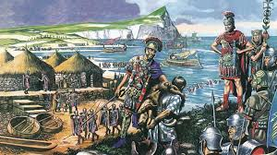
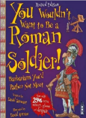
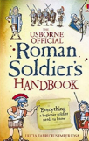
The Romans KS2 Knowledge Mat
Subject Specific Vocabulary |  |  | Exciting Books
centurion | A commander of a group of 100 Roman soldiers.
emperor | The Roman leader of the Roman Empire during the imperial period.
aqueduct | A large system, like a bridge, for carrying water from one place to another is called an aqueduct.
gladiator | A gladiator was an armed fighter who entertained audiences in the Roman Republic.
 |  | Sticky Knowledge about the Romans
 |  | Julius Caesar was probably the best known Roman leader. He extended the empire by invading other lands.
Londinium | This was the Roman name for London.
conquer | To overcome and take control of people or land using military force.
 |  | Boudicca was a queen of the British Celtic Iceni Tribe who led an uprising against the occupying forces of the Roman Empire.
invade | Enter a place or land with the intention of occupying it. | A legend tells that Rome was created by two brothers, Romulus and Remus who were abandoned after they were born. | Important Places
Romanisation | When the countries that the Romans conquered became very much like Rome. | Romans used to eat food like dormice dipped in honey. | Colosseum An oval amphitheatre in the centre of Rome which held up to 50,000 people. Hadrian’s Wall A long wall built by the Romans across the north of England. It was to keep out the Scots. It is now one of Britain’s most famous tourist attractions.
senate | Similar to the Roman version of our parliament. | Romans occasionally used a spoon, but they would never use a knife and fork. Rich Romans liked to eat exotic food, such as stork, roast parrot and even flamingo!
Roman baths | A number of rooms designed for bathing, relaxing, and socialising, as used in ancient Rome. | When the Romans came to Britain they helped us by creating roads; a written language (which was Latin); introducing coins and even introducing rabbits to our country.

