Slide 1
Punctuating Direct Speech
WALT: Distinguish between direct and reported speech. Use inverted commas to accurately punctuate direct speech.

Slide 2
Direct vs. Reported Speech

Slide 3
Direct vs. Reported Speech
There are two types of speech: direct and reported.
Direct speech | Reported/Indirect speech
Quotes the exact words which have been spoken. | Reports a summary of what a person has said – has the same meaning but doesn’t necessarily use the same words .
Usually in the present tense. | In the past tense.
Inverted commas are placed around what the speaker says. | Doesn’t use speech marks.
Direct speech | Reported/Indirect speech
Quotes the exact words which have been spoken. | Reports a summary of what a person has said – has the same meaning but doesn’t necessarily use the same words .
Usually in the present tense. | In the past tense.
Inverted commas are placed around what the speaker says. | Doesn’t use speech marks.
Direct speech | Reported/Indirect speech
Quotes the exact words which have been spoken. | Reports a summary of what a person has said – has the same meaning but doesn’t necessarily use the same words .
Usually in the present tense. | In the past tense.
Inverted commas are placed around what the speaker says. | Doesn’t use speech marks.
Direct speech | Reported/Indirect speech
Quotes the exact words which have been spoken. | Reports a summary of what a person has said – has the same meaning but doesn’t necessarily use the same words .
Usually in the present tense. | In the past tense.
Inverted commas are placed around what the speaker says. | Doesn’t use speech marks.

Slide 4
Direct vs. Reported Speech
Decide whether each sentence is direct or reported speech.
Sentence | Direct / Reported
Dad told me he was tired.
Josh explained that he supported Chelsea.
“I wish I could come too!” replied Jess
“Umm...” Ella pondered thoughtfully, “I think blueberries are probably my favourite fruit.”
Mr Turner described the terrifying sight of a wooden ship with black sails attacking the harbour.
Sentence | Direct / Reported
Dad told me he was tired. | Reported
Josh explained that he supported Chelsea.
“I wish I could come too!” replied Jess
“Umm...” Ella pondered thoughtfully, “I think blueberries are probably my favourite fruit.”
Mr Turner described the terrifying sight of a wooden ship with black sails attacking the harbour.
Sentence | Direct / Reported
Dad told me he was tired. | Reported
Josh explained that he supported Chelsea. | Reported
“I wish I could come too!” replied Jess
“Umm...” Ella pondered thoughtfully, “I think blueberries are probably my favourite fruit.”
Mr Turner described the terrifying sight of a wooden ship with black sails attacking the harbour.
Sentence | Direct / Reported
Dad told me he was tired. | Reported
Josh explained that he supported Chelsea. | Reported
“I wish I could come too!” replied Jess | Direct
“Umm...” Ella pondered thoughtfully, “I think blueberries are probably my favourite fruit.”
Mr Turner described the terrifying sight of a wooden ship with black sails attacking the harbour.
Sentence | Direct / Reported
Dad told me he was tired. | Reported
Josh explained that he supported Chelsea. | Reported
“I wish I could come too!” replied Jess | Direct
“Umm...” Ella pondered thoughtfully, “I think blueberries are probably my favourite fruit.” | Direct
Mr Turner described the terrifying sight of a wooden ship with black sails attacking the harbour.
Sentence | Direct / Reported
Dad told me he was tired. | Reported
Josh explained that he supported Chelsea. | Reported
“I wish I could come too!” replied Jess | Direct
“Umm...” Ella pondered thoughtfully, “I think blueberries are probably my favourite fruit.” | Direct
Mr Turner described the terrifying sight of a wooden ship with black sails attacking the harbour. | Reported

Slide 5
Direct vs. Reported Speech
It is easy to convert between direct and reported speech.
For example:
Direct speech | Reported speech
“If I had to pick just one, I’d say blue is my favourite colour,” said Noah.
 | Jess asked if I was busy that night.
Direct speech | Reported speech
“If I had to pick just one, I’d say blue is my favourite colour,” said Noah. | Noah told me his favourite colour was blue.
“Are you busy tonight?” asked Jess | Jess asked if I was busy that night.

Slide 6
Direct vs. Reported Speech
Reported speech is a simple, but effective, way of moving stories on.
For example, instead of having a main character retell a whole series of events (which can take pages of dialogue!) you can simply write that they explained what had happened.

Slide 7
Inverted Commas
“
”

Slide 8
Inverted Commas
Inverted commas are also known as speech marks.
They are used to show when someone is speaking.
Although it may look complicated, by following just a few simple rules you can become an expert at punctuating direct speech.

Slide 9
Rules for Punctuating Direct Speech
Place “ ” around the words which are spoken.
Use a capital letter at the start of a speech sentence (even if it is in the middle of another sentence).
Before you close your inverted commas use a comma, question mark or exclamation mark to separate what was said from the speaker.
If a new person speaks, start a new line.

Slide 10
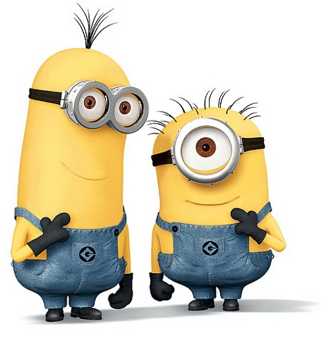
For example:
“Should we tell the humans we can speak English?” asked Stuart.
Kevin replied, “No, definitely not.”
The punctuation placed before closing the inverted commas is a ? as Stuart asked a question
‘No’ is capitalised because it is the start of the speech sentence.

Slide 11
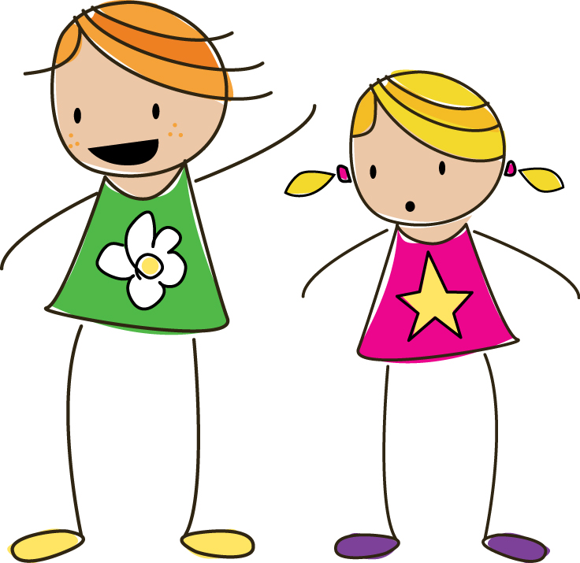
For example:
“You’ll win then,” murmured Emery, “you’re much faster than I am.”
“I’ll race you there!” said Isla.
‘you’re’ doesn’t need a capital letter because it is not the start of the speech sentence.
Despite coming after an ! , said is not capitalised.

Slide 12
Punctuating Direct Speech
Can you punctuate the speech in these sentences correctly?
What time are we going out asked Zoe.
“What time are we going out?” asked Zoe.
Yasmin shouted look out
Yasmin shouted, “Look out!”
Besides said Sam thoughtfully what was she doing there anyway
“Besides,” said Sam thoughtfully, “what was she doing there anyway?”
Remember: Put inverted commas around what the speaker says, start each speech sentence with a capital letter and place a piece of punctuation before closing your inverted commas.

Slide 13
Punctuating Direct Speech
Can you rewrite this section of text using the correct punctuation?
did you eat the last doughnut Hannah asked her little brother. no I had carrot sticks for my snack replied Zac innocently. then where questioned Hannah did the sugar all around your mouth come from. smiling mischievously, Zac responded I’m not sure, but it definitely wasn’t from your doughnut

Slide 14
Punctuating Direct Speech
Can you rewrite this section of text using the correct punctuation?
“Did you eat the last doughnut?” Hannah asked her little brother.
“No, I had carrot sticks for my snack,” replied Zac innocently.
“Then where,” questioned Hannah, “did the sugar all around your mouth come from?”
Smiling mischievously, Zac responded, “I’m not sure, but it definitely wasn’t from your doughnut!”
Remember: New speaker, new line.

Slide 15
Reporting Clause

Slide 16
Reporting Clause
Direct speech will almost always need a reporting clause.
A reporting clause tells the reader who the speaker was and how they spoke.
For example:
“I came 1st!” shouted Frank excitedly.
“I came 1st!” shouted Frank excitedly.
This is a reporting clause – it tells you that Frank was our speaker and he was shouting excitedly.

Slide 17
Reporting Clause
A reporting clause can come before, after or split the direct speech. For example:
Varying the location of the reporting clause keeps your writing interesting for the reader.
Location | Sentence
Before | Dan asked hungrily, “Do you know what time lunch is?”
After | “Do you know what time is lunch is?” Dan asked hungrily.
Embedded | “Do you know,” Dan asked hungrily, “what time lunch is?”

Slide 18
Reporting Clause
Can you change the position of the reporting clause?
Location | Sentence
Before | Darcey whispered quietly, “I think we should hide upstairs.”
After | “I think we should hide upstairs,” whispered Darcey quietly.
Embedded | “I think,” Darcey whispered quietly, “we should hide upstairs.”
Location | Sentence
Before | Darcey whispered quietly, “I think we should hide upstairs.”
After | “I think we should hide upstairs,” whispered Darcey quietly.
Embedded | “I think,” Darcey whispered quietly, “we should hide upstairs.”
Location | Sentence
Before | Darcey whispered quietly, “I think we should hide upstairs.”
After | “I think we should hide upstairs,” whispered Darcey quietly.
Embedded | “I think,” Darcey whispered quietly, “we should hide upstairs.”
***CAREFUL***
You may have to add, remove or change some punctuation when you move the reporting clause.

Slide 19
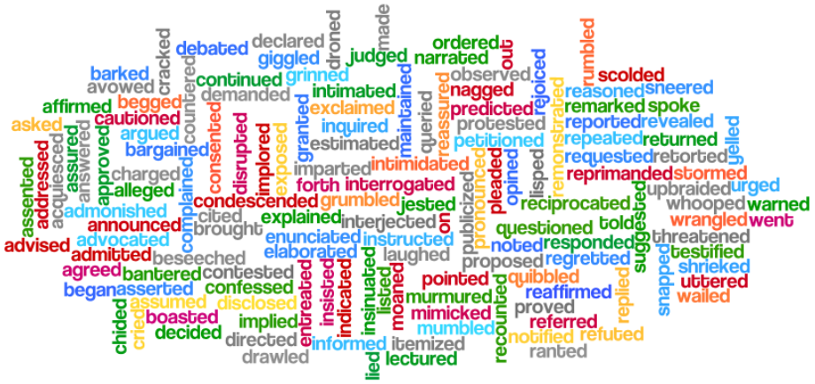
Synonyms for Said

Slide 20
Synonyms for Said
Repeatedly using the word ‘said’ after every speech sentence is a quick way of making your writing very boring for others to read.
Keep a thesaurus handy and refer to it when writing dialogue to keep your writing interesting.

Slide 21
Quiz

Slide 22
Which is correct?
“Can I have lemonade to drink?” Asked Vivian.
“Can I have lemonade to drink?” asked Vivian.
“Can I have lemonade to drink,” asked Vivian.

Slide 23
Which is correct?
“Can I have lemonade to drink?” Asked Vivian.
“Can I have lemonade to drink?” asked Vivian.
“Can I have lemonade to drink,” asked Vivian.

Slide 24
Which is correct?
Flynn replied, “He said he was going to the park”.
Flynn replied, “he said he was going to the park.”
Flynn replied, “He said he was going to the park.”

Slide 25
Which is correct?
Flynn replied, “He said he was going to the park”.
Flynn replied, “he said he was going to the park.”
Flynn replied, “He said he was going to the park.”

Slide 26
Which is correct?
“I think” said mum, “that we’ll go to the zoo today”
“I think,” said mum, “That we’ll go to the zoo today.”
“I think,” said mum, “that we’ll go to the zoo today.”

Slide 27
Which is correct?
“I think” said mum, “that we’ll go to the zoo today”
“I think,” said mum, “That we’ll go to the zoo today.”
“I think,” said mum, “that we’ll go to the zoo today.”

Slide 28
Which is correct?
“I love vanilla ice cream” exclaimed Zara excitedly.
“I love vanilla ice cream!” exclaimed Zara excitedly.
“I love vanilla ice cream!” Exclaimed Zara excitedly.

Slide 29
Which is correct?
“I love vanilla ice cream” exclaimed Zara excitedly.
“I love vanilla ice cream!” exclaimed Zara excitedly.
“I love vanilla ice cream!” Exclaimed Zara excitedly.

Slide 30
Which is correct?
“I’m really sorry ,” said Oscar sadly, “but I can’t come tomorrow.”
“I’m really sorry ,” said Oscar sadly, “But I can’t come tomorrow.”
“I’m really sorry ” said Oscar sadly, “but I can’t come tomorrow.”

Slide 31
Which is correct?
“I’m really sorry ,” said Oscar sadly, “but I can’t come tomorrow.”
“I’m really sorry ,” said Oscar sadly, “But I can’t come tomorrow.”
“I’m really sorry ” said Oscar sadly, “but I can’t come tomorrow.”

