Slide 1
Global Trade Lesson 1: How did trade get global?

Slide 2
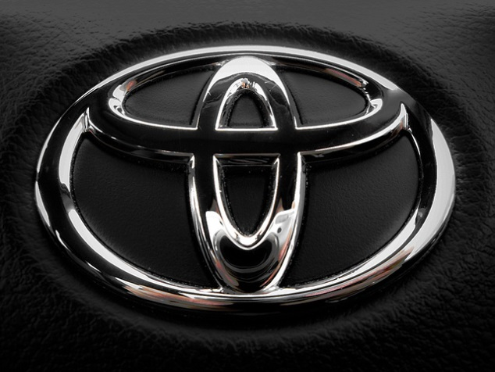
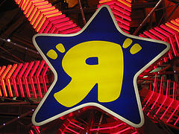
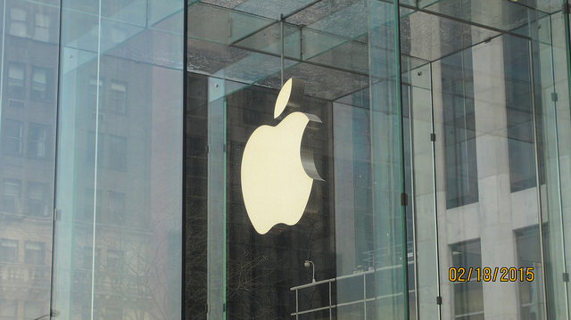
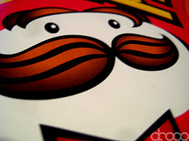
Do you recognise these company logos?
Toyota is a Japanese company that manufactures cars. The headquarters are in Japan
but Toyota cars are produced,
sold, and bought all over the world.
Toys R Us is a toy company.
It was founded in New Jersey,
North America. It now has stores
in 37 different countries.
Untitled © Procsilas Moscas Flickr
Ross G Strachan © Flickr
Apple Inc. is an electronics company based in California, USA. Apple has shops in 16 countries and anyone in the world can by an Apple computer or Ipod over the internet and have it delivered.
Move the image to reveal the answers.
Pringles headquarters are in the USA.
Pringles are enjoyed by people in countries all over the world.
Andrew © Flickr
Jim Peake © Flickr
Notes:
Teacher answers: Toys R Us, Audi, Pringles, Apple
Source Audi: Audi Classic © Leonid Mamchenkov, Flickr
Pringle Zoom © Andrew, Flickr
Apple Logo Suspended 5th Avenue New York City IMG_6900 © Flickr

Slide 3
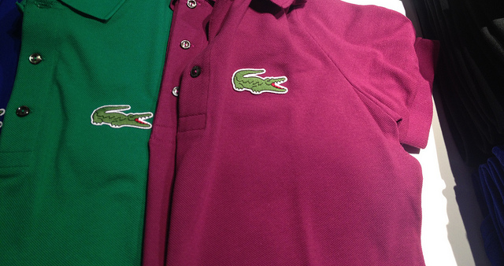
How about these?
Starbucks Coffee Company is based in Seattle, USA.
The coffee beans come from countries such as Costa Rica and are sold in coffee shops all over the world.
Shell is an oil and gas company. It is an English and Dutch company with its headquarters in the Netherlands.
Makipapa © Flickr
Mike Mozart © Flickr
The Hello Kitty logo can be found on lots of items from notebooks to bags. The company Sanrio who makes these goods is a Japanese company.
Lacoste is a French clothing company. Lacoste has stores worldwide and also sells goods online to countries all over the world.
Hayley Bouchard © Flickr
Christian Jensen © Flickr
Notes:
Teacher answers: Starbucks, Shell, Hello Kitty, Lacoste
2011 new Starbucks LOGO © makipapa, Flickr
Shell gas station © Mike Mozart, Flickr
Hello Kitty cupcake © Hayley Bouchard, Flickr
Lacoste joins Ralph Laurrens Logo size madness © Christian Jensen, Flickr

Slide 4
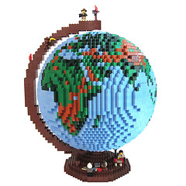
Where are these goods sold?
Goods such as clothing, computers, drinks, food, toys and notebooks are made by these companies.
They sell these goods to people living in countries in all seven continents of the world.
They are sold on a global scale.
A class of children in Australia, India, Sweden, North America, or China are as likely to recognise these logos as you are.
Dirk’s Lego Globe © dirkb86, Flickr

Slide 5
Starbucks in Shanghai, China
Starbucks Coffee
Company started in Seattle, USA.
You can now buy Starbucks coffee in countries all over the world.
Starbucks © Jasmin, Flickr

Slide 6
IKEA in Saudi Arabia, Middle East
IKEA started in Sweden, Europe.
You can now buy IKEA furniture all over the world.
Ikea in Saudi Arabia © Paul Pehrson, Flickr

Slide 7
Learning Objective
To understand what trade is.
To discover how and why trade has become ‘global’.
Dirk’s Lego Globe © dirkb86, Flickr

Slide 8
What is trade?
Trade is the buying and selling of goods and services we want and need.
Trade involves the exchange of goods or services in return for other goods or services or money.
The famous economist, who lived over 200 years ago, Adam Smith once said
“Every man lives by exchanging”- Do you agree?

Slide 9
The scale of trade
When we think about trade as geographers we consider the scale of trade and think about how trade links places and people.
Local
Global
National

Slide 10
The scale of trade
Local
GLOBAL
National
Swapping a football card that you need with a friend so you complete your collection.
Buying a T-shirt made in Turkey from a shop on the High Street.
Buying a British Cox apple in the supermarket.
A company based in Japan sells you a TV online.
Selling your old bicycle to a friend who lives in another town.

Slide 11
Trade in the past
Trade has occurred between people since the beginning of civilisation when people exchanged goods and skills within their community on a local scale.
Even in the Stone Ages people exchanged goods such as tools, clothing and food.
Trade only occurred on a local scale at this time. People had no contact with people from distant places.

Slide 12
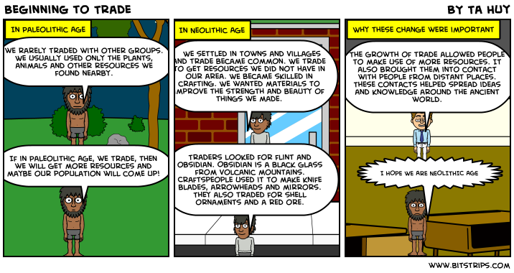
Beginning to trade
Source: http://bitstrips.com/read.php?comic_id=4S0XP&sc=1

Slide 13
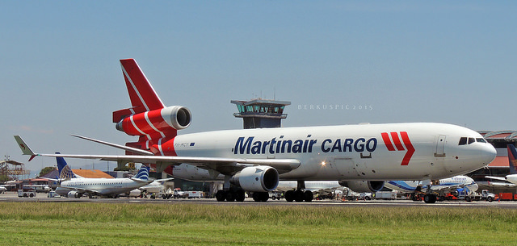
How trade got ‘global’
The scale of trade has increased through time and exchanges can now happen on a global scale.
The development of communication, technology and transport have enabled trade to be carried out on this scale.
MD11 Martinair © Bernal Saborio, Flickr

Slide 14
Globalisation
A process called ‘globalisation’ has occurred.
Globalisation: process of the world’s countries becoming more connected as a result of international trade and cultural exchange.
Trade now happens on a larger scale (global) and at a faster pace than ever before. This means we can sell and have more access to larger range of products.

Slide 15
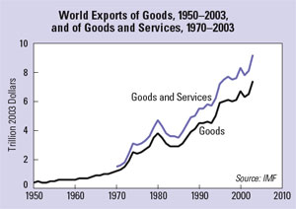
The increase in value of global trade
Source: Worldwatch Institute

Slide 16
Value of Global Trade exports in 2012
18.3 trillion US dollars
Global trade exports generate a huge amount of money each year.

Slide 17
Wednesday 7th March WALT: To explore how and why trade has changed through time to become ‘global’.
You each have an important time period in the history of global trade to research:
1) Read the information sheet and examine the images.
2) Discuss the key features of trade during this time and consider what conditions caused this.
3) Create a section of the ‘Trade Timeline’ with clear bullet points summarising the key points and illustrate.
4) Make sure you are prepared to teach classmates what you have discovered at the end of the lesson.
The Stone Ages
The 17th Century
The 21st Century

Slide 18
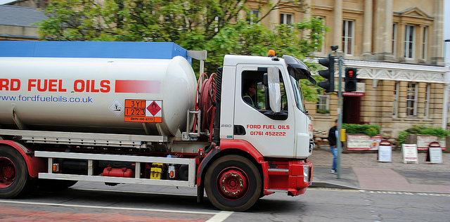
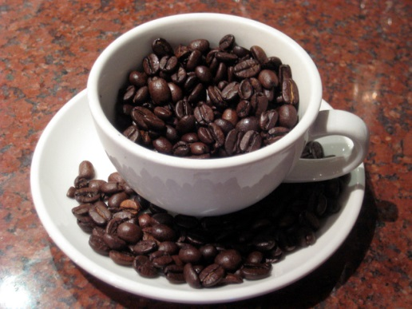
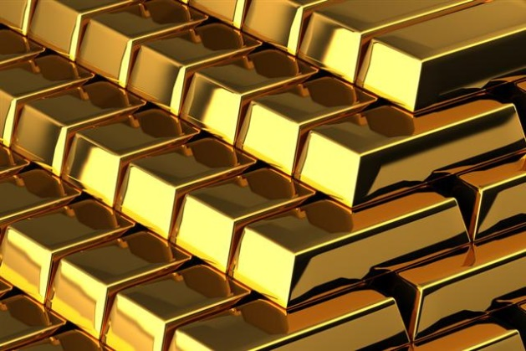
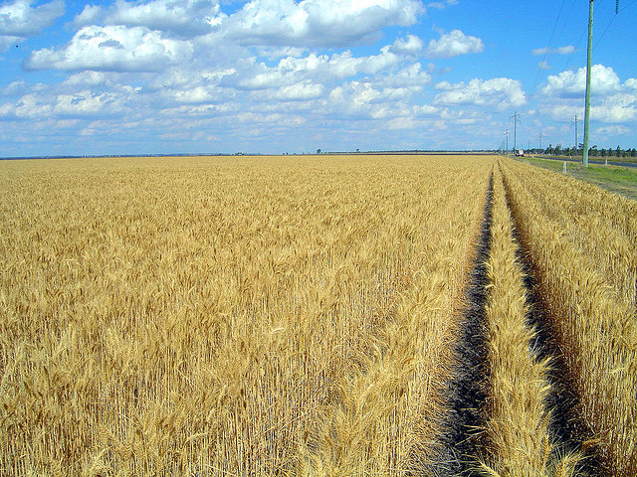
What are the current top ten most traded items in the world?
Crude oil
Coffee
Natural gas
Gold
Brent oil
Silver
Sugar
Corn
Wheat
Cotton
Volvo Fl.250 Ford Fuel Oils Tanker © lee bristol, Flickr
Coffee Beans © Amanda, Flickr
Gold (small) © Backdoor Survival, Flickr
Wheat_field_rows © Rae Allen, Flickr
Information source: http://bestteneverything.com/top-ten-most-traded-commodities/

Slide 19
Top commodities
Crude oil: supplies the modern world with our energy needs.
Coffee: the world consumes 2.25 billion cups of coffee a day!
Natural gas: used for everything, from cooking, to heating, to lighting our homes.
Gold: used for currency and by investors.
Sugar: traded in every country in the world, by 2030, the annual consumption of sugar will exceed 257 million tons!

Slide 20
Plenary
Selected groups to present their section of the trade timeline to the rest of the class and take any questions.
Join timeline sections together for display on the working wall:
‘Trade Timeline: The Journey of Global Trade’

