Slide 1
WALT: identify key features of a newspaper
Success Criteria;
I understand the purpose of a each feature
I know the order each feature comes in
I can explain what each feature means

Slide 2
EXTRA! EXTRA! READ ALL ABOUT IT!
Class 4 become fantastic feature spotters!!
Newspapers have a range of features that attract the reader.
Does anyone know any of them?

Slide 3

Headline!
Newspapers use headlines to grab your attention. Headlines try to tell the story in as few words as possible;
Watery weather washes out Wales!
Driverless car ploughs through busy junction!’

Slide 4


The 5 W’s
WHAT?
WHERE?
WHY?
WHO?
WHEN?
Can you tell which of these sentences are facts and which are opinions?
The house exploded at 9.30am exactly.
The footballer gets paid too much money and isn’t playing well enough.
In Western Brazil, carnivals are lively and exciting.
Barney, the 32 year old Labrador, is the oldest dog in living memory.

Slide 5


“QUOTES”
Quotations tell us what has been said and who said it. They can help to tell the story by giving the reader the opinions of the people involved. They use inverted commas.
Eg. Class teacher for Year 3 and 4, Mrs Jones said “They are a lovely class of children and I really like teaching them.”
“It was the scariest moment of my life!” the 28 year old home owner told us.
“They’re lucky to be alive!” said Sam Fenton, (35) Chief Fire Officer for Greater Manchester Fire Service.
Are these quotes FACTS or OPINIONS?

Slide 6

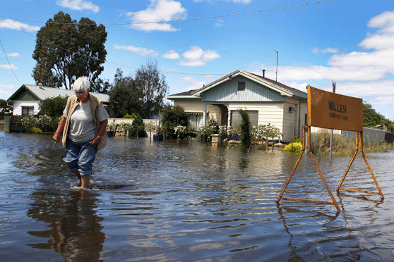
Photographs & Captions
Photos and captions help to tell the story by giving readers a snapshot of what happened, where it happened or who it happened to.
What do you think a report using this picture would be about?
Photos also need a caption underneath them. A caption is a short sentence explaining what is happening in the photograph.

Slide 7
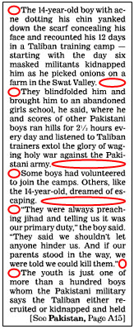
PARAGRAPHS
Paragraphs help the reader clearly understand the information on the story. Each new paragraph should be given a 'subheading'. This is a very short title that tells the reader a little about what the paragraph is will about.
All work and no play for
parents…
Parents are working longer
hours than ever before. They
may have to stay late at work or
continue working after they get
home. A quarter of parents said
that in an average week they
spend less than an hour with
their children, although almost
half would like to spend more
time together as a family.
What is the Family
Charter?
Thomson Holidays want to
work with kids across the country
on a Family Charter. The Charter
will involve parents and kids
identifying the promises and
rules that every family member
should make to make sure they
spend proper time together,
whether it’s at home or on
holiday. We want you to vote
for rules for family holidays and
breaks that everyone in the
family must follow. For example,
no mobile phones during
mealtimes or promising to play a
game together once a day.
Holidays = happy times
A new all-party
parliamentary group
report called Giving
Britain a break, which
is supported by
the Family Holiday
Association and
Thomson Holidays,
says that families

Slide 8
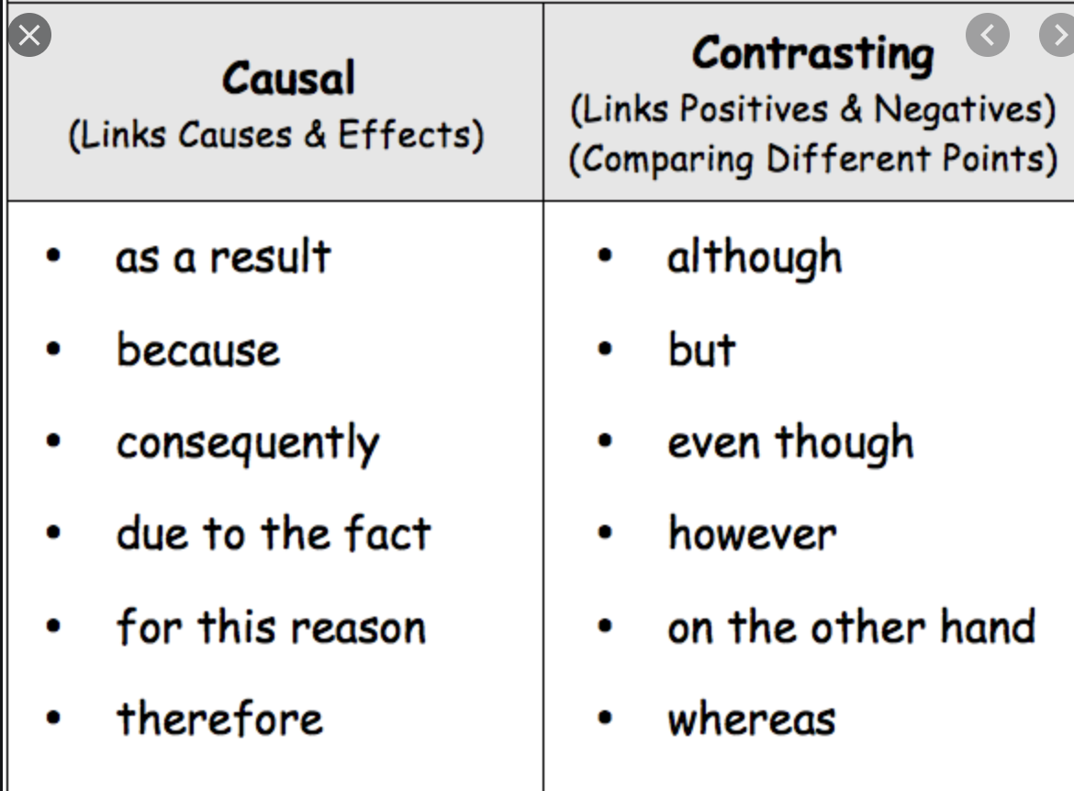
The table shows a list of conjunctions which connect two sentences.

Slide 9
EXTRA! EXTRA! READ ALL ABOUT IT!
Newspapers have a range of features that attract the reader.
TASK A
Your job is to look through your local newspaper (or the newspaper provided on the school website) and spot all of the features.
Write them down using a spider diagram.

Slide 10


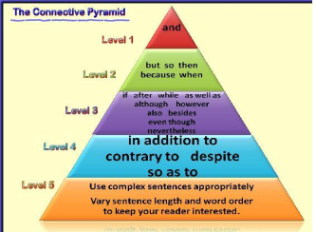
FEATURES
Headline!
5 W’s (Fancy Facts)
Quotes (inverted commas)
Photographs & captions
Paragraphs
Conjunctions

Slide 11
TASK B
Choose an interesting article in your newspaper.
Read it and then think about how you might explain what it is about.
Use 5 bullet points to explain the 5 w’s for your article.
To help you, think about the main points of the article.

