Slide 1
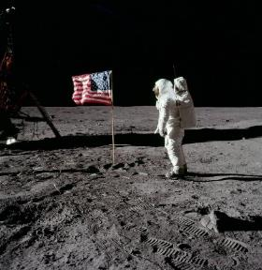
UKS2 Earth and Space Knowledge Mat
Subject Specific Vocabulary |  |  | Sticky Knowledge about Earth and space
orbit | An orbit is a repeating path that one celestial body takes around another.
 |  |  | One million Earths could fit inside the sun – and the sun is considered an average-sized star.
solar system | The solar system is made of the eight planets that orbit our sun; it is also made of asteroids, moons, comets and lots more.
 |  |  | An asteroid about the size of a car enters Earth’s atmosphere roughly once a year – but it burns up before it reaches us.
astronomical | Astronomy is the study of outer space, focusing on celestial bodies such as stars, comets, planets and galaxies.
planet | There are 8 planets in our solar system, they are Mercury, Venus, Earth, Mars, Jupiter, Saturn, Uranus and Neptune.
 |  |  | The sunset on Mars appears blue.
rotation | Rotation is when a shape is turned around a fixed point. |  | Earth is the third planet from the sun and the only world known to support an atmosphere with free oxygen, oceans of liquid water on the surface, and life.
spherical | Something spherical is like a sphere in being round, or more or less round, in three dimensions. | Important facts to know by the end of the Earth and space topic:
crescent moon | It is a slither of the moon that is lit up and can be seen. It is less than half the moon. | Know about and explain the movement of the Earth and other planets relative to the Sun. Know about and explain the movement of the Moon relative to the Earth. Know and demonstrate how night and day are created. Describe the Sun, Earth and Moon (using the term spherical). Know information about the planets. Neil Armstrong was the first man to step on the moon. | There is no atmosphere in space, which means that sound has no medium or way to travel to be heard.
gibbous moon | The best way to describe a gibbous moon is that the moon is three-quarters lit up.
 |  |  | Venus is the hottest planet in the solar system and has an average surface temperature of around 450° C.
eclipse | An eclipse occurs when an astronomical object is temporarily obscured. A lunar eclipse is when the Earth moves between the Sun and the Moon, therefore blocking the Sun's rays from striking the Moon.
 |  |  | The sheer size of space makes it impossible to accurately predict just how many stars exist.
lunar | Is anything related to the moon.

