Slide 1
The impact of non-attendance

Slide 2
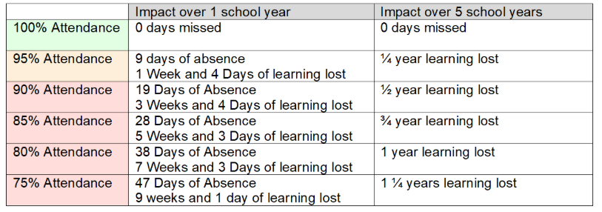

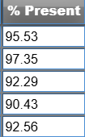
5-year average of 93.6% - somewhere between ¼ and ½ year lost.

Slide 3
The impact of low attendance at primary school on educational standards is significant.
Children who attend school nearly every day are 30% more likely to achieve the expected standard in reading, writing, and maths compared to those who attend 90-95% of the time.

Slide 4
The link is even stronger at secondary school, where Year 11 pupils with near-perfect attendance are almost twice as likely to achieve grade 5 in English and Maths GCSE compared to those attending 90-95% of the time.
Children with low attendance at primary school often go on to have poor attendance at secondary school

Slide 5
A week of absence at primary school can equate to approximately 2.6% of attendance lost
Our attendance is 96.81% - so again, thank you

