Slide 1
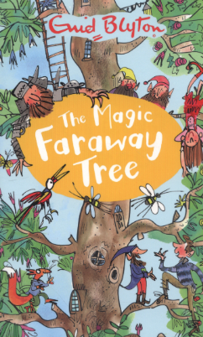
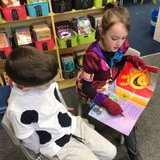
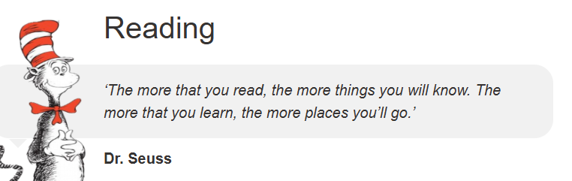
Reading
Ireby Church of England
‘Created to Do Good,’ Ephesians 2:10

Slide 2
Contents for the session
Our Christian vision
Reading standards at Ireby
The importance of reading standards
Consequence of low reading standards
Impact of low attendance
What is reading?
Why is reading out loud so important?
So, what is research telling us
What next?

Slide 3
Our Christian Vision: ‘Created to do good.’ Ephesians 2:10

Slide 4
In-line with our role as a Church of England school, to serve the local community and provide an education for children of all backgrounds, including those of different faiths or no faith, our Christian vision is for our whole community.

Slide 5
Grow a strong and loving community: ‘one big family,’ using our unique talents and passions to serve and love one another.

Slide 6
Support our children's academic, social and spiritual development through a rich curriculum where all can flourish

Slide 7
Reading standards at Ireby

Slide 8
 | Reading
 | Expected+ | Greater Depth
2025 | 80% | 60%
Average Scaled Score | 109.8 (National average: 106)
2024 | 100% | 0%
Average Scaled Score | 104 (National average: 105)
2023 | 100% | 100%
Average Scaled Score | 117 (National average: 105)

Slide 9
Phonics: 100%

Slide 10
So, a big thank you!

Slide 11
The importance of reading standards at primary school:

Slide 12
One in four children nationally left primary school in 2025 unable to read to the required standard.

Slide 13
Only 10% of disadvantaged children who leave primary school reading below the expected achieve a pass at GCSE English and Maths (a pass is Grade 4)

Slide 14
Children who are weak readers will struggle as much in maths and science at GCSE as they do in English and in arts subjects, according to one of the biggest ever studies of student reading

Slide 15
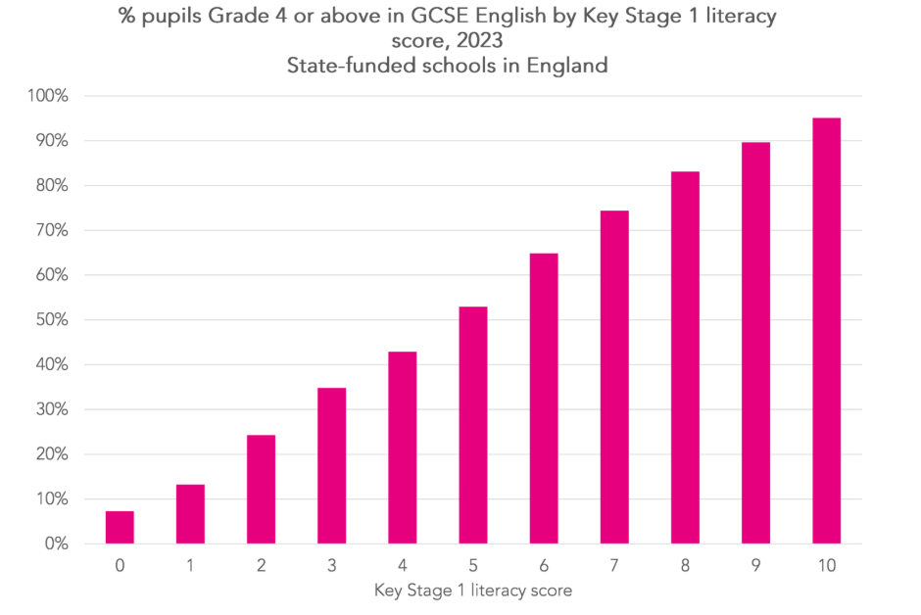
The relationship between GCSE outcomes and KS1 reading
A ‘5’ at KS 1 is just about at the expected standard - which converts to approx. 53% gaining a grade 4 or above at GCSE
An ‘8’ at KS 1 is just about above the expected standard - which converts to approx. 83% gaining a grade 4 or above at GCSE
A ‘3’ at KS 1 below the expected standard - which converts to approx. 35% gaining a grade 4 or above at GCSE

Slide 16
Why does this matter?

Slide 17
Evidence from research shows that those who perform just one GCSE grade better than their counterparts across nine subjects have been shown to earn on average over £200,000 more throughout their lives. (based on 2021 research) This figure will now be higher.

Slide 18
Researchers found that GCSE results strongly predicted whether an individual would go on to achieve further educational success, for example at university.
But even after accounting for further education, doing well in GCSEs made a significant difference for securing a prestigious job and earning a good income.

Slide 19
The cost of illiteracy in the UK

Slide 20
It is estimated that six to eight million adults are functionally illiterate not able to read the front page of a broadsheet newspaper, understanding the instructions on a medicine bottle, sitting a theory test for a driver’s licence, or succeeding in writing a job application

Slide 21
The cost of illiteracy in the UK is estimated to be £81.312 billion annually.

Slide 22
Illiteracy leads to individuals earning 30-42% less than their literate counterparts, but without the skills to pursue further vocational education or training

Slide 23
The impact of non-attendance

Slide 24
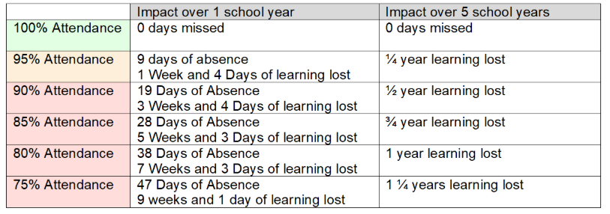

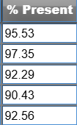
5-year average of 93.6% - somewhere between ¼ and ½ year lost.

Slide 25
The impact of low attendance at primary school on educational standards is significant.
Children who attend school nearly every day are 30% more likely to achieve the expected standard in reading, writing, and maths compared to those who attend 90-95% of the time.

Slide 26
The link is even stronger at secondary school, where Year 11 pupils with near-perfect attendance are almost twice as likely to achieve grade 5 in English and Maths GCSE compared to those attending 90-95% of the time.
Children with low attendance at primary school often go on to have poor attendance at secondary school

Slide 27
A week of absence at primary school can equate to approximately 2.6% of attendance lost
Our attendance is 96.81% - so again, thank you

Slide 28
What helps our children achieve the expected standard in reading?

Slide 29
Building strong relationships and interacting with children from the outset….

Slide 30
Why positive attention is important
From birth, children need experiences and relationships that show them they’re valued, capable human beings who make other people happy.
Positive attention, reactions and responses from familiar and trusted grown-ups help children build a picture of how valued they are.

Slide 31
Face-face interaction – is a key element of linguistic and social development – Government warns of the risks of screen time in reducing opportunities for this.
Screen time inhibits young children’s ability to read faces and learn social skills – to key elements of empathy
It also detracts from activities that help boost their brain power like play and interacting with children
Government considering a 2-hour screen limit for children

Slide 32
Speaking comes next…..

Slide 33
Rich vocabulary development is crucial for young children as it forms the foundation for their future success.

Slide 34
Vocabulary knowledge has a profound impact on reading development, academic achievement, and even emotional well-being

Slide 35
Children with a strong vocabulary are better readers, more confident when facing new challenges, and have the words to identify and express their emotions with more accuracy and depth.
Education Endowment Foundation

Slide 36
Children in vocabulary-rich homes hear significantly more words than those in environments vocabulary-deficit environments.

Slide 37
Research indicates that children from vocabulary rich families may hear 30 million more words by age 3 compared to their counterparts

Slide 38
A lack of exposure to a variety of words and the quantity of language input

Slide 39
Engaging in frequent conversations, reading aloud, and using a rich vocabulary in daily interactions are essential for fostering language development in children

Slide 40
Societal impact of phones and technology Princess of Wales “We are raising a generation that maybe more ‘connected’ than any in history while simultaneously being more isolated, more lonely and less equipped to form meaningful relationships.’

Slide 41
Children who are exposed to longer than 2 hours a day of recreational screen time had a worse working memory, processing speed, attention levels, language skills than those who did not

Slide 42
What is reading?

Slide 43
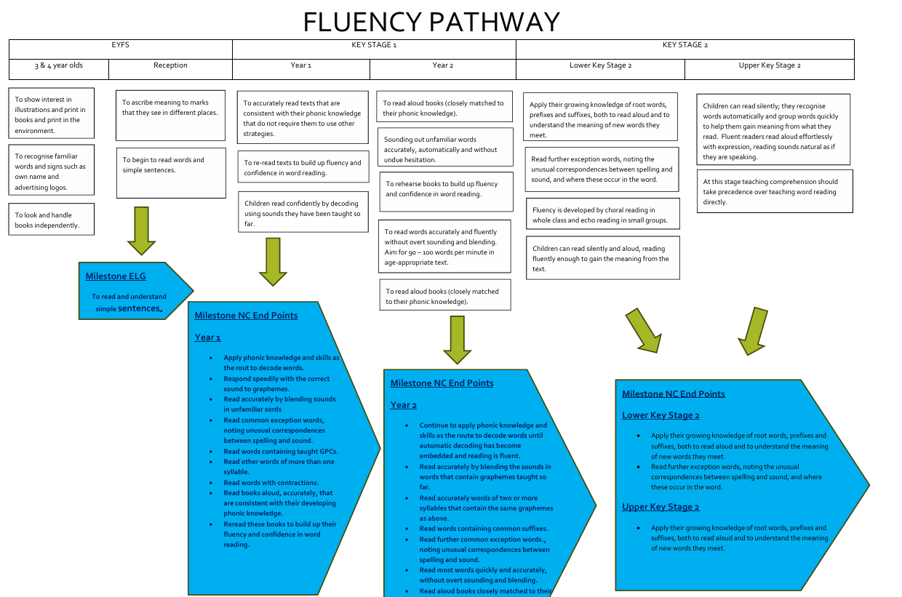

Slide 44
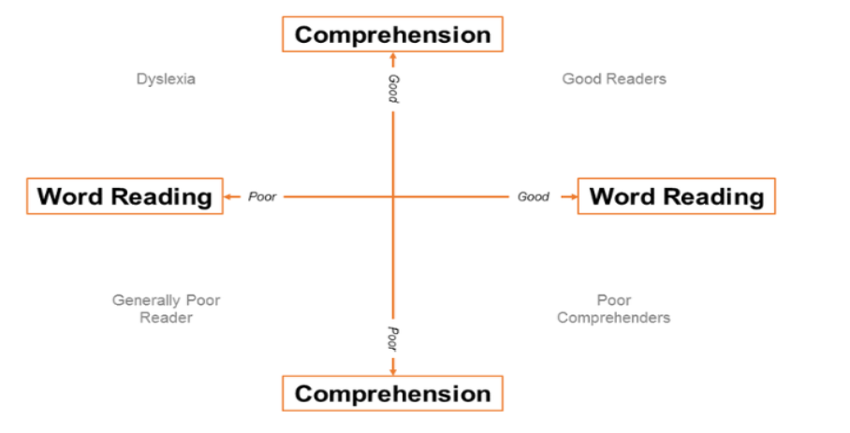

Slide 45
Importance of reading out loud – throughout primary school!

Slide 46
Reading aloud to children significantly expands children’s vocabulary, as research by Beck et al. (2002)

Slide 47
Massaro’s study further illuminates this by examining the vocabulary in children’s picture books, revealing that children are three times more likely to encounter new words during a read-aloud session than in regular conversation.

Slide 48
This exposure to a broader lexicon not only enriches children’s language but also enhances their understanding of the world around them, providing a solid foundation for future reading comprehension and academic success

Slide 49
Enhances Listening Comprehension
Listening comprehension comes before reading comprehension.
If a child has never heard the word, he or she will never say the word.
And if you have neither heard it nor said it, it is highly unlikely you’ll be able to read and write it.
The listening vocabulary is that reservoir of words that feeds the reading vocabulary pool” (Trelease, 1989, pp.204-205)

Slide 50
Develops Syntactic Skills
Reading aloud to children significantly contributes to the development of their syntactic skills (grammatical rules), as highlighted by Lane & Wright (2007)
Exposure to diverse sentence structures and grammatical patterns in read-aloud sessions, children learn to understand and use complex language constructs, enhancing their ability to form sentences and grasp the rules of language.

Slide 51
Reading aloud to children has been shown to significantly bolster their word recognition abilities, as Stahl (2003) points out.
This practice exposes children to a wide range of vocabulary in different contexts, allowing them to become familiar with the appearance and sound of words.

Slide 52
Reading aloud to children not only supports their cognitive and literacy development but also fosters social bonding and emotional growth, as Trelease (1989) highlights.
This shared activity strengthens the connection between the child and the reader, creating a nurturing environment that promotes emotional security and empathy

Slide 53
Inspires Literacy desire
In watching and hearing the competent reader aloud, the child sooner or later yearns to imitate, looks to the day when he or she will be able to work such magic with words and books. And thus are planted the seeds of desire that can only spring from awareness. (Trelease, 1989, p. 205)

Slide 54
Encourages Imagination and Creativity
Reading aloud to children is a gateway to uncharted realms of imagination and creativity.
Through the vivid narratives and diverse characters encountered in stories, children are transported to worlds far beyond their immediate surroundings.
This journey not only entertains but also stimulates mental imagery, encouraging them to visualise the events, settings, and characters described.
Let’s read out loud!

Slide 55
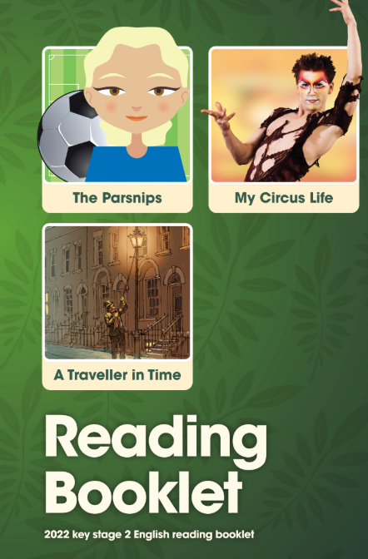
What is reading comprehension?
The Education Endowment Foundation defines reading comprehension as learners’ understanding of written text.
Pupils learn a range of techniques which enable them to comprehend the meaning of what they read.
Let’s take a quick look at a KS 2 SATs paper

Slide 56
So, what is the research telling us?

Slide 57
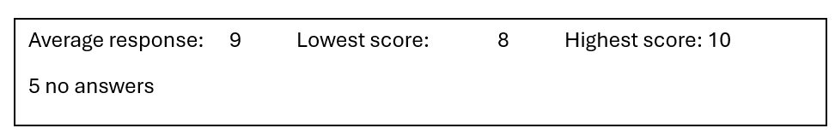
The link between parents’ reading skills and their children's reading abilities is significant. Research indicates that children with parents who have low literacy skills, have a 72% chance of landing in the lowest reading levels themselves.

Slide 58
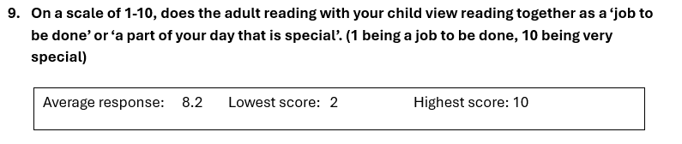
Gen Z parents, who grew up with technology themselves, are significantly more likely than Millennials or Gen X to view reading as “more a subject to learn” rather than a fun or enriching activity.

Slide 59
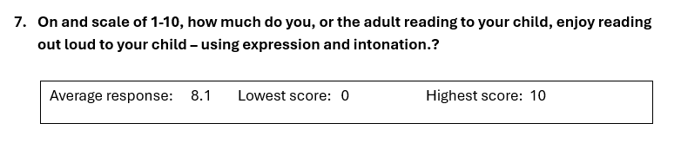
New research reveals that parents are losing the love of reading aloud, with fewer than half saying reading to children is “fun for me”

Slide 60
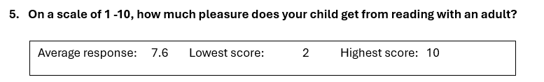
Almost one in three (29%) children aged 5–13 think reading is “more a subject to learn than a fun thing to do”, up from 25% in 2022.
This growing association of reading with pressure rather than pleasure is contributing to disengagement

Slide 61
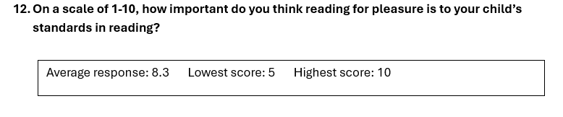
In fact, research shows that reading for pleasure accounts for 13 percent of the variation between strong and weak readers in primary school, a difference that climbs to 30 percent in secondary and 34 percent in college students.

Slide 62
More than one in five boys (22%) aged 0-2 are rarely or never read to

Slide 63
Only 29% of boys in this age group are read to daily, compared to 44% of girls, underscoring early disparities in exposure to books.

Slide 64
The crisis in boys reading for pleasure continues from infancy to adolescence, as only 12% of 12–13-year-old boys read for fun.

Slide 65
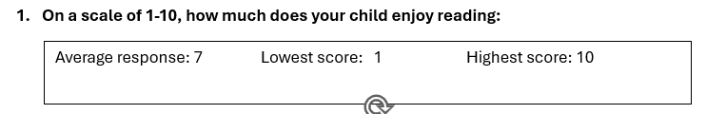
Only 32% of 5–10-year-olds frequently choose to read for enjoyment, down from 55% in 2012.

Slide 66
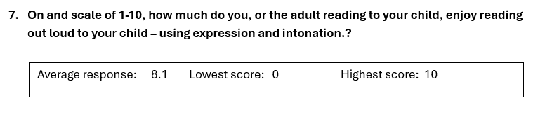
Despite reading aloud to children being a proven way to boost their enjoyment of reading, the number of parents reading aloud to children is at an all-time low.
Fewer than half (41%) of 0–4-year-olds are read to frequently, a steep decline from 64% in 2012.

Slide 67
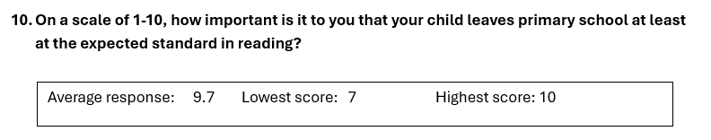
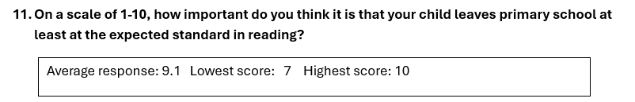
What do we want for our children?
Love their reading and access a world of literacy, stories, information – and fun!
So they can access all their subjects at secondary school and enjoy their learning
Achieve stronger GCSE results
Achieve economic well-being and happiness in future life
Pass on their love of reading and learning to their children

Slide 68
What our data currently shows:
Our 3-year trend is above national averages
And we want to keep this going – and keep making progress!

Slide 69
So, what next….. Back to our vision…..
Grow a strong and loving community: ‘one big family,’ using our unique talents and passions to serve and love one another.
Support our children's academic, social and spiritual development

Slide 70
Work together as a community – using our talents to support all our children to succeed and give them the very best start we can.

Slide 71
How well is your child supported at home to be a confident reader? Staff at school will be asking themselves the same questions…
On a scale of 1-10 (1 being the worst) how well do you:
Give your child your attention and listen to them _______
Develop rich vocabulary through conversation and interactions and through activities such as games/ cooking/ eating a meal together/ going for a walk________
Read out loud with your child _____
Set aside a part of the day that is specially for reading____________
Talk about books, characters and plots in the books you share_______
Share activities that involve reading, such as visiting a book shop or library_______

Slide 72
What would a 10 look like?
Work in a group of up to four people to write down what it would look like if each answer was a 10.
Importantly – only focus on the perfect 10
Would anyone be willing to share their discussions

Slide 73
Some ideas for working together:
What would be helpful to our children?

Slide 74
What can we do as a school to work with you in partnership to support our children? What would a 10 look like?

Slide 75
Teachers will follow up with a chat about children and how best we can support
Thank you for you time everyone

