Slide 1

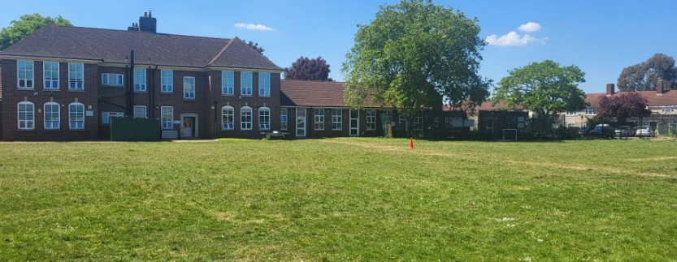
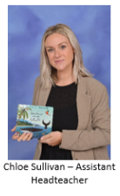

Nursery
2025-26
Notes:
AW

Slide 2
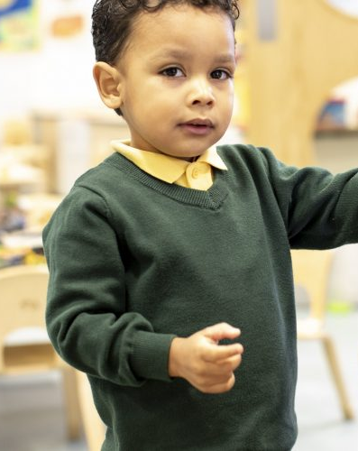
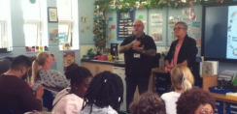
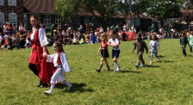
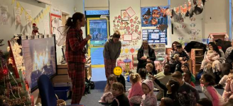
James Cambell is a great place for your child!
We provide children with the opportunities they deserve
Children receive good quality teaching in an exciting and engaging curriculum
We are committed to working with parents and carers – and involving them in the life of the school (Assemblies, Christmas, Summer fairs and Sports Days)

Slide 3
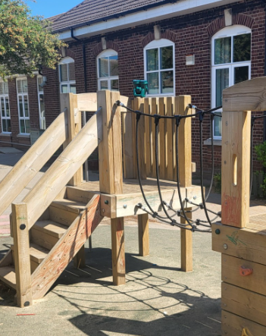
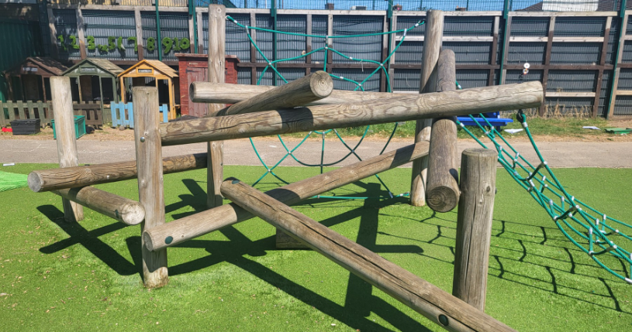
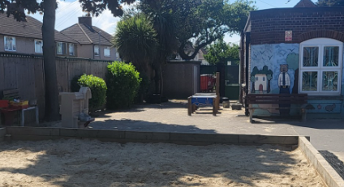
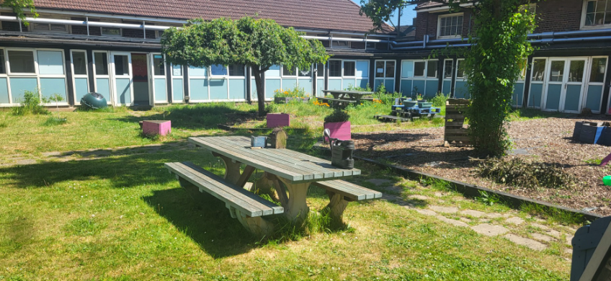
We also have wonderful resources and facilities, including great outdoor spaces for your children to play

Slide 4
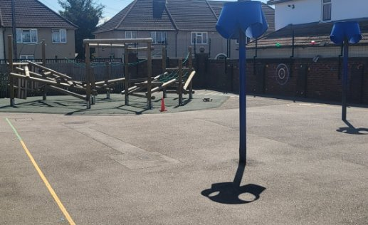
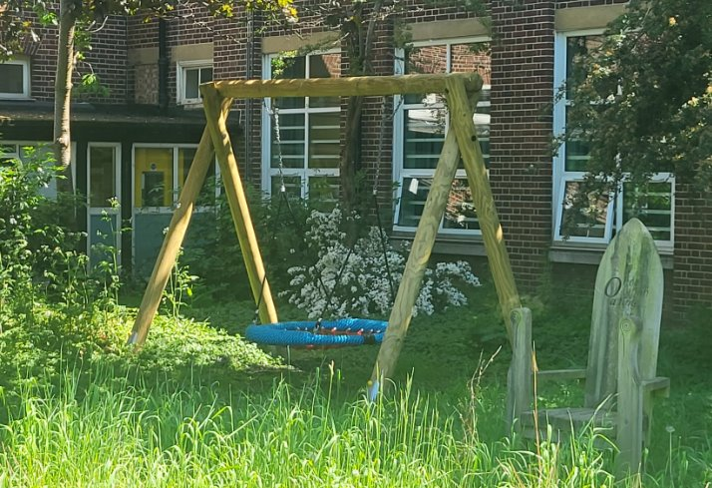
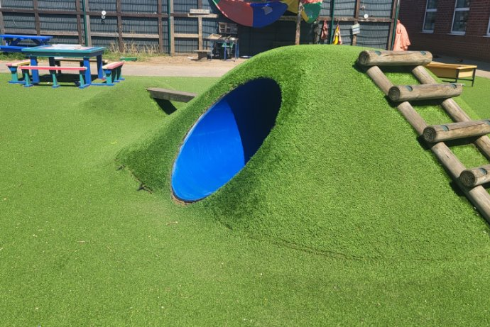

Slide 5
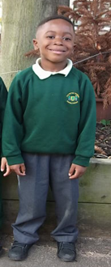

Uniform
At James Cambell Primary School we are proud of our school uniform
Every child is expected to wear the correct uniform every day
Please remember to put your child’s name in their clothes so they are not lost
No earrings or jewellery are allowed in Nursery or Reception
No dyed hair, or patterns/lines cut into hair
Notes:
AW

Slide 6

Uniform
Our school uniform
Dark green jumper/cardigan Grey trousers/skirt/pinafore Yellow polo shirt Black school shoes/black trainers (No laces) Grey/ white socks or grey tights
Please make sure your child’s coat is waterproof
All uniform needs to have names inside
Including hats, scarves shoes etc.
Notes:
AW

Slide 7


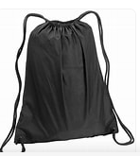
Book Bags
Please send in a book bag everyday, your child can have one small keyring on the bag so they know it is theirs
Letters, pictures etc. go home in their bag so please ensure they are in everyday
No backpacks
Children will need a spare uniform set in a drawstring bag incase we need to change them during the day
Water Bottles – all children will need to bring in a named water bottle
Notes:
AW

Slide 8
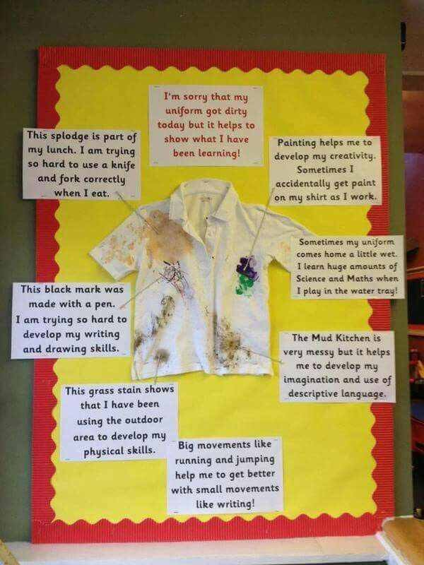
Notes:
AW

Slide 9



Attendance
‘Research has proven that there is a high correlation between school attendance and academic performance and success, while absence from school is often the greatest single cause of poor performance and achievement.’
Our attendance target is 97%
Parents/Carers will be contacted where there are concerns about attendance
Holidays during term time will not be authorised and may result in a fine
Notes:
LD

Slide 10
Timings
Morning Nursery 8:30-11:20
Afternoon Nursery 12:30-3:20
All-day nursery 8:30-3:20
If your child is having difficulty settling into nursery we may shorten their session, but we will have a discussion with you about this.

Slide 11
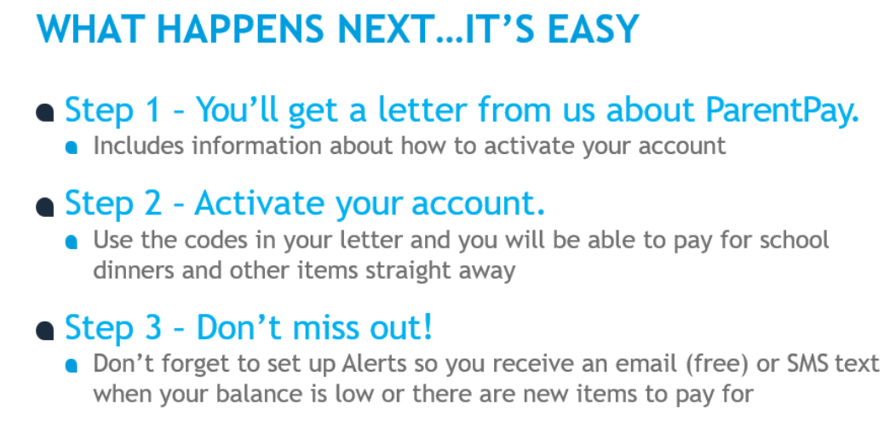
Costings
All fees are payable via ParentPay – please note we are a cashless school. Information about ParentPay will be given
The fee for the additional 15hours is £5 an hour, each morning or afternoon session is therefore £15 which totals £75 a week. You are required to pay this a fortnight in advance.
Lunchtime – there will be an additional £1 added each day to cover lunchtime as this is not included in your 15 hours.
Special Treat Money – we ask all parents for a contribution of £5 per half term. This money funds things such as special snacks.
You will not be charged any days in which the school is closed.

Slide 12
Lunch
If your child is morning or afternoon they do not need to bring lunch – they must eat before or after their session.
All day nursery children must bring a healthy lunch box with them. There is also a cost of £1 for your child to stay for the extra hour to have their lunch.

Slide 13


Parent Communication
DOJO
Class teachers use the app Class Dojo to communicate with parents about the children’s day. It is also a way you can message the teacher directly. A link will be emailed or text to you, to allow access to your child’s account.
ParentMail
We are a paperless school so all letters and permission slips will be sent via the ParentMail app. A link will be emailed or text to you, to allow access to your child’s account.

Slide 14


How can I support my child?
Encouraging the children to be independent. That includes toilet trained, putting on their own shoes and coats, verbalising their needs.
Reading with them
Looking for numbers around the environment
Talking about their name and what sound it starts with.
Following links on the school website
Climbing skills
Remember: if you have any questions, you can always send your class teacher a message on Class Dojo or speak to them at the end of the day
Notes:
RM

Slide 15
September
Home visits – you will have a home visit in September – you will be informed of the date and time via email.
Staggered start times – when your child starts in September they will have a staggered start time so they can get used to the environment and adults in smaller groups - this will be in your pack
Paperwork, if you haven’t yet submitted the paperwork to the office please do so asap.
Short Sessions Start - 15th September
Full Sessions Start – 18th September

Slide 16
Final Reminders
Please remember the importance of a healthy diet and early nights.
Please also remember the importance of attending school every day and arriving on time - this enables your child to make the most of the learning time available to them.
Please ensure full uniform is worn as this helps children with behaviour while at school.
Home Visits.
Class DOJO app.
Thank you for attending this session - are there any questions?
Notes:
RM

