Slide 1
Reception
2024-25
Welcome to a new year at James Cambell!
Providing your child with the opportunities they deserve
Notes:
AW

Slide 2
James Cambell is a great place for your child!
We provide children with the opportunities they deserve
Children receive good quality teaching in an exciting and engaging curriculum
We have wonderful resources and facilities, including great outdoor spaces for your children to play
We are committed to working with parents and carers – and involving them in the life of the school (Assemblies, Christmas, Summer fairs and Sports Days)

Slide 3
James Cambell School Values
At James Cambell we work to provide all the children with the opportunities that they deserve. We promote five core values:
Respect
Honesty
Responsibility
Equality
Resilience
Notes:
LD

Slide 4
Transition Dates
Parent Meeting: Thursday 13th June
Stay and play, 2-3pm:
Tuesday 25th June
Wednesday 26th June
Thursday 27th June
Stay and play, 2-3pm:
Monday 8th July – Class A
Tuesday 9th July – Class B
Wednesday 10th July – Class C
First day of school (Half day): Wed 4th September
First full day of school: Monday 9th September

Slide 5
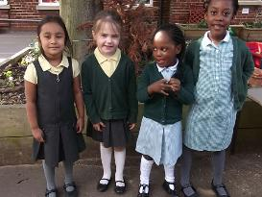
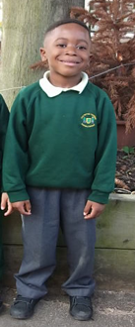
Uniform
At James Cambell Primary School we are proud of our school uniform.
Every child is expected to wear the correct uniform every day.
Please remember to put your child’s name in their clothes so they are not lost
No earrings or jewellery are allowed in Reception.
Children are not to have shoes with laces.
Notes:
AW

Slide 6

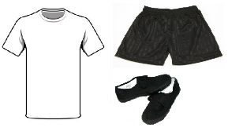
Uniform requirements
Our school uniform | PE Kit
Dark green jumper/cardigan Grey trousers/skirt/pinafore Yellow polo shirt Black school shoes/black trainers (No laces) Grey/ white socks or grey tights A waterproof coat with a hood. | Black shorts White t-shirt (no buttons) Black plimsolls – No laces Hair needs to be tied back
Notes:
AW

Slide 7
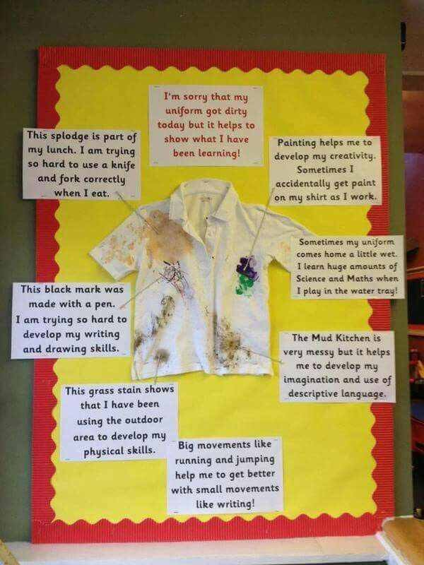
Notes:
AW

Slide 8
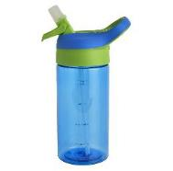
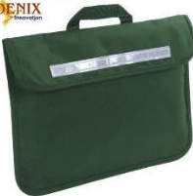
Book Bags and Water Bottles
YOUR CHILD MUST BRING A BOOKBAG AND WATER BOTTLE EVERYDAY!
Notes:
AW

Slide 9



Attendance
‘Research has proven that there is a high correlation between school attendance and academic performance and success, while absence from school is often the greatest single cause of poor performance and achievement.’
Our attendance target is 97%
Parents/Carers will be contacted where there are concerns about attendance
Holidays during term time will not be authorised and may result in a fine
Children with 100% attendance will receive rewards
Notes:
LD

Slide 10



Behaviour
We have high expectations for the behaviour of all children.
At all times in school, children are expected to follow three simple rules of ready, respectful and safe.
Ready | Respectful | Safe
We arrive at school on time We get to lessons on time We wear our uniform correctly and with pride and have the right clothes for PE and playing outdoors We make sure we have the right equipment for all lessons We take part fully in lessons and show resilience | We always listen when someone else is talking We are polite and show good manners to everyone We respect difference and know we are all equal We look after equipment and share it We look after the school environment and never drop litter We are honest and take responsibility for our actions | We follow instructions – first time, every time We stand up to bullying of any kind We line up sensibly and walk quietly around the school We know who to go to for support We stay safe online and outside school
Notes:
LD

Slide 11
Curriculum Coverage
The themes for each term are:
Term1 = All About Me
Term 2 = Puddles to Icicles – Church Nativity
Term 3 = Foot Prints – Farm Visit
Term 4 = Whizz Flash Dash – Superhero Dress Up Day
Term 5 = Growing – Trip to Hainault Forest
Term 6 = Once Upon a Time – Pool and picnic day
You can find further details on the school website.
Notes:
LD

Slide 12


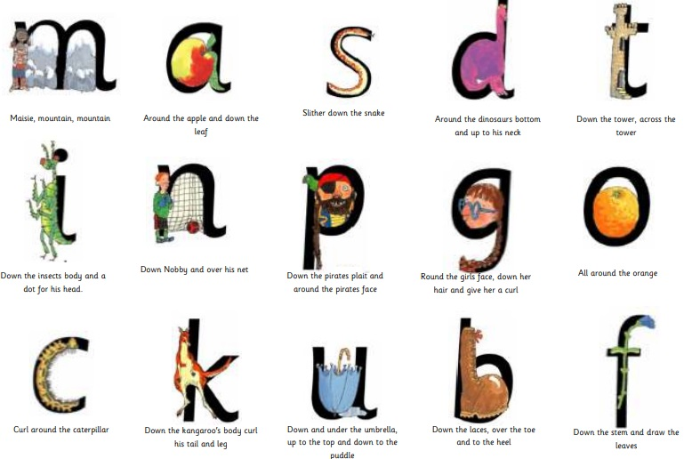
Phonics
We follow the Ruth Miskin’s, Read Write Inc Phonics scheme. This runs throughout the school and is a proven way to successfully teach children to read.

Slide 13

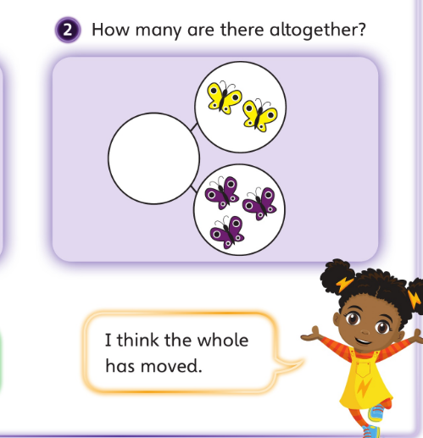
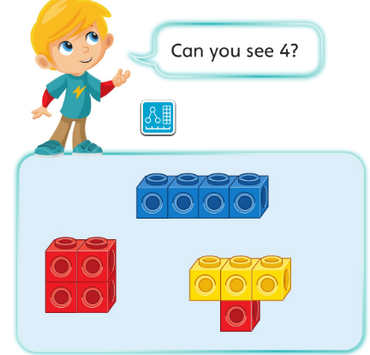
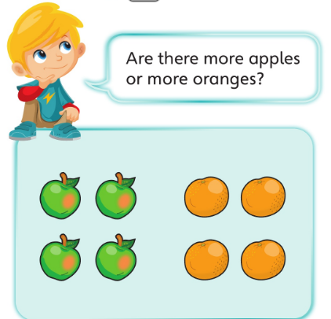
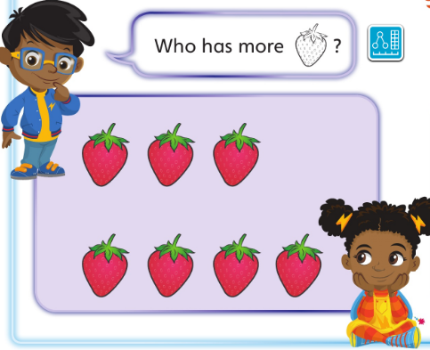
Maths
Many children in Reception can count well above 20 and beyond. However, we focus on mastery at James Cambell and embedding the children’s solid understanding of number.
We focus on numbers up to 10.
We look at number patterns, rules and mathematical language.
4
four

Slide 14
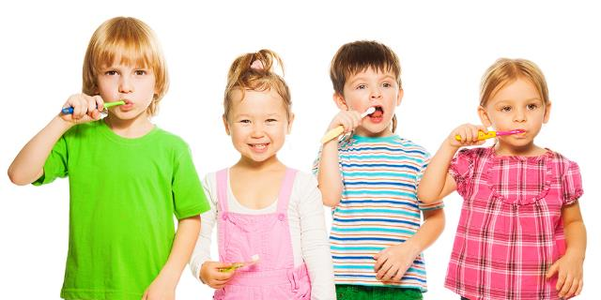
Oral Health in Reception
In the Summer Term Reception will learn to brush their teeth each day to promote good oral health.

Slide 15

Homework
10 minutes reading every day
Regular updates will be put on dojo with extra activities you can complete at home to support your child’s learning.
Notes:
RM

Slide 16


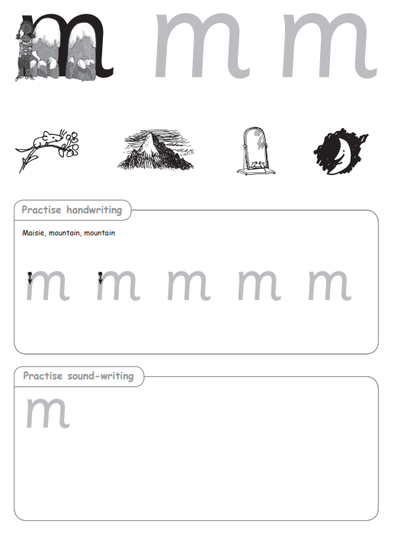

How can I support my child?
Reading with them
Supporting them with their homework
Practising counting and number bonds to 5
Practise name writing
Practising going to the toilet independently
Practising getting changed independently
Following links on the school website
Remember: if you have any questions, you can always send your class teacher a message on Class Dojo or speak to them at the end of the day.
Notes:
RM

Slide 17

Statutory assessments
Reception Baseline Assessment
On leaving the Foundation Stage at the end of Reception, a child is considered to have a 'good level of development' if they have achieved the expected level in the Early Learning Goals in all aspects.
Notes:
RM

Slide 18
Are you eligible for Pupil Premium?
If so, your child will get:
A free, nutritious school meal every day (this would cost £400 per year)
Reduced costs on school trips
Supermarket vouchers during school holidays (for example, this Christmas holiday you will get a £50 voucher)
Extra funding for the school to support your child's learning
In addition, new applicants will receive a £20 voucher to spend on school uniform or books

Slide 19
Who is eligible?
Your child is eligible for Pupil Premium if you receive:
Universal Credit - if you apply on or after 1 April 2018 your household income must be less than £7,400 a year (earnings after tax and not including any benefits you get)
Child Tax Credit (provided you’re not also entitled to Working Tax Credit and have an annual gross income of no more than £16,190)
Income Support
Income-based Jobseeker’s Allowance
Income-related Employment and Support Allowance
support under part VI of the Immigration and Asylum Act 1999
the guaranteed element of Pension Credit
Working Tax Credit run-on - paid for 4 weeks after you stop qualifying for Working Tax Credit

Slide 20
Final Reminders
Please remember the importance of a healthy diet and early nights.
Please also remember the importance of attending school every day and arriving on time - this enables your child to make the most of the learning time available to them.
Please ensure full uniform is worn as this helps children with behaviour while at school and in being ready to learn.
Remember to sign up to ParentMail and Class Dojo.

Slide 21
Thank you
We are happy to answer any questions you may have.

