Slide 1

MEMORIES
DUM, DUM, DUM, DUM, DUM x4
CHORUS
Here's to the ones that we got
Cheers to the wish you were here, but you're not
'Cause the dreams bring back all the memories
Of everything we've been through
Close to the ones here today
Close to the ones that we lost on the way
'Cause the dreams bring back all the memories
And the memories bring back, memories bring back you.
There's a time that I remember, when I did not know no pain
When I believed in forever, and everything would stay the same
Now my heart feel like December when somebody say your name
'Cause I can't reach out to call you, but I know I will one day, yeah
Everybody hurts sometimes
Everybody hurts someday, yeah
But everything will be alright
Go and raise your voice and say, ayy
CHORUS
Doo doo, doo doo doo doo
Doo doo doo doo, doo doo doo doo
Doo doo doo doo, doo doo doo
Memories bring back, memories bring back you
There's a time that I remember when I never felt so lost
When I felt all of the hatred was too powerful to stop
Now my heart feel like an ember and it's lighting up the dark
I'll carry these torches for ya that you know I'll never drop, yeah
Everybody hurts sometimes
Everybody hurts someday, ayy ayy
But everything will be alright
Go and raise your voice and say, ayy
CHORUS
Doo doo, doo doo doo doo
Doo doo doo doo, doo doo doo doo
Doo doo doo doo, doo doo doo
Memories bring back, memories bring back you
Doo doo, doo doo doo doo
Doo doo doo doo, doo doo doo doo
Doo doo doo doo, doo doo doo
Memories bring back, memories bring back you
Yeah, yeah, yeah
Yeah, yeah, yeah, yeah, yeah, doh, doh
Memories bring back, memories bring back you. CHOIR

Slide 2
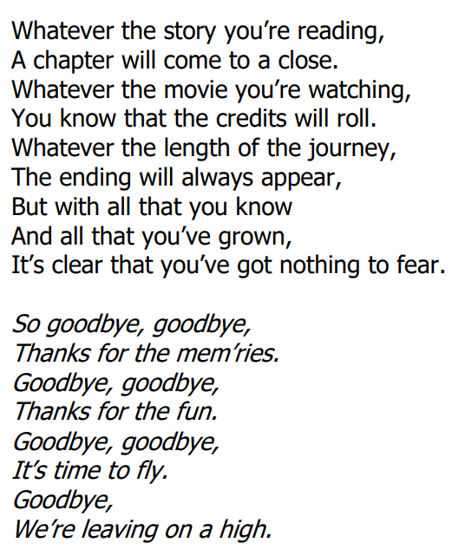
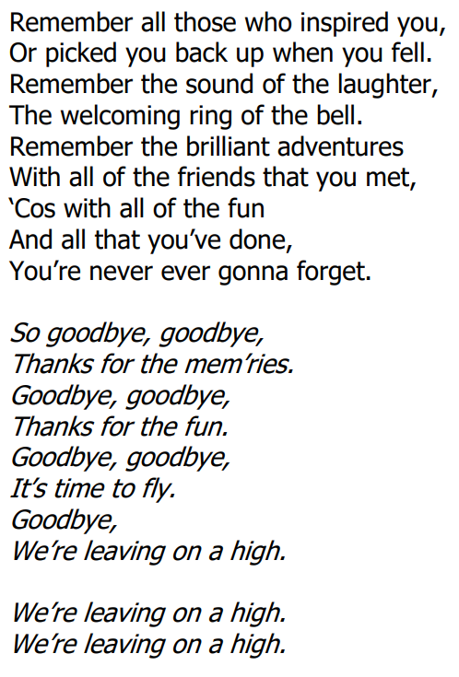


Slide 3
NEVER GONNA GIVE YOU UP
We're no strangers to love
You know the rules and so do I (do I)
A full commitment's what I'm thinking of
You wouldn't get this from any other guy
I just wanna tell you how I'm feeling
Gotta make you understand
Never gonna give you up
Never gonna let you down
Never gonna run around and desert you
Never gonna make you cry
Never gonna say goodbye
Never gonna tell a lie and hurt you
We've known each other for so long
Your heart's been aching, but you're too shy to say it (say it)
Inside, we both know what's been going on (going on)
We know the game and we're gonna play it
And if you ask me how I'm feeling
Don't tell me you're too blind to see
CHORUS x 2
Ooooh, give you up
Never gonna give, never gonna give
We've known each other for so long
Your heart's been aching, but you're too shy to say it (to say it)
Inside, we both know what's been going on (going on)
We know the game and we're gonna play it
I just wanna tell you how I'm feeling
Gotta make you understand
CHORUS x 3
Sing along - https://www.youtube.com/watch?v=dQw4w9WgXcQ
Backing track - https://www.youtube.com/watch?app=desktop&v=5bCwue1d9Js

