Slide 1
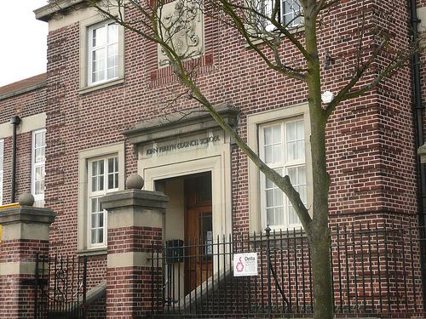
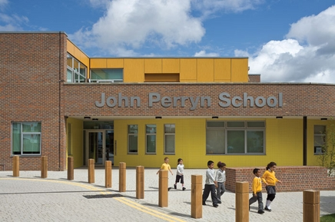
Happy 90th Birthday
John Perryn!
Notes:
Chilene B: Welcome to our special 80th Birthday Assembly
It is so wonderful to see so many guests at our special celebration
Child B:
Miss Fowler comes up to the children
Ms Fowler: Children I have a special job that I would like you to do for me
B Children : Yes, Miss Fowler?
Miss F: I want you to show these children around the school – Its their first day today
Hashim: Come with us We’ll take you on a tour -please ask us any questions about the school
Children singing Happy Birthday
Kyle: I’ve got a question- why are they singing happy birthday to John Perryn?
Elena: Well it’s John Perryn’s birthday – our school is 80 years old today!
Shirea: But who was John Perryn?
All A children: Who was John Perryn?
Rahma: I don’t know. Do you know ?
Abdi Salaam: Ask a Teacher ?
Hashim: Mr Diaz, Who was John Perryn ?
Mr Diaz: Shrugs shoulders and looks at other teachers they all shrug shoulders

Slide 2
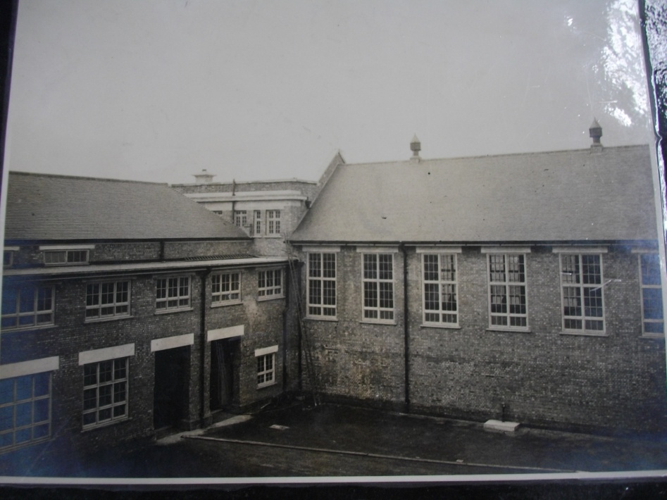
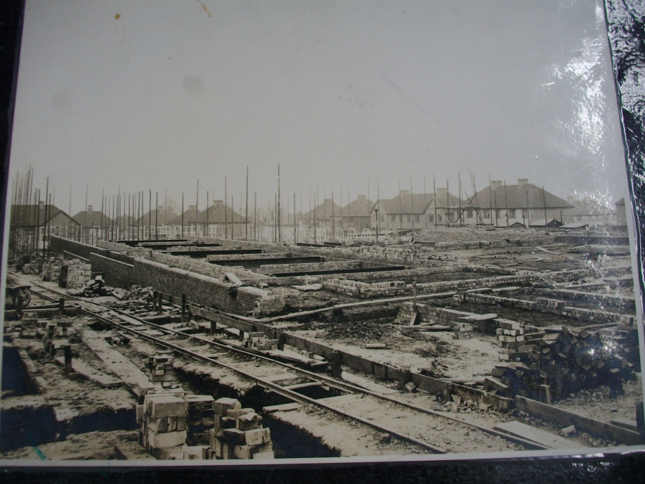
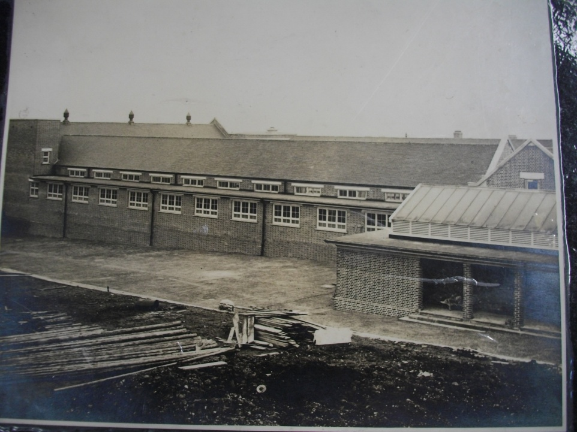
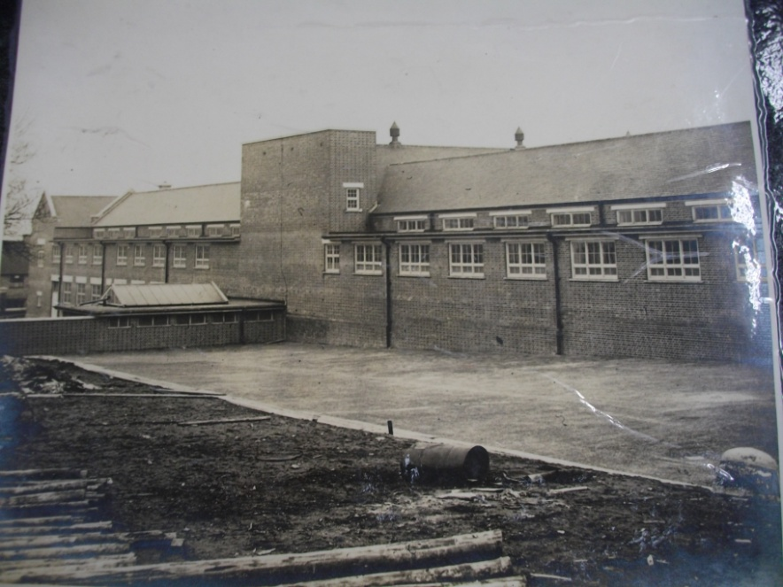
Building John Perryn in 1931

Slide 3
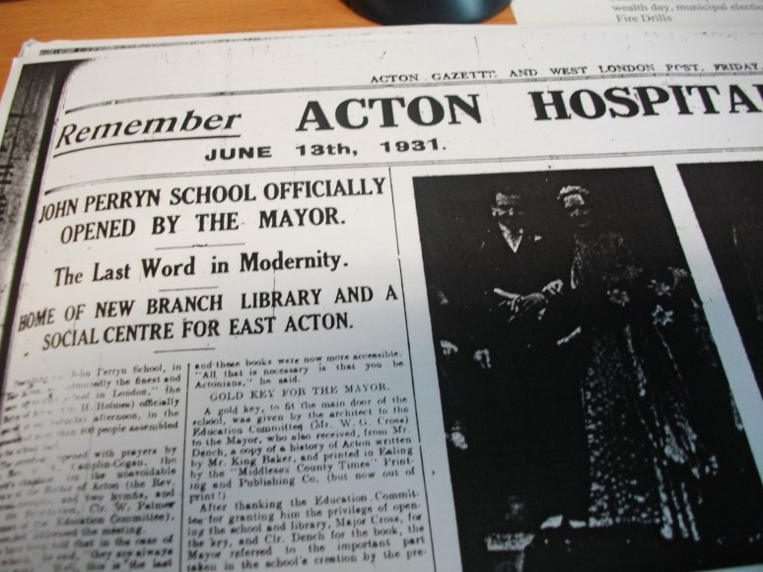
School Opened 13th April 1931
Opened by the Mayor of Acton – Clr H. Holmes
It cost £45,000 to build
There were three Head teachers Mr Pursar (Seniors) Mr E. Sparshott (Juniors) and Miss Beatrice Upton (Infants)
There were 480 pupils at the school.
The Mayor said,
“Our children are the most highly – prized possessions; they are both the wealth and capital of our country; on them rests the future development of the Empire.” (Acton Gazette June 12th 1931)

Slide 4
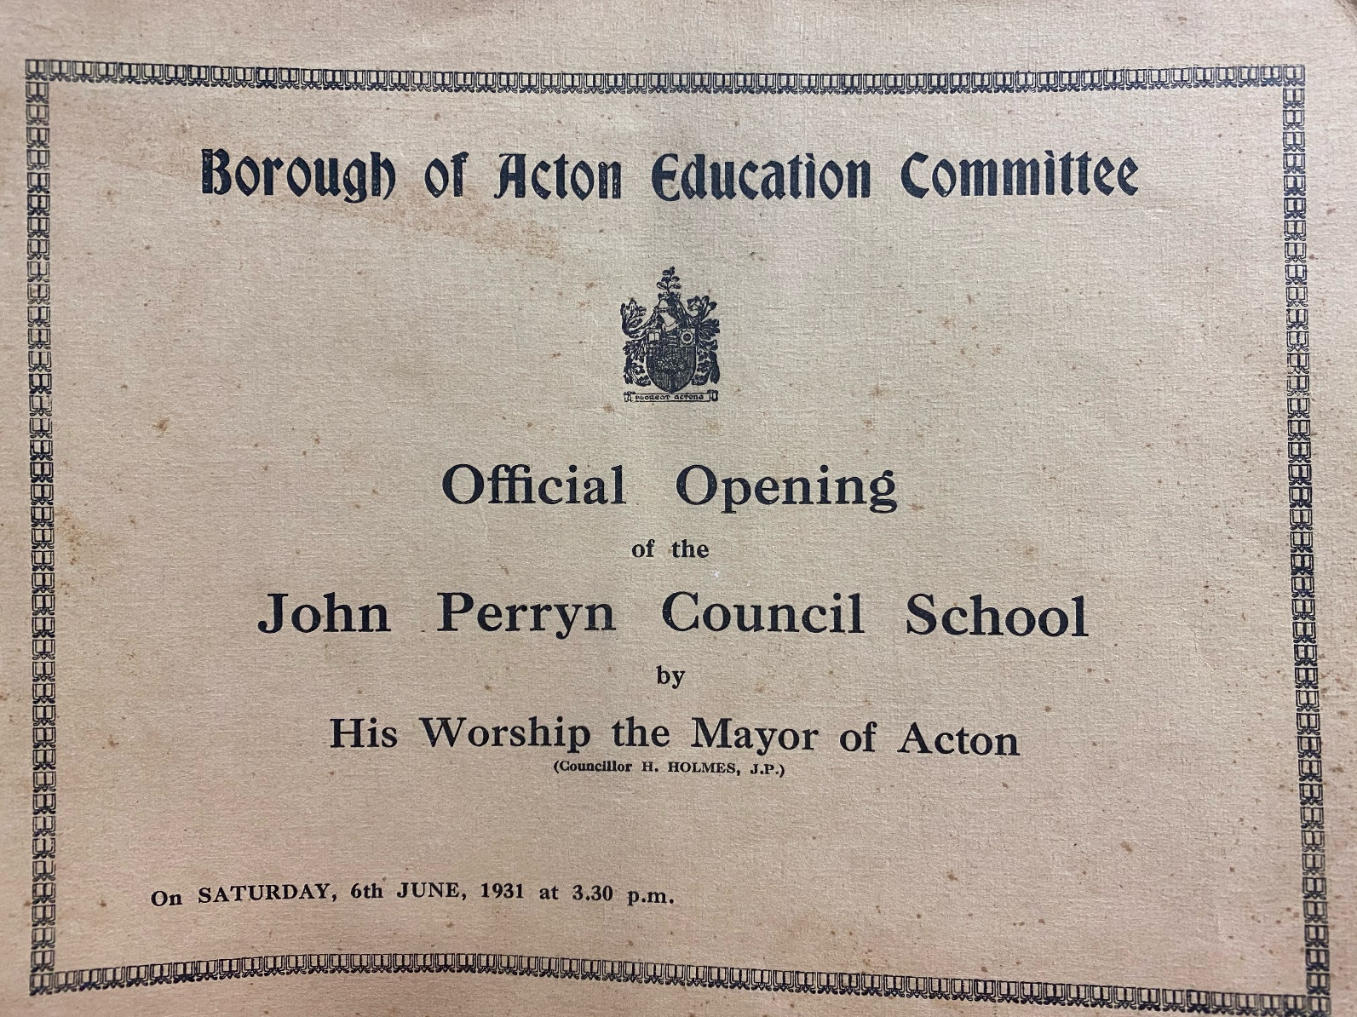
Official School Opening Brochure

Slide 5
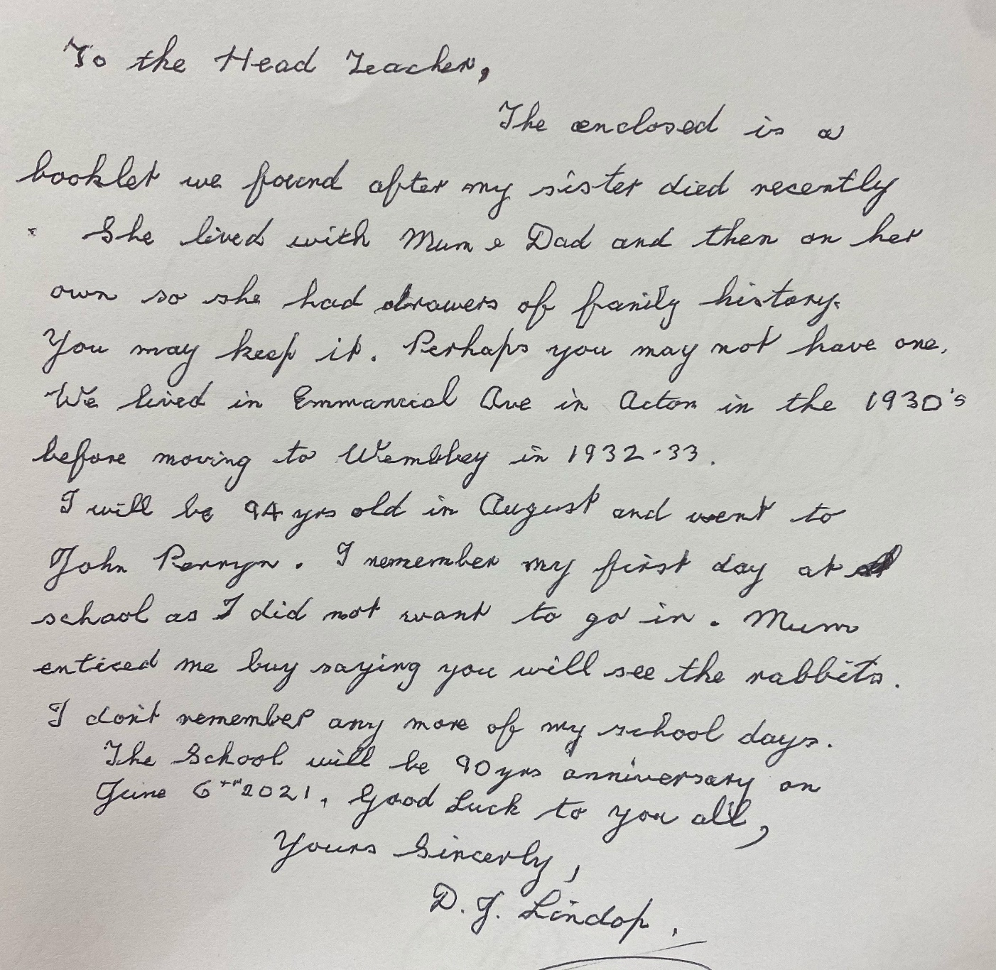
“We lived in…Acton in the 1930’s.”
“I will be 94 years old in August and went to John Perryn.”
“90 years anniversary on June 6th 2021.”

Slide 6
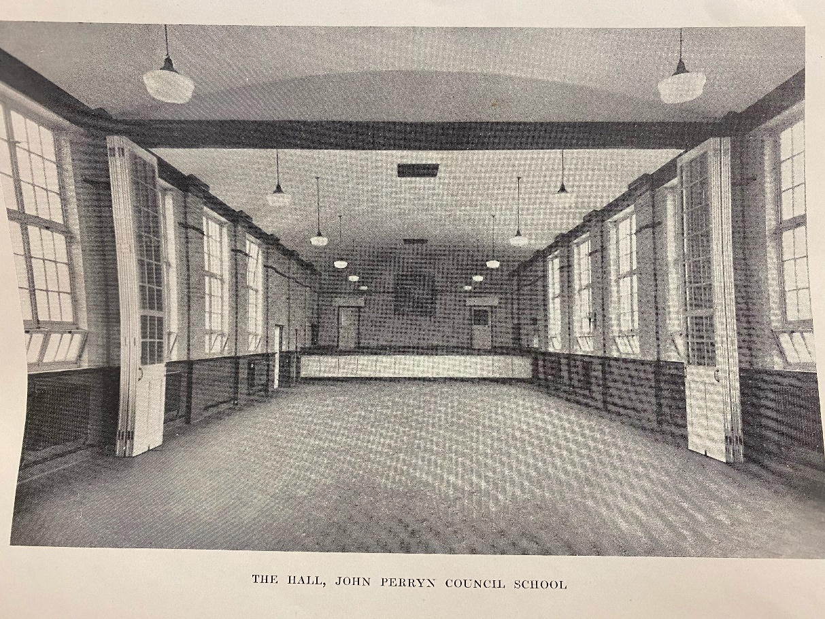

Slide 8
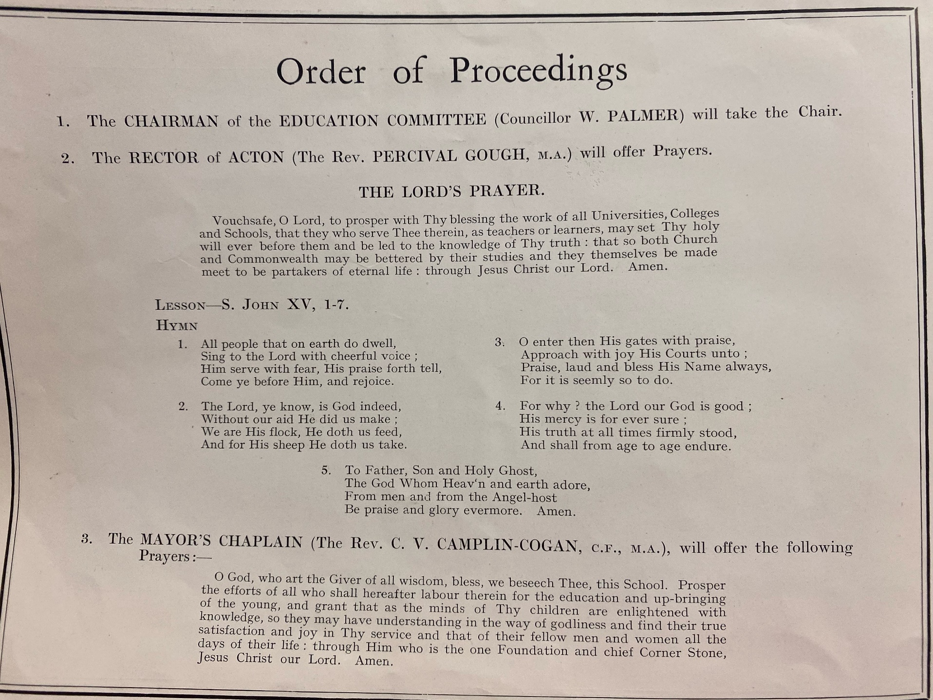

Slide 9
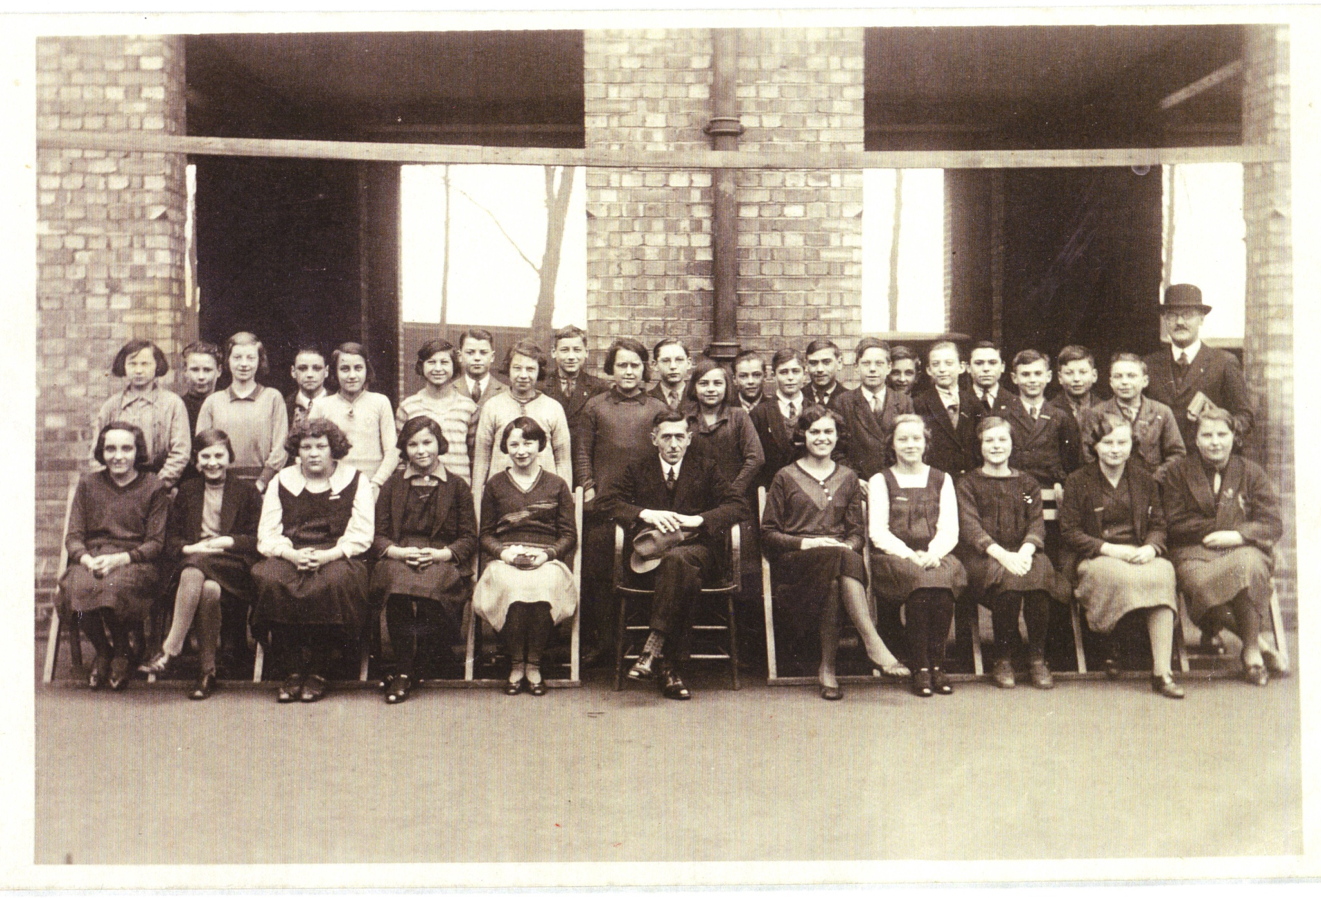
Head of the Senior School Mr Pursar (Bowler Hat) 1931

Slide 10
First School Inspection - 1935
What did they say? The headmaster is anxious for the success of his new school He sets a good example and he is very industrious The teachers prepare their lessons carefully and the use of illustration deserves praise The children’s arithmetic in particular is good The children are keen and alert (in some classes) Signed Mr Smart the Director of Education

Slide 11
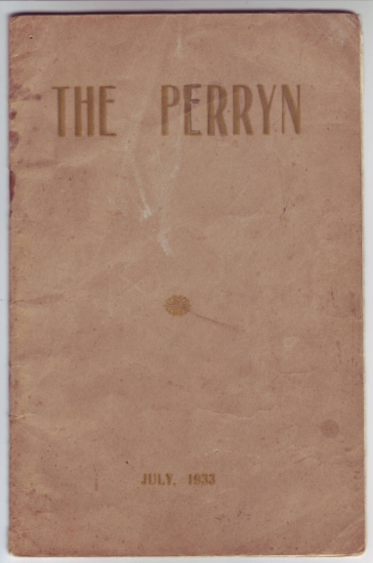
THE PERRYN
Mr Sparshott – Junior headmaster in 1933
“ We are yet to find a girl or boy who hasn't benefitted from his or her stay at John Perryn.”
“ What lies in the future none can tell : ‘Wisely and lovingly, Heaven from all creatures hides the book of Fate’, but we believe that mountains of apparent worry and trouble will crumble before our cheerful efforts and boundless optimism.”

Slide 12
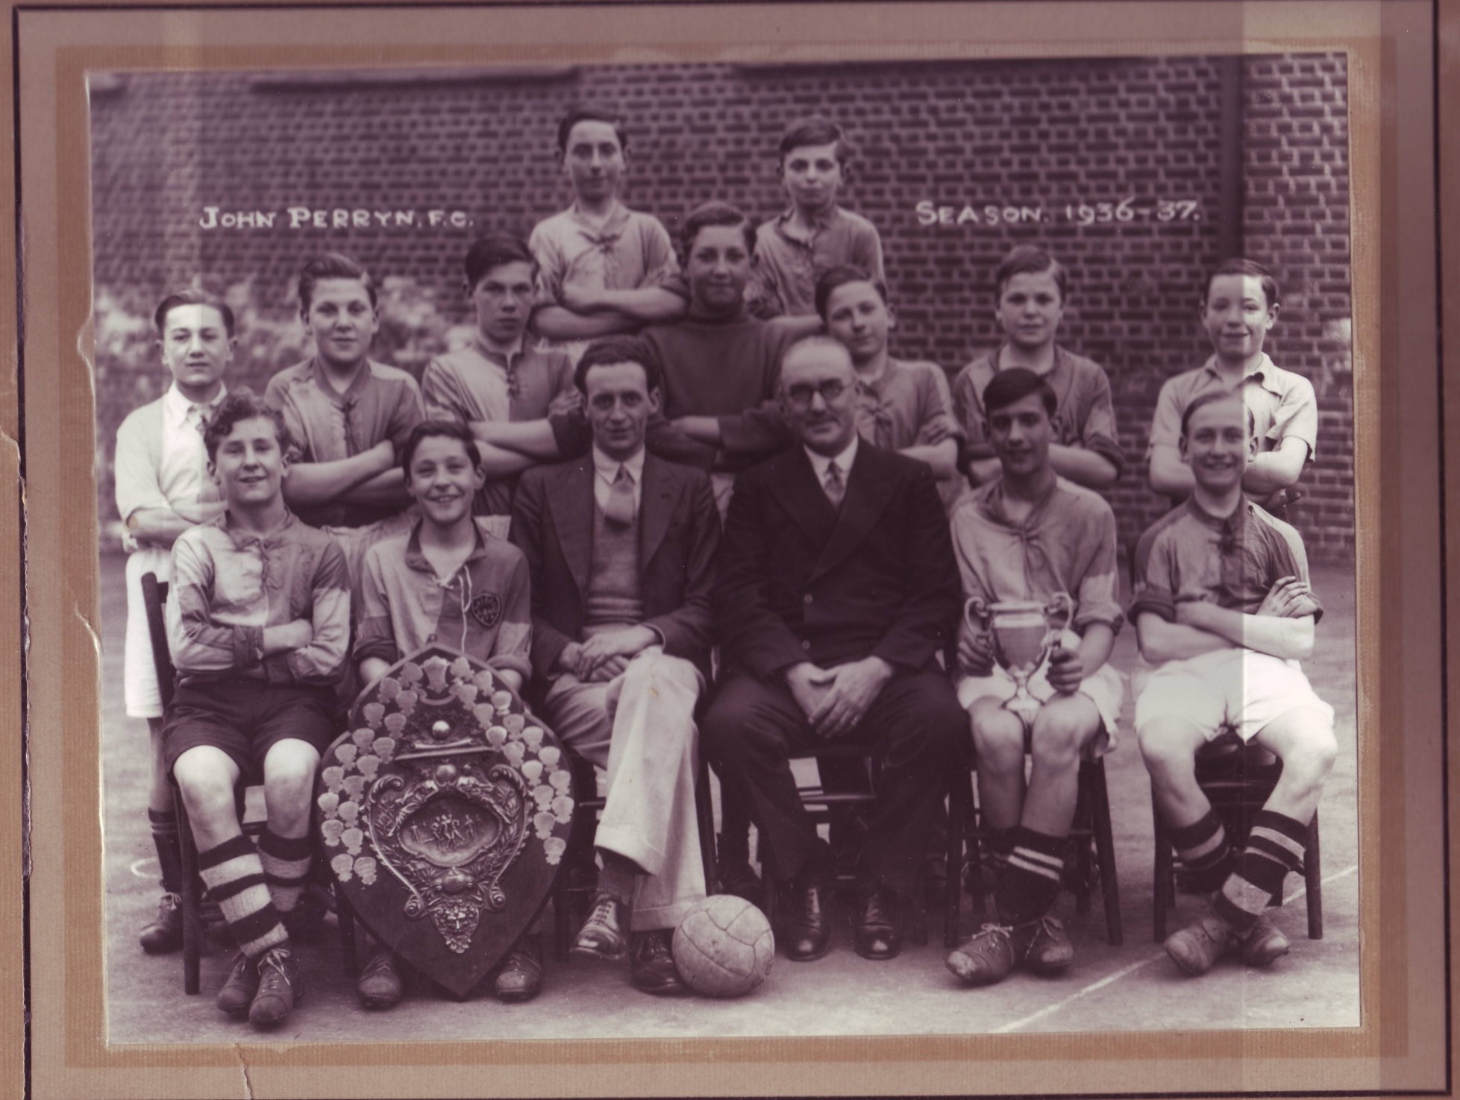
Here are some past pupils of John Perryn over the 90 years.

Slide 13
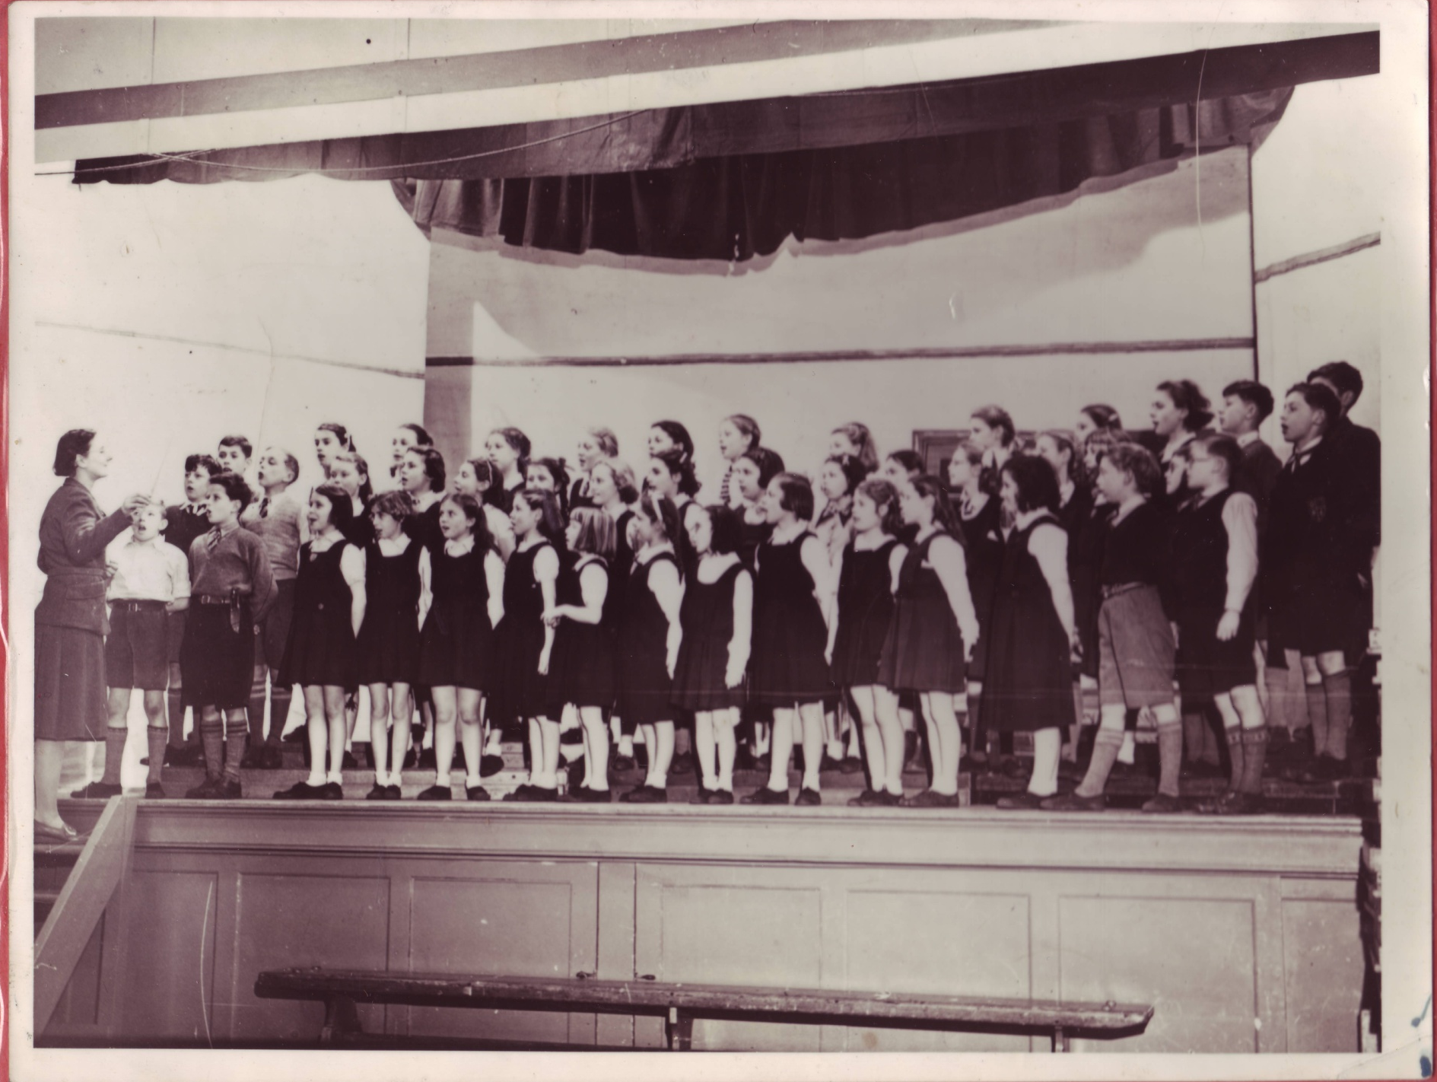
Notes:
Here is

Slide 14
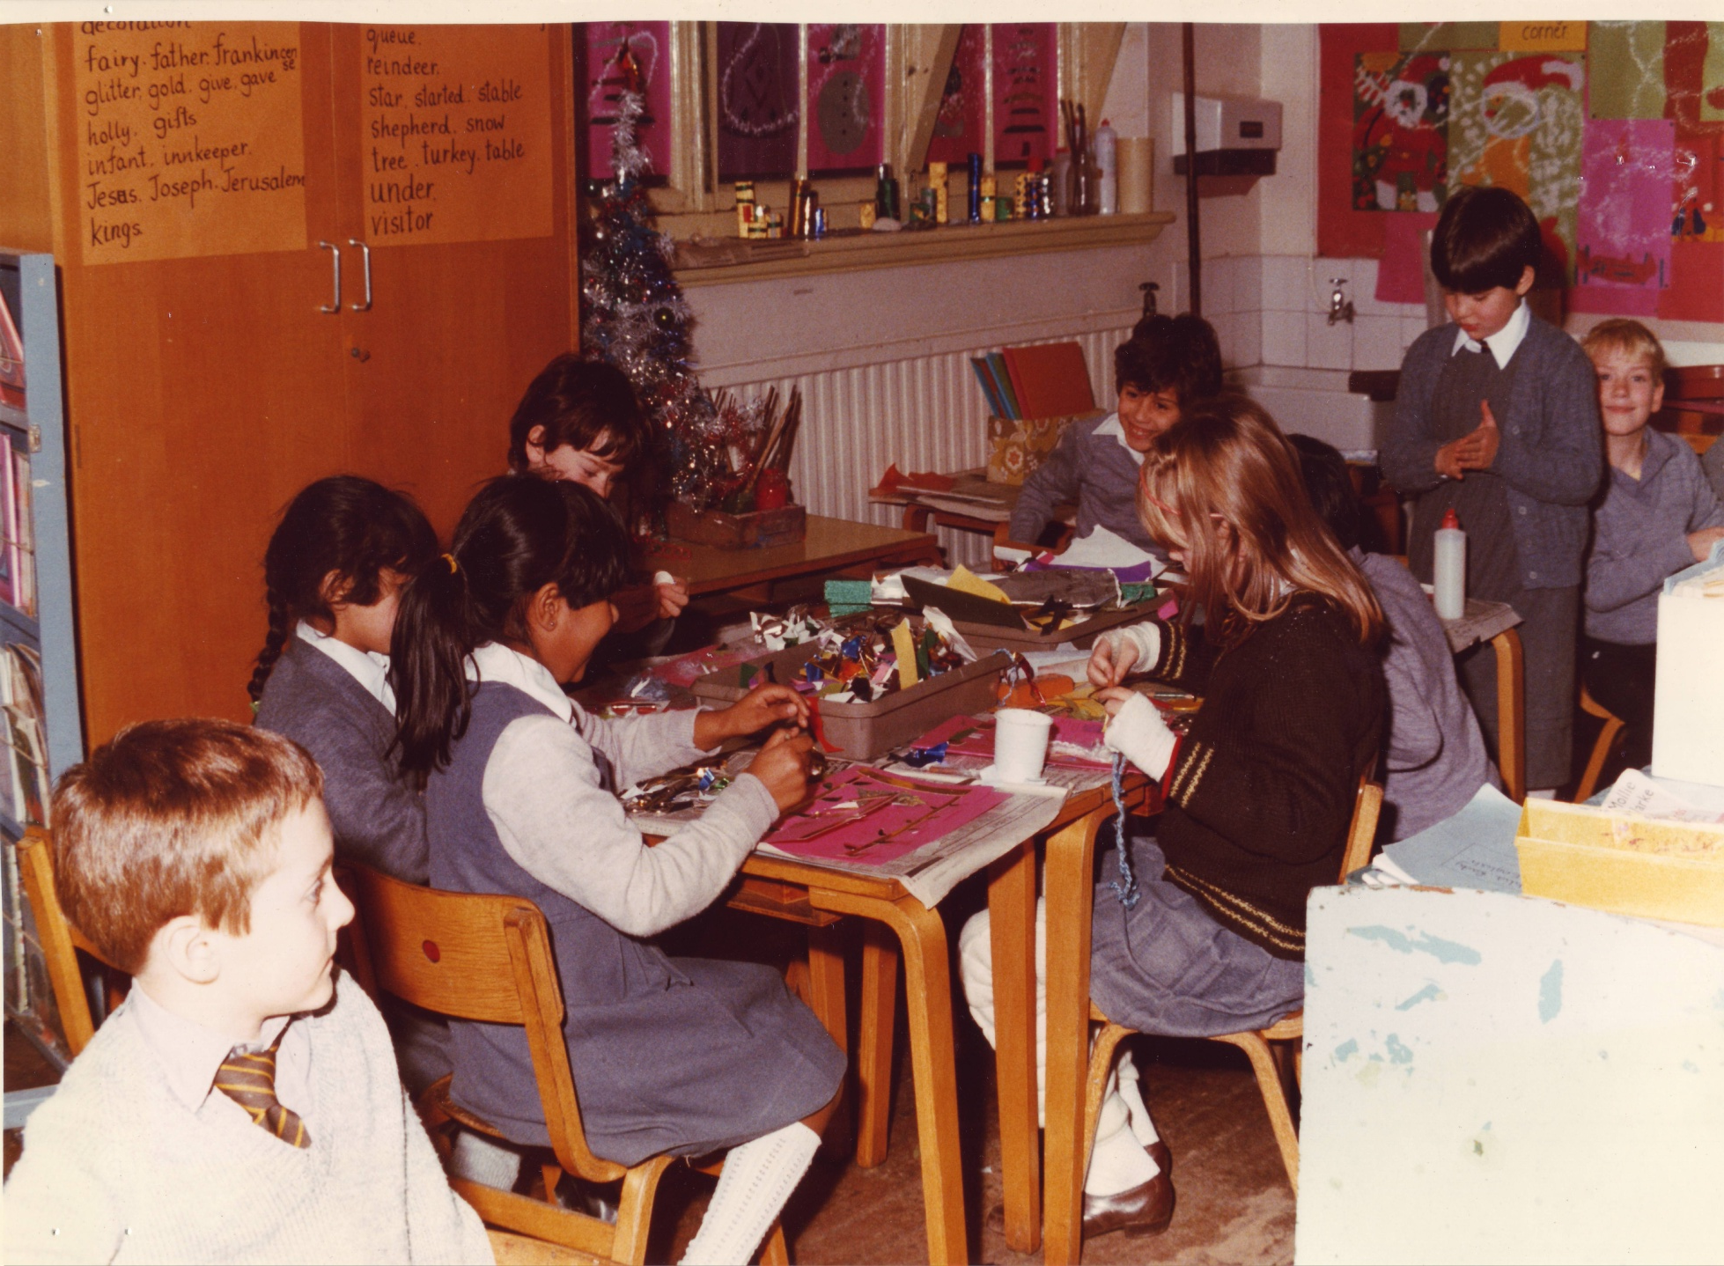

Slide 18
How do you think the school has changed since it opened in 1931?

Slide 19
Many children and teachers have passed through the doors of John Perryn School. May we continue to hope and pray for health, happiness and success for all our students. Past, present and Future.

