Slide 1


Dear Parents,
These are phonics resources to help your child learn to identify the sounds taught
in KS1. There is then an opportunity for children to read the sounds in words. (green words)
Included are also nonsense or alien words. This practise is mainly for Year 1 and any children
who will do the Phonics Screening Check in Year 2.
Once your child is confident identifying the sound, and reading it in the given words, they could
then practise spelling 3 words containing the sound.
A phonics session could include:
An adult teaching the new sound.
The child practising writing this sound.
The child reading the green and nonsense words with an adult’s help.
The child spelling 3 words containing the target sound.
Reviewing 2 sounds taught previously by reading a few green/nonsense words.
www.phonicsplay.co.uk has a wide selection of fun phonics games for children.
It is free on this login

Slide 2
Online Phonics Sessions
Read Write Inc phonics is posting daily sound lessons for set 1, set 2 and set 3 sounds.
Set 1 Speed Sounds at 9.30 am and again at 12.30 pm Set 2 Speed Sounds at 10.00 am and again at 1.00 pm Set 3 Speed Sounds at 10.30 am and again at 1.30 pm
Note: films are streamed live and won’t be available at other times.
https://www.youtube.com/channel/UCo7fbLgY2oA_cFCIg9GdxtQ

Slide 3
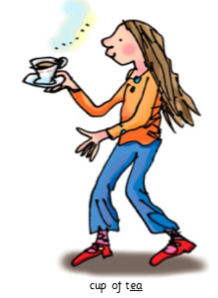

ea
cup of tea
sea
tea
seat
dream
clean
scream
teapot
tream
streag

Slide 4
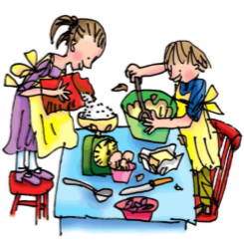
oi
spoil the boy
oil
join
coin
spoil
voice
point
noisy
koid
gloith

Slide 5
a-e
make a cake
make
cake
name
same
late
date
plate
snakes
whape
spale

Slide 6
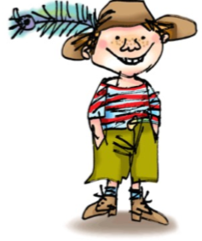
i-e
nice smile
like
time
hide
smile
white
nice
ice-cream
jite
pribe

Slide 7
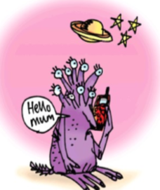
o-e
phone home
home
hope
spoke
broke
phone
notebook
quove
chobe

Slide 8
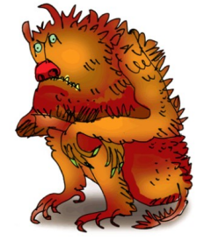
u-e
huge brute
June
rude
cube
huge
cute
brute
include
gute
flune

Slide 9
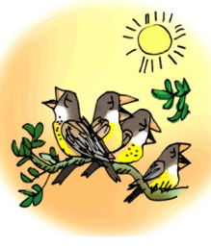
aw
yawn at dawn
saw
raw
draw
straw
paw
yawn
crawls
hawt
traw

Slide 10
are
care and share
care
share
bare
spare
scare
square
careful
tare
slare

Slide 11
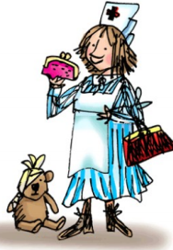
ur
nurse with a purse
fur
hurt
burn
turn
nurse
purse
slurping
yurk
sturp

Slide 12
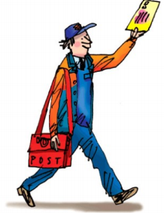
er
better letter
her
over
never
corner
better
after
weather
herk
clerm

Slide 13
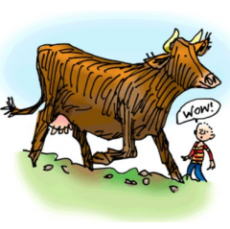
ow
brown cow
how
cow
now
brown
crown
town
allow
growb
owlp

Slide 14
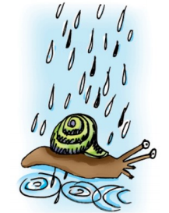
ai
snail in the rain
rain
tail
snail
paid
train
stain
paintbrush
chaik
prail

Slide 15
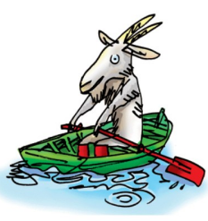
oa
goat in a boat
goat
boat
road
coat
throat
toast
cloak
zoat
yaist

Slide 16
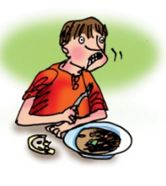
ew
chew the stew
few
new
chew
threw
knew
flew
grew
stew
kew
trews

Slide 17
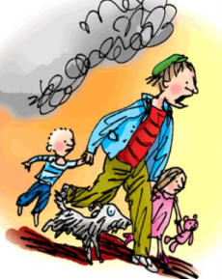
ire
fire, fire!
fire
wire
spire
hire
bonfire
inspire
cire
stire

Slide 18
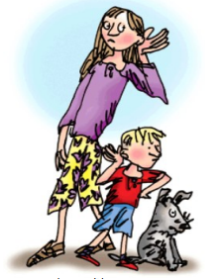
ear
hear with your ear
ear
hear
fear
beard
spear
dear
clearest
jear
flear

