Slide 1


Dear Parents,
These are phonics resources to help your child learn to identify the sounds taught
in KS1. There is then an opportunity for children to read the sounds in words. (green words)
Included are also nonsense or alien words. This practise is mainly for Year 1 and any children
who will do the Phonics Screening Check in Year 2.
Once your child is confident identifying the sound, and reading it in the given words, they could
then practise spelling 3 words containing the sound.
A phonics session could include:
An adult teaching the new sound.
The child practising writing this sound.
The child reading the green and nonsense words with an adult’s help.
The child spelling 3 words containing the target sound.
Reviewing 2 sounds taught previously by reading a few green/nonsense words.
www.phonicsplay.co.uk has a wide selection of fun phonics games for children.
It is free on this login

Slide 2


ie
I spied a pie.
pie
tie
lie
lied
cried
tired
quiet
untie
tream
streag

Slide 3
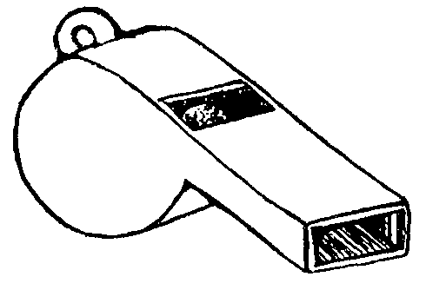
wh
a white whistle
when
wheel
whale
white
while
whisper
whistle
whapt
wheck

Slide 4

ph
elephant on a phone
phone
dolphin
trophy
photo
sphere
nephew
elephant
phol
phonit

Slide 5

oe
Joe, touch your toe
Joe
toe
foe
doe
goes
heroes
tomatoes
potatoes
phoe
stroe

Slide 6
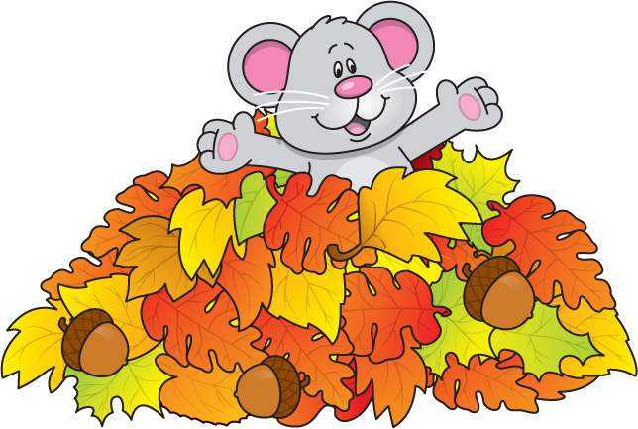
au
launch autumn leaves
Paul
haunt
launch
pause
author
August
because
vaun
jaubs

Slide 7
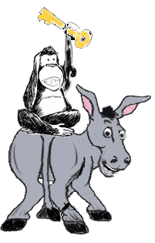
ey
monkey on a donkey
key
donkey
monkey
turkey
trolley
money
honey
chimney
drey
bley

Slide 8

e-e
Pete the athlete
Pete
these
complete
delete
athlete
evening
concrete
veme
splete

Slide 9

ue
a true clue
true
clue
blue
glue
rescue
argue
tissue
leu
kesue

Slide 10
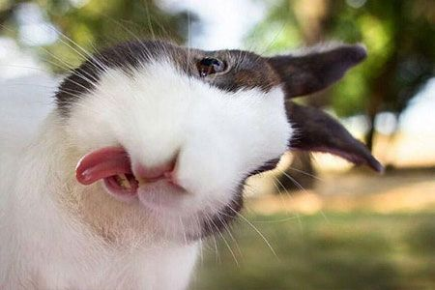
y
funny bunny
funny
bunny
silly
spotty
belly
smelly
baby
lucky
ly
bly

Slide 11

ff
coffee and muffin
puff
fluff
cliff
muffin
stuff
coffee
sniff
bluffing
shiff
biffs

Slide 12

ll
smelly jelly
fell
bell
shell
smell
doll
silly
still
jelly
thell
shilly

Slide 13

ss
class on the grass
hiss
miss
pass
class
boss
press
grass
classroom
kliss
wess

Slide 14

zz
pizza and fizz
fizz
buzz
jazz
puzzle
fuzzy
buzzy
sizzle
whizz
grizz
trazz

Slide 15
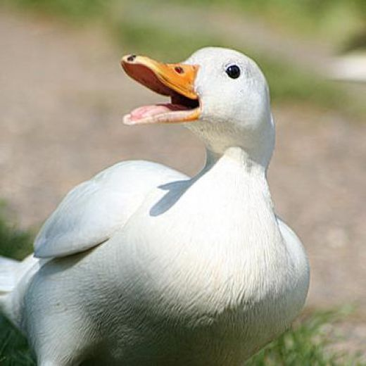
ck
ducks’ quack
duck
pick
trick
back
quick
bucket
shipwreck
cruck
strack

