Slide 1



English
We will begin our writing by looking at the text Rooftoppers by Katherine Rundell, where we will write a character description and a newspaper article. We will apply our VIPERS skills to understand and to develop our writing and to enjoy the novel.
Curriculum – History
This term, our curriculum focus is History. Our learning question is, ‘How do we know what it was like to live an Anglo-Saxon life?
We will be using historical skills to enquire into life after the Roman conquest in Britain – the people known as the Anglo-Saxons. We will explore their society during this period alongside conflicts, settlements and how the Vikings affected Anglo-Saxon life.
Maths
This term, we will be learning about place value of numbers to one million to ensure we have a strong understanding of the number system. We will then go on to study formal methods of addition and subtraction applying these to reasoning problems.
Please keep up practice on timetables at home. We are continually practising our number fluency in school to revisit the `basics` and to keep our brains ticking.
Login details for Times Tables Rock Stars (TTRS) can be found at the front of your child`s homework books.
Science
This term, we will be learning and making investigations into properties of materials by comparing materials across different states. We will learn about reversible and irreversible changes, mixing and separating materials and revisit our knowledge of solids, liquids and gases.
Year 5 Newsletter
Autumn Term 1, 2024
Homework
Children will be assigned homework on a Friday, which will be due in the following Thursday. Children will be given homework books.
Homework will entail research, quizzes and recapping previous learning alongside self-discovery around our curriculum topic of History.
Children may be given additional homework in relation to English and Maths, but this will be given at teacher discretion.
If you have any issues with your child returning homework or struggling with homework, please contact Miss Rands ASAP.
Wider Curriculum
Jigsaw – Being me in my world
Computing – E-safety and digital Literacy
Music – Rock music – Livin’ on a prayer
PE- Body management and invasion games
Spellings – .In school we will be using the Scode spelling scheme to set and assess our spellings.
PE - is on a Monday afternoon – please ensure full kit is in school at all times and our uniform policy is adhered to for health and safety.
Reading
Please continue to support your child to continue a love of reading. Reading records should be filled in 5 times per week and returned to school every Friday. Please contact Miss Rands if you need any suggestions for new books/authors/genres to read! I’ll be more than happy to help you find something you love.
Most importantly – enjoy your reading time!
.

Slide 2

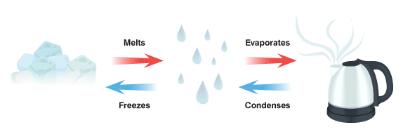
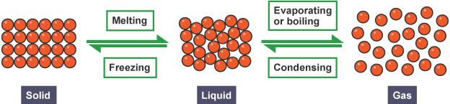
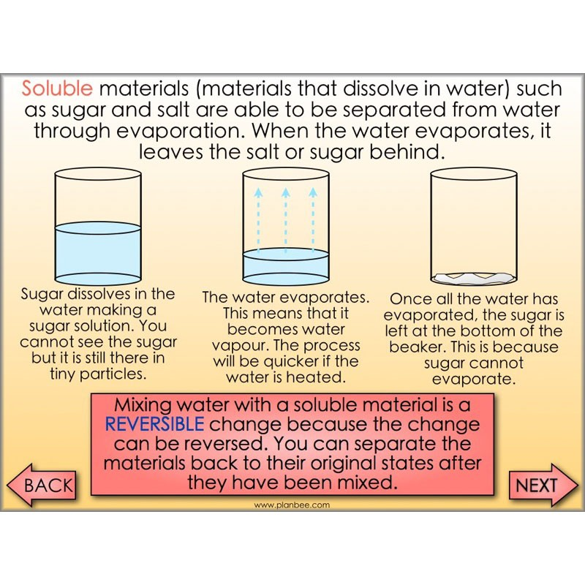
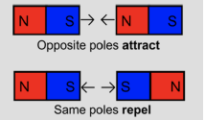
Year 5 – Properties of Materials
Vocabulary
Conductor | A material which allows heat, sound or electricity to pass through.
Dissolve | When something solid mixes with a liquid and becomes part of the liquid.
Evaporation | The process of turning from liquid to vapour.
Flexible | Capable of bending easily without breaking.
Gas | A substance which expands freely to fill any space available.
Insulator | A material which does not allow passage of heat, electricity or sound.
Liquid | A substance that flows freely. It is measured by volume.
Magnetic | Capable of being magnetised.
Opaque | Light cannot pass through.
Solid | Firm and stable in shape, not a liquid
Soluble | Able to be dissolved, especially in water
Transparent | See through; allows all light to pass through
Thermal | Relating to heat
States of Matter
Separating Solids and Liquids
Filtering | Separates an insoluble solid from a liquid.
Sieving | Separates solids of different sizes
Evaporation | Separating dissolved substances from liquids.
How magnets work
Magnets have a North and a South Pole. North is often Red while South is often Blue. Arrows show the direction of the force in this diagram:
Reversible and Irreversible Changes
Reversible change | Changes that are not permanent. Dissolving, mixing, melting, freezing are reversible changes. E.g. water turning to ice or water vapour.
Irreversible change | Changes that are permanent and cannot be undone. This results in the making of a new material. E.g. burning wood, baking a cake.

Slide 3


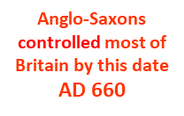
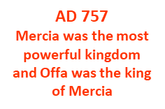

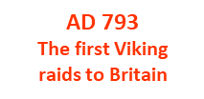

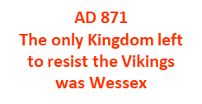

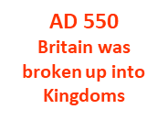
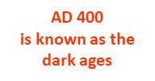

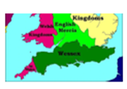




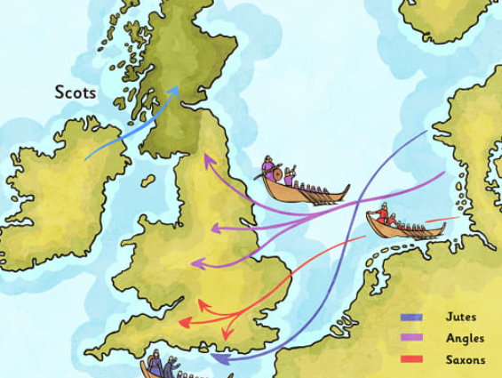
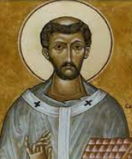
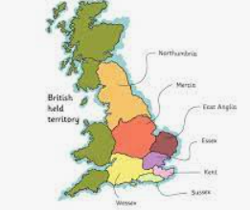
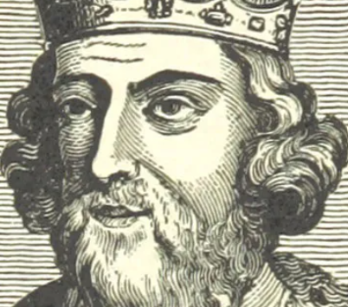
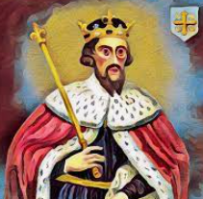
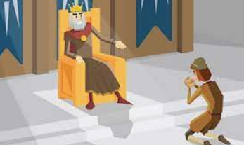
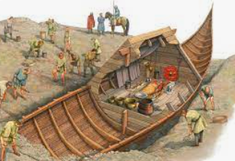
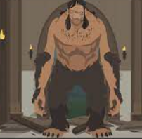
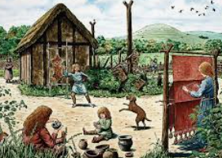
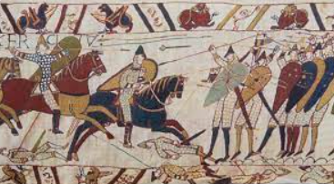
Vocabulary
Key Information
England was attacked from Ireland (by Scots) and Europe (by Saxons). Britain then became ‘Anglo-Saxon’.
A very old and popular story that may be true.
legend
kingdom | A country/region ruled by a king or queen.
culture
Christianity
laws | A system of rules that a society must live by.
raids
runestones
Treaty
Christianity became central to Anglo-Saxon life.
The habits/behaviours of a group of people.
A religion based on the teachings of Jesus Christ.
Despite a treaty, Wessex was split between King Alfred and the Danes.
East Anglia on the East coast of Britain is named after the Angles who settled there.
A sudden, armed attack to steal from or cause damage
to a place.
The Vikings raided England and eventually invaded its kingdoms. King Alfred of Wessex resisted!
Anglo-Saxon kings laid down laws called ‘dooms’.
A raised stone that has (usually) ancient writing on it.
A written agreement between countries in which they agree to do something or to help each other.
Two sources of evidence on Anglo – Saxon life is Beowulf and Sutton Hoo.
Conflict continued between Anglo-Saxons and Vikings until Harold Godwinson died at Hastings.
Anglo-Saxon life was uncomfortable.

