Slide 1
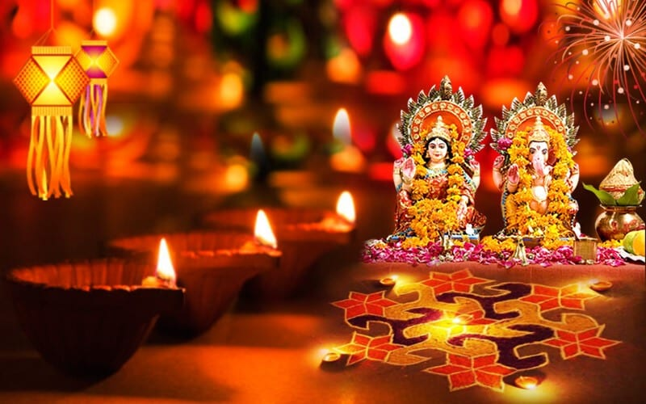


English
This half term we will be looking at the book `Pax` we will become the character `Peter` and write letters to Pax. We will then think about the question `Should we keep foxes as pets?` We will be researching the question and answering this through a balanced argument.
Curriculum – RE
This half term our RE focus enquiry question will be `Why is it important to show commitment to God for different people?` to answer this question we will be exploring the religions and beliefs of both Hinduism and Christianity. We will be exploring how these religions show commitment to God through rich discussion, debate and questioning.
Design and Technology
We will also be researching and designing packaging for our own, home baked mince pies.
Maths
This half term, we will be applying our multiplication knowledge to division and begin to look at fractions, applying all these to reasoning problems.
Please keep up practice on timetables at home. We are continually practising our number fluency in school to revisit the `basics` and to keep our brains ticking.
Science
We will be continuing to make investigations into properties of materials by comparing materials across different states. We will learn about reversible and irreversible changes, mixing and separating materials and revisit our knowledge of solids, liquids and gases.
Year 5 Newsletter
Autumn term 2, 2024
Wider Curriculum
PSHE – Celebrating difference
Computing – Computer Science
Music – Singing with Mrs Pearson
PE- Dance and Athletics.
Spellings – We will continue to complete our spellings using the Scode spelling scheme.
Performance: We will produce and present our own musical Christmas story, just before Christmas.
PE - is on a Monday afternoon – please ensure full kit is always in school and our uniform policy is adhered to for health and safety.
Reading
Please continue to support your child to continue a love of reading. Reading records should be filled in 5 times per week and returned to school every Friday. Please contact Miss Rands if you need any suggestions for new books/authors/genres to read! I’ll be more than happy to help you find something you love.
Most importantly – enjoy your reading time!
.
Homework
Children will be assigned homework on a Friday, which will be due in the following Thursday.
Homework will entail research, quizzes and recapping previous learning.
If you have any issues with your child returning homework or struggling with homework, please contact Miss Rands ASAP.
This Photo by Unknown Author is licensed under CC BY-NC

Slide 2
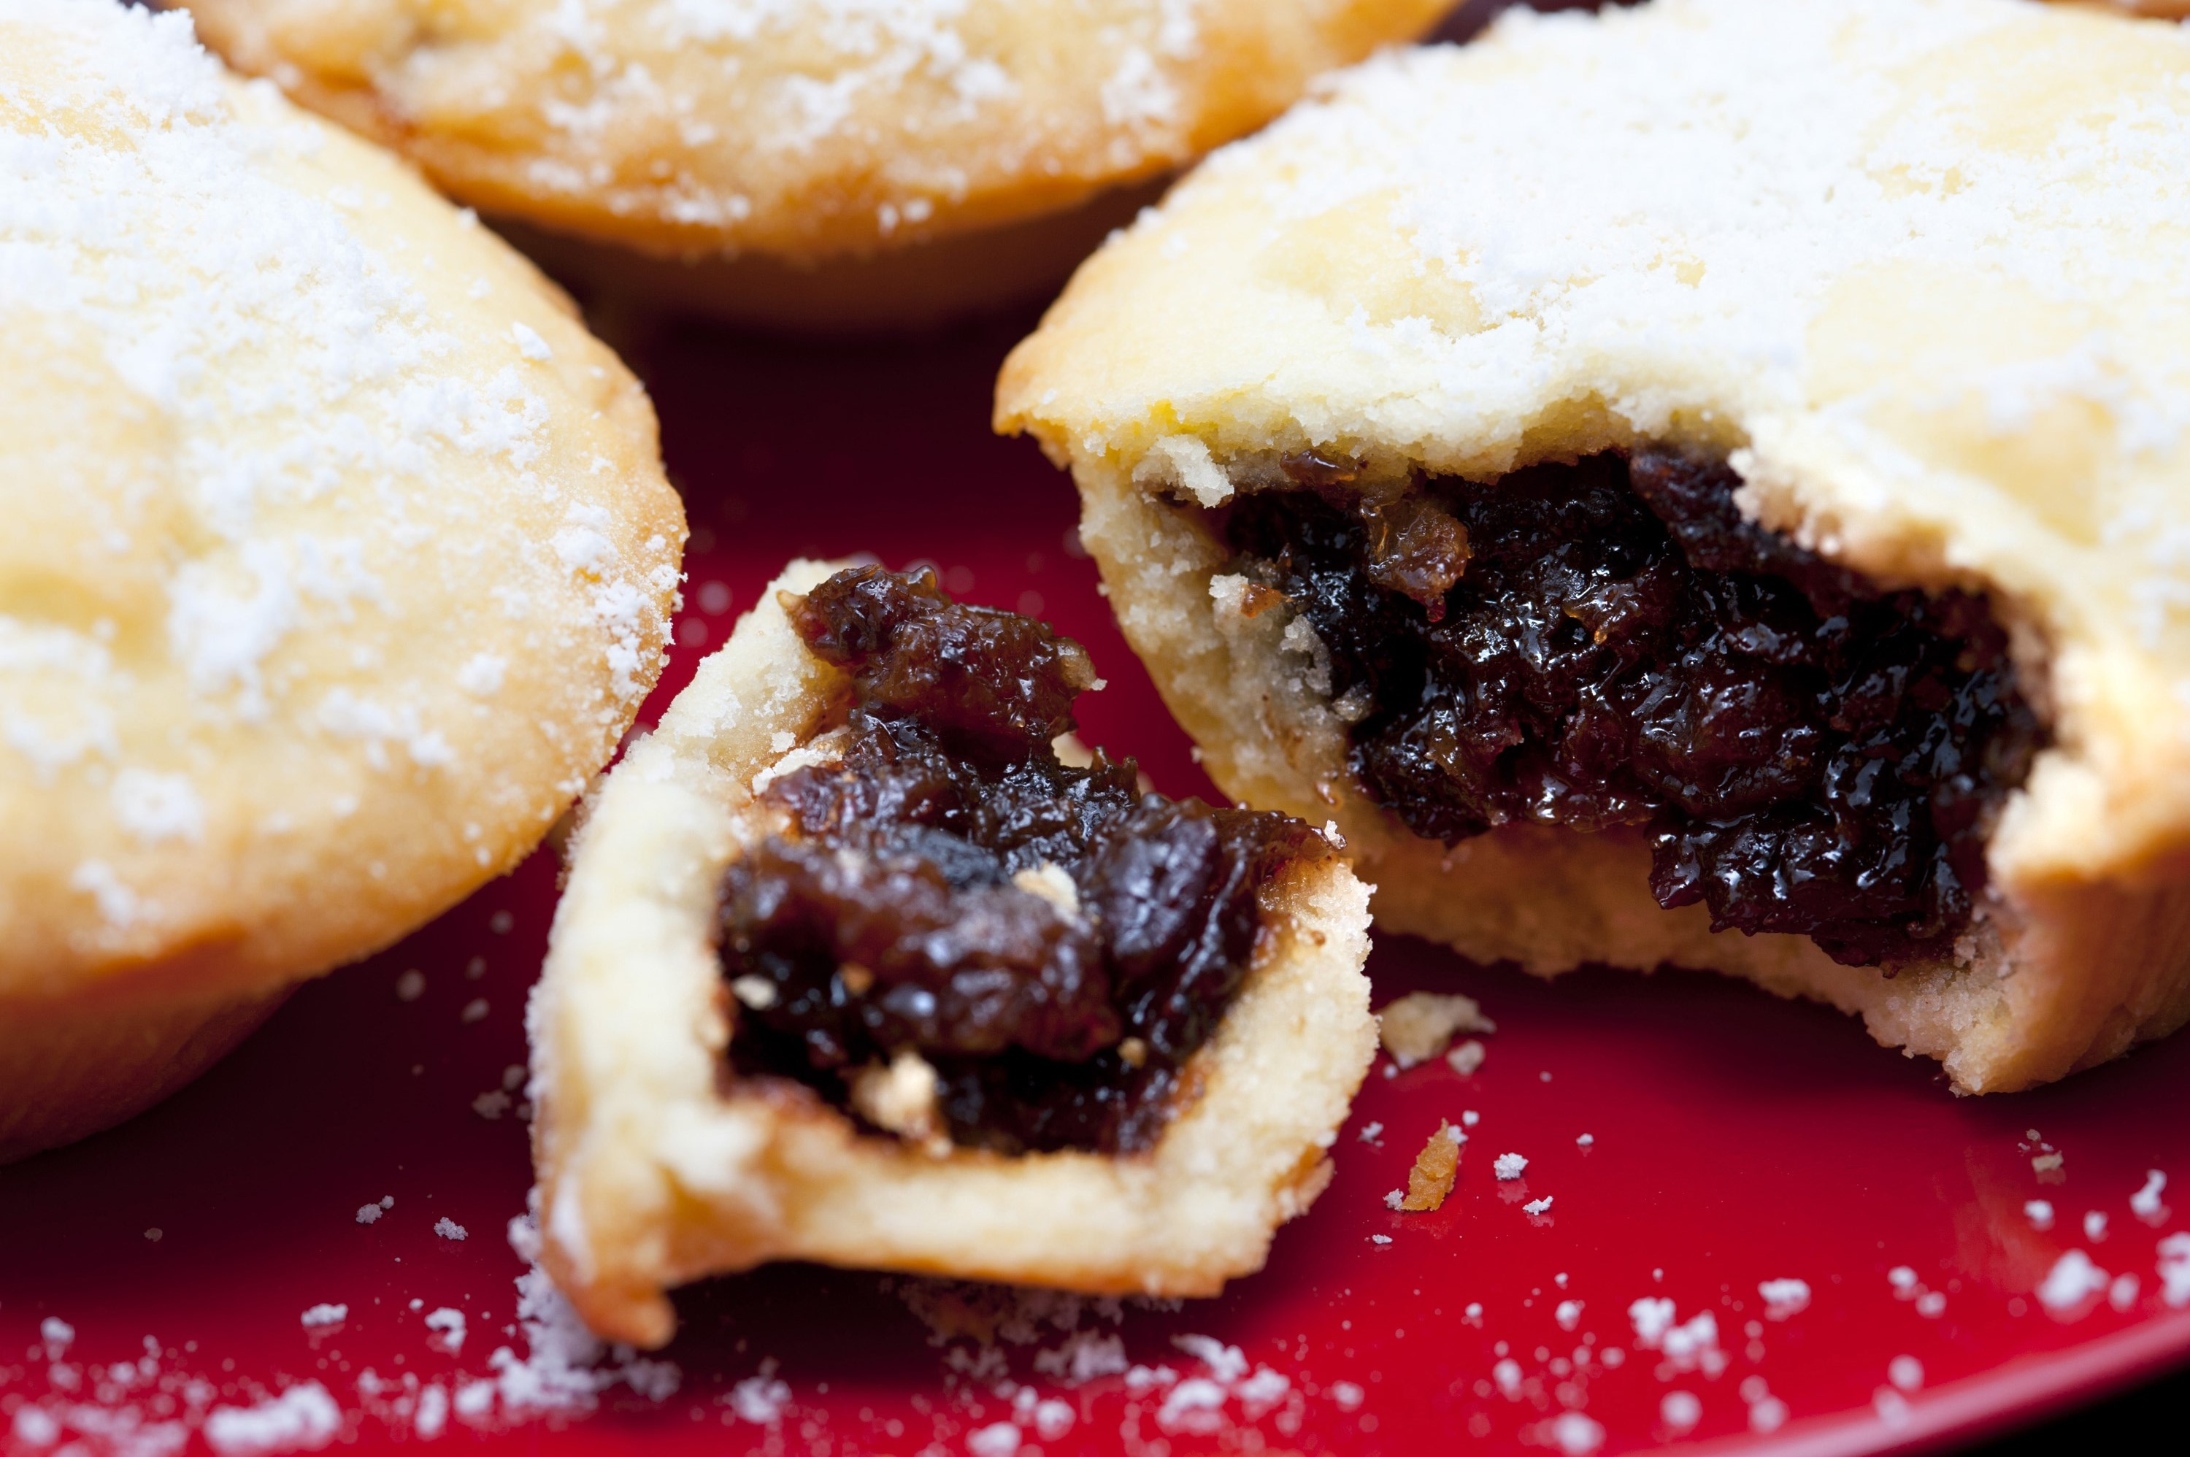
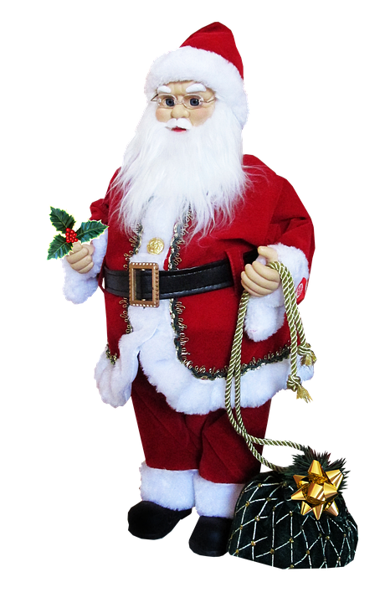
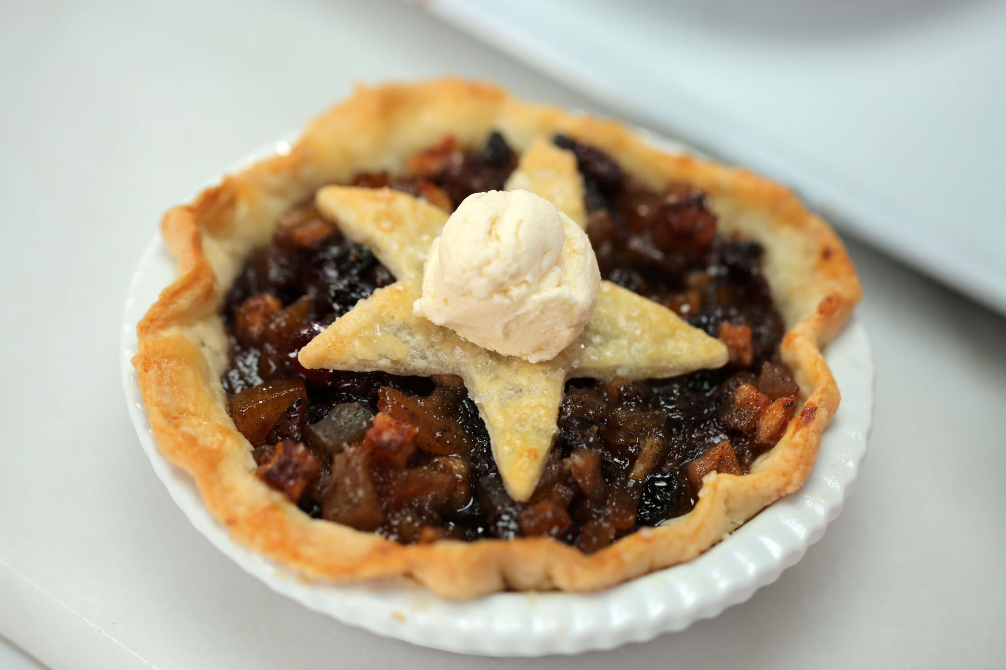
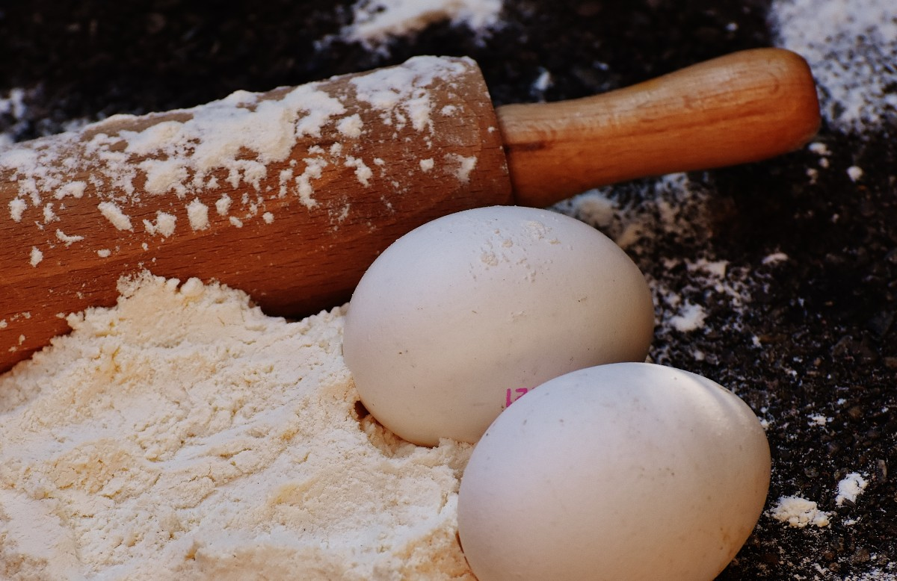

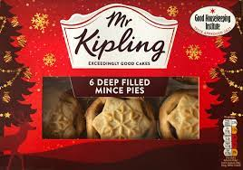
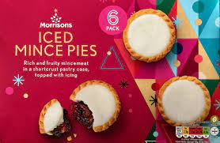
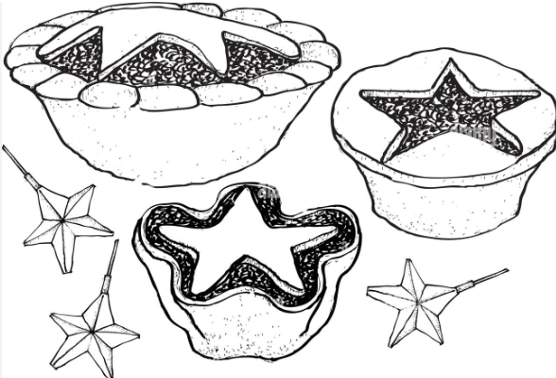
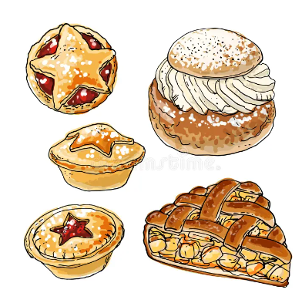

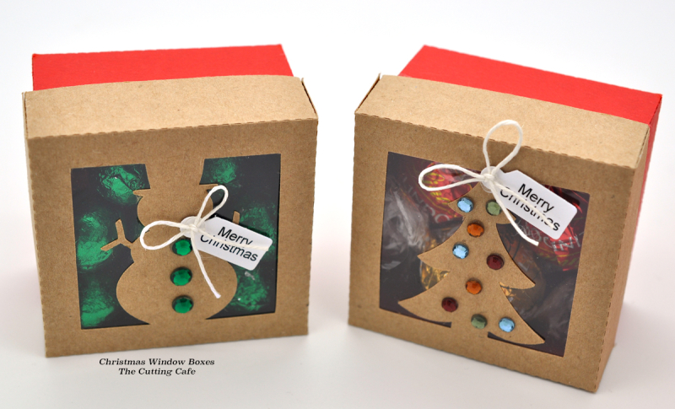
Year 5 Autumn 2 DT - How can we make a Mince Pie fit for Father Christmas?
Vocabulary
Research
Make
Ingredients
Food that is combined to make a particular dish.
What ingredients will we need?
What are the most popular flavours?
Dough
A thick mixture used for baking
flour
Used in dough to make bread, cakes and pastry.
Sugar
Used as a sweetener for food and drinks.
Savoury
A food that is salty or spicy rather than sweet.
Make, decorate and present the mince pie, in your box for the intended user.
Seasonality
Season or time of the year.
wholemeal
Adds flavour and nutrition to baked products.
Design
Evaluate
Fat
Nutrients in food that you only get from your diet.
Carbohydrate
Sugar molecules found in food and drinks.
Protein
Made up of molecules called amino acids.
Substances that are found in the food we eat.
Design what you want your mince pie and box to look like.
Evaluate your product.
What went well?
What would you improve next time?
Vitamins
Nutrition
The study of food and how it works in your body.
Source
All the ingredients you will be using to make your product.

Slide 3


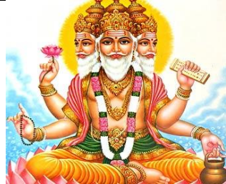

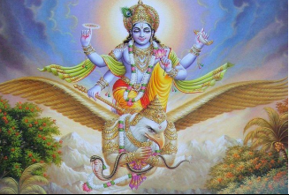

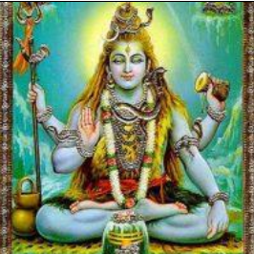
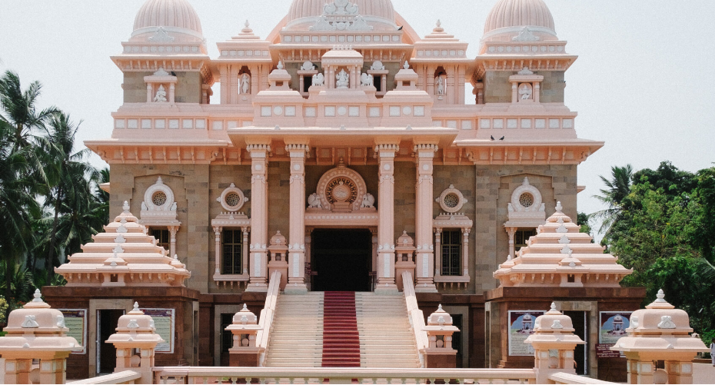
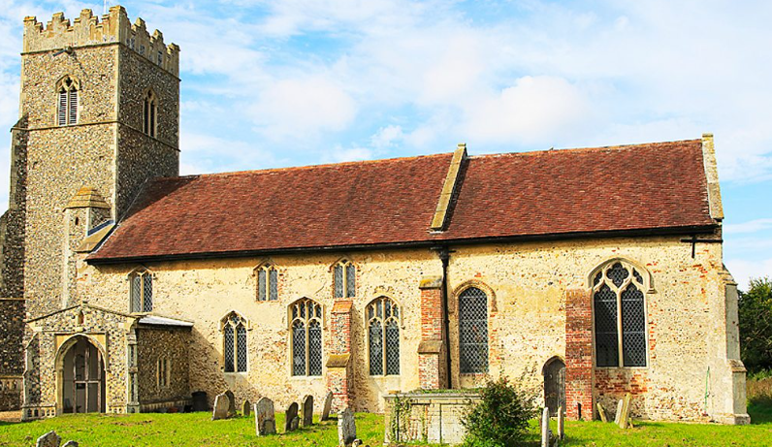
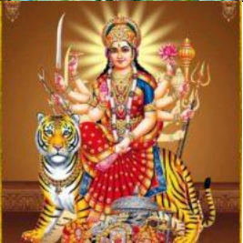
Year 5 Autumn 2- Why is it important to show commitment to God for different people?
Hindu Gods
Key facts
Vocabulary
Brahman | The highest caste in the Hindu caste system.
Tri-Murti | Three chief gods
Karma | All your actions in this life affect all your future lives.
Moksha | Freedom from samsara
Samsara | The endless cycle of birth, death and rebirth.
Gayatri Mantra | Hindu mantra used daily by the devout.
Brahman: She is fierce and powerful. She is shown with many arms, which she uses to fight demons.
Vishnu: One of the most loved Hindu Gods, often shown with dark blue skin and playing the flute.
Shiva: Preserver of the universe. When humankind need help on Earth he appears to help.
Durga: God who created the universe. He is also one of the Tri-Murti.
Hindu
Christianity
Hindus use worship at home and in temples to show commitment to God.
Christians show commitment to God in different ways, through prayer and communion.
Hindus have a personal God or Goddess whom they pray to regularly.
Christians have one God, who they pray to.
Hindus believe Karma may not reward them in this “lifetime”
The Christmas story has meaning to all Christians.
Temple
Church

