Slide 1



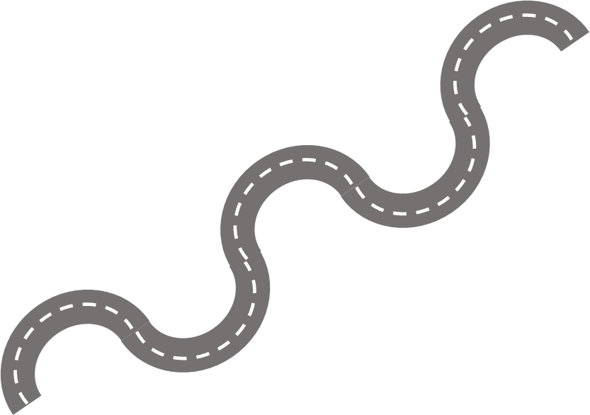
D&T in the Foundation Stage
D&T at Keelby
D&T in the Key Stage 1
Autumn
Planning opportunities through play.
Spring
Follow a pictorial design to personalise products.
Spring
Food
Preparing fruits and vegetables.
Autumn
Mechanisms
Y1 – vehicles
Y2 – sliders & levers
Summer
Y1 Structures
Y2 Textiles
Summer
Pictorial design, make and evaluate a simple product.
Explore existing products, focussed tasks, design, make, evaluate.
Summer
Y5 Structures
Y6 Mechanical Systems
Summer
Y3 Food
Y4 Textiles
Spring
Y5 Textiles
Y6 Electrical Systems
Autumn
Y5 Food
Y6 Enterprise
Spring
Y3 Structures
Y4 Electrical Systems
Autumn
Y3 Textiles
Y4 Mechanisms
D&T in Upper Key Stage 2
D&T in Lower KS2

