Slide 1




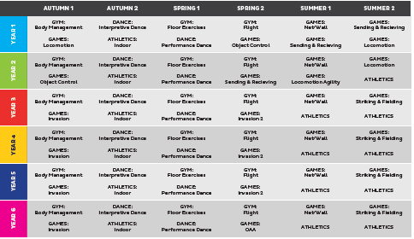

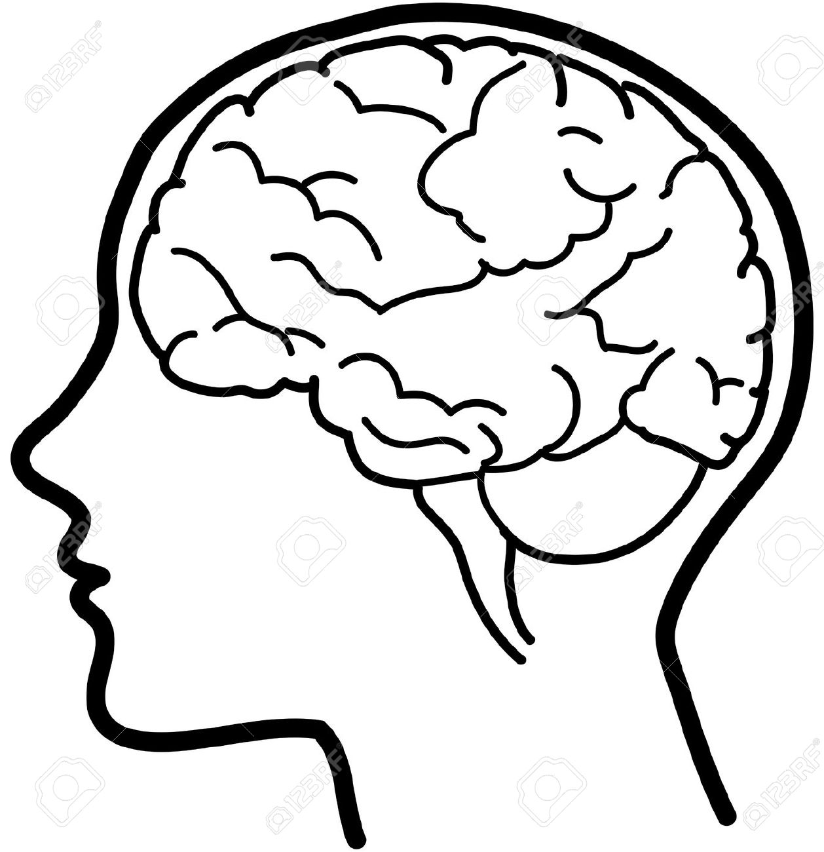


PHYSICAL EDUCATION AT KEELBY
Our PE curriculum is designed to educate our pupils through physical activities. We aim to develop students’ physical competence and knowledge of movement and safety, while equipping them to lead an active and healthy lifestyle.
Big Ideas
Acquiring and Developing Skills. Children should be taught to use running, jumping, catching and throwing in isolation and in combination.
Selecting and applying skills, tactics and compositional ideas. Pupils should be taught to participate in team games, developing simple tactics for attacking and defending.
Evaluating and improving performance where children analyse and critique their own performance and the performance of others in order to improve it.
Knowledge and understanding of Health and Fitness. Pupils should be taught about the benefits of being physically active and leading a healthy lifestyle.
Content and Sequencing
2 lessons per week (back-to-back over the same morning or afternoon).
PE long term overview provided to staff to ensure National Curriculum coverage and to ensure sequencing allows skills to be revisited and developed year-on-year.
Gymnastics is timetabled across the
the whole school in Autumn 1, Spring 1
and Spring 2.
Dance is timetabled across the whole
School in Autumn 2 and Spring 1.
Games is timetabled across the whole
School in Autumn 1, Spring 2, Summer 1
& Summer 2.
Athletics is timetabled in Autumn 2,
Summer 1 & Summer 2 (except KS1 in S1)
Swimming is delivered in the summer of Y5.
Links with English
and Maths
Every lesson is a reading lesson
High quality texts chosen for English that may link with PE units where appropriate.
Expression of critiques and opinions both orally and in written form.
PE specific language to be taught, used and regularly used in everyday discussions.
Retrieval Practice
Knowledge, skills and vocabulary identified
Key concepts and PE specific vocabulary to identified, taught (some above) and revisited
Key skills are developed and connections made with previous attempts/units from previous terms/years.
Evaluations are valued and reflection linked to previous lessons, performances or game situations.
Outcomes
All units begin with a visual examples of elite performance (what could be achieved).
All children to complete practice sessions/routines as skills are refined ahead of playing competitively and/or performing in front of peers.
All children to have the chance to apply skills taught in a game situation (games units) or in a final performance/routine (gymnastics/dance).
End of unit self-evaluation/reflection to take place with areas for improvement identified.
Support
Everyone has access to the Physical Education National Curriculum.
Support is provided for those learners who require it
Considerations is given for learners who grasp concepts and new skills more rapidly

