Slide 1



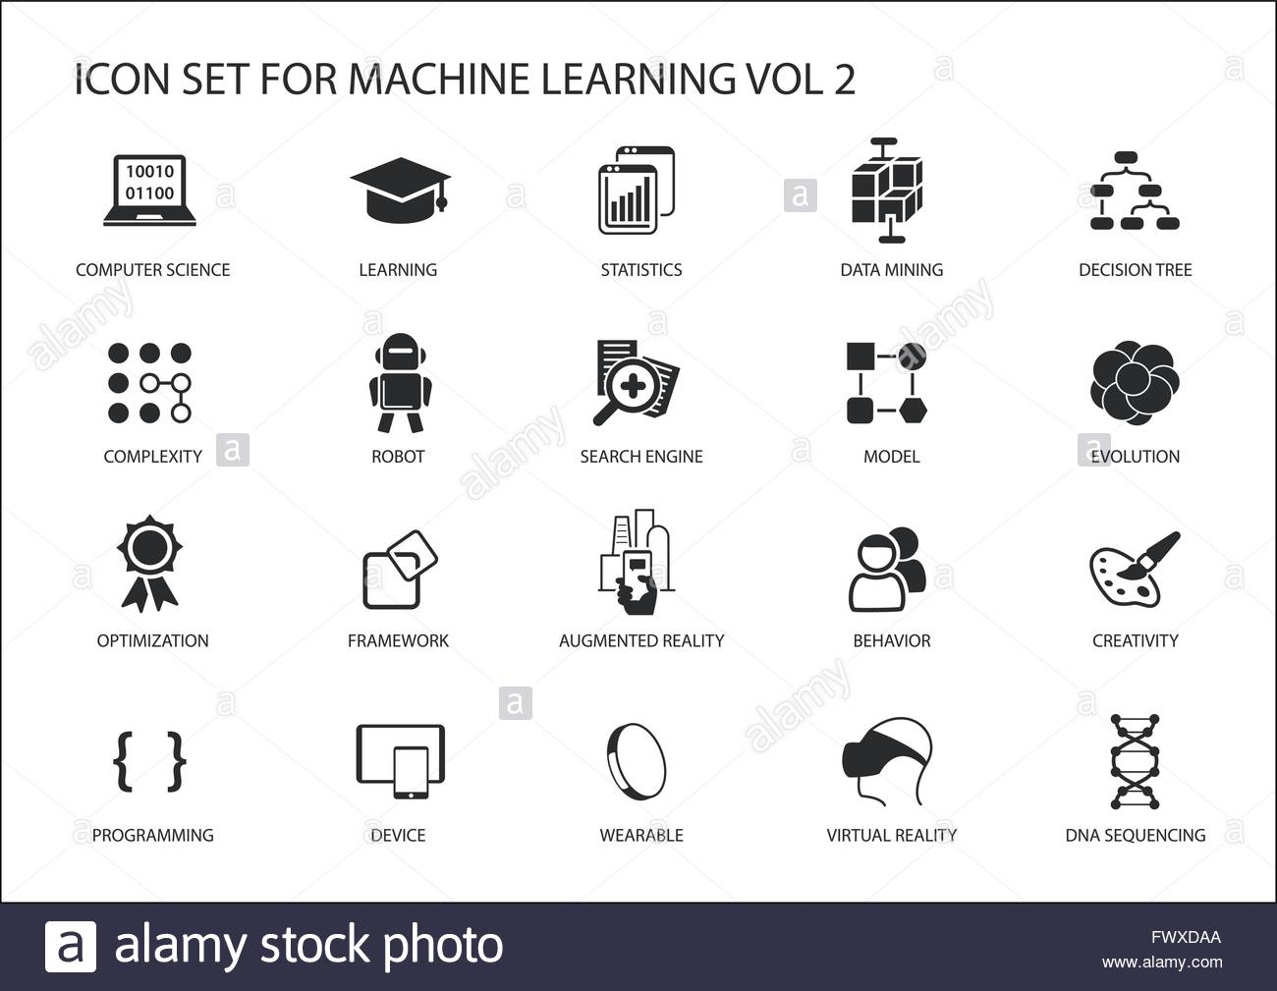




RELIGIOUS EDUCATION AT KEELBY
Our RE curriculum aims to enable children to think critically about religion and to be culturally aware of the many beliefs in the UK. We aspire for children to be respectful citizens whilst also considering their own faith and beliefs.
Big Ideas
Investigating facets of religion (places of worship, artefacts, symbols, holy scripture)
Religious story telling (investigating scripture and inferring messages and morals)
Commitment (exploring why people do the things they do)
Philosophy (posing questions, thinking deeply and forming respectful opinions)
Content and Sequencing
6 half termly units per year
Content of the National curriculum and to ensure our children have an accurate understanding of the religious beliefs of the world in which they live. Content from Discovery RE scheme.
Religious studies in KS1
Y1 Judaism and Christianity exploring these people’s relationship with God
Y2 compare and contrast Judaism and Christianity with beliefs and stories within Islam.
Religious studies in KS2
Each year children learn about a new religion with which they can compare previous learning
Y3 Explore Diwali, Brahman and the River Ganges in Hinduism. Investigation questions to deepen Christianity learning around the meaning of Christmas, miracles and Good Friday.
Y4 Compare and contrast Christian and Jewish relationships with God. Children examine symbolism, commitment and forgiveness.
Y5 Examine Sikh and Christian commitment and stories from Guru Granth Sahib and the Bible.
Y6 Study commitment and afterlife in Islam. Dive into the meaning of “eternity” and if Christianity is still a strong religion in this century.
Links with English and Maths
Lessons investigate religious scripture where children read and are read to
Oral discussion regarding religious teaching points
Respectful speaking and listening is practised throughout all age phases
Outcomes may be assessed through writing
Retrieval Practice
Knowledge, skills and vocabulary identified
Mini recaps at the start of lessons
Low stakes quizzing to develop long term memory
Big ideas identified (above) are revisited through progressive content
Key ideas are investigated by considering what they are and what they are not
Religious inks across year groups for retrieval of knowledge
Outcomes
All units begin with an enquiry questions which children should be able to answer at the end of the unit
End of the unit children with complete a task which gives them the opportunity to apply all their religious knowledge and understanding
End of unit quiz
Support
Everyone has access to the RE National Curriculum.
Support is provided for those learners who require it.
Consideration is given for learners who grasp concepts more rapidly.

