Slide 1

English
This term we will be reading the book Floodland by Marcus Sedgwick. We will be taking inspiration from the characters within the Floodland book to write a persuasive speech. We will also be looking at poetry and begin writing our own. We will also apply reading VIPERS skills to improve our comprehension during our guided reading time and enable us to show good understanding of the story.
Geography
This term, our curriculum focus is Geography. Our learning question is, ‘How do rivers and seas influence where we live?’
We will be acting as geographers by looking at the physical and human aspects of rivers: reading maps; observing photographs; exploring the parts (course) of a river; and much more! By the end of the term, we should know the names and locations of the world’s major rivers.
Maths
Now we have learned about place value, addition, subtraction, multiplication and division. We will be moving on to learn about fractions. We will be finding equivalent fractions, converting improper fractions as well as comparing them. We will also be applying our fraction knowledge to worded problems.
Please keep up practice on times tables at home.
Year 5 Newsletter
Spring Term 1, 2025
Science
In science this term, we are investigating forces! We will explore how forces act on objects and how they can be balanced and unbalanced. We will investigate the discovery of gravity and experiment with air and water resistance.
Wider curriculum
PSHE – Dreams and Goals
Computing – eSafety and computer science
Music – Ballads – Make You Feel My Love
PE – gymnastics and dance
Spellings - We will continue to complete our spellings using the Scode spelling scheme.
PE is on a Monday afternoon – please ensure full kit is in school at all times and our uniform policy is adhered to for health and safety.
Reading
Please continue to support your child to continue a love of reading. Reading records should be filled in 5 times per week and returned to school every Friday. Please contact Miss Rands if you need any suggestions for new books/authors/genres to read! I’ll be more than happy to help you find something you love.
Most importantly – enjoy your reading time!
Homework
Children will be assigned Maths and English homework on a Friday, which will be due the following Thursday. There will also be a piece of wider curriculum revision homework. Information for homework will go out in homework books each week. Please make sure homework books come back into school on a Thursday, even if the previous weeks homework is not complete.

Slide 2
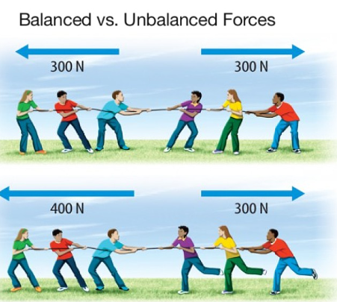
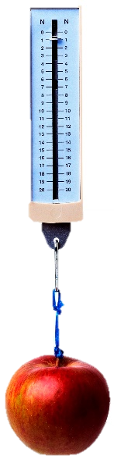
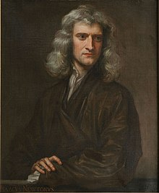
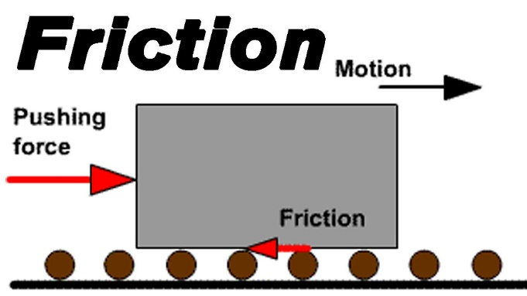
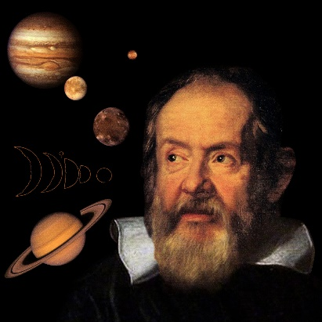
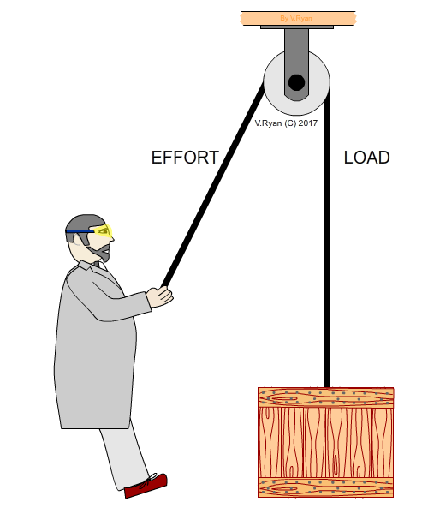
Year 5 – What Are Forces?
How can forces act on objects?
Are mass and weight the same?
Vocabulary
gravity | A pulling force exerted by the Earth
force | Pushes or pulls
friction | A force that acts between two surfaces or objects that are moving, or trying to move, across each other.
air resistance | A type of friction caused by air pushing against any moving object.
water resistance | A type of friction caused by water pushing against any moving object.
streamlined | When an object is shaped to minimise the effects of air or water resistance.
mechanism | Parts which work together in a machine: pulleys, gears, levers.
weight | The measure of the force of gravity on an object.
mass | A measure of how much matter is inside an object.
balanced forces | Opposite forces which are equal.
unbalanced forces | Opposite forces where the one is greater than the other.
Sir Isaac Newton discovered gravity. Mass is different to weight because the weight involves the force of gravity on an object.
What might create friction?
What might affect air and water resistance?
Surface area
Weight
Streamlined
Size of force, roughness and smoothness can affect friction.
How can mechanisms help us?
Pulley, levers and gears mean that we can exert less effort (create less force) to be able to move a certain load.
Galileo’s Tower of Pisa experiment found that object will fall at the same speed even if they have a different mass.

Slide 3

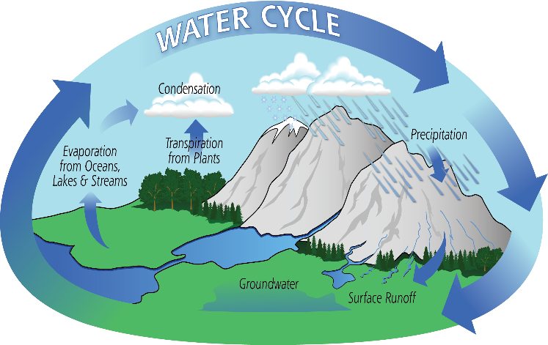
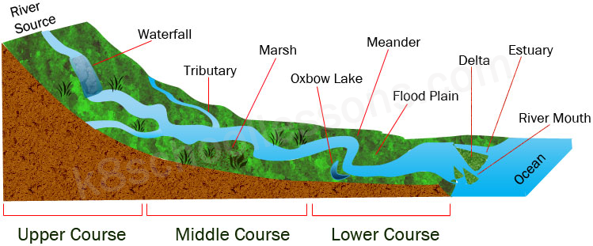
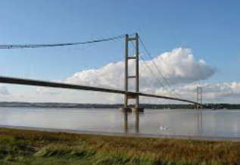
Year 5 Geography How do rivers and seas influence where we live?
The longest river on each continent
Vocabulary
course | the route or direction a river follows
source | the original point from which a river flows
precipitation | rain, snow, sleet, or hail that falls after condensing
erosion | the gradual destruction of something
transportation | The movement of something to elsewhere
deposition | the process of material being left behind
sediments | matter that settles to the bottom of a liquid
tributary | a river or stream flowing into a larger river or lake
infiltrate | the process of water on the ground surface entering the soil
saturate | to become thoroughly soaked with water or other liquid so that no more can be absorbed
Continent | Longest River
Africa | River Nile
North America | Missouri River
South America | Amazon River
Europe | Volga River
Asia | Yangtze River
Australia | Murray River
Antarctica | Onyx River
The Course of a River
Lots of precipitation
Steep slopes
Turbulent waters
Transports rocks
Waterfalls
Water erodes downwards, carving the valley floor
River gets wider as tributaries join
Land is flatter
Becomes deeper and meanders
Shape of the river in the middle course is constantly changing
Widest point of the river
Land is very flat with gentle, wide valleys
Rivers deposit large amounts of material at the estuary
At low tide, deposits (sediment and mud) are exposed

