Slide 1

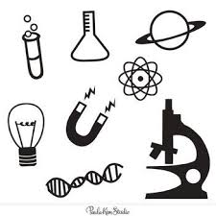

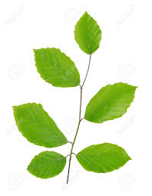
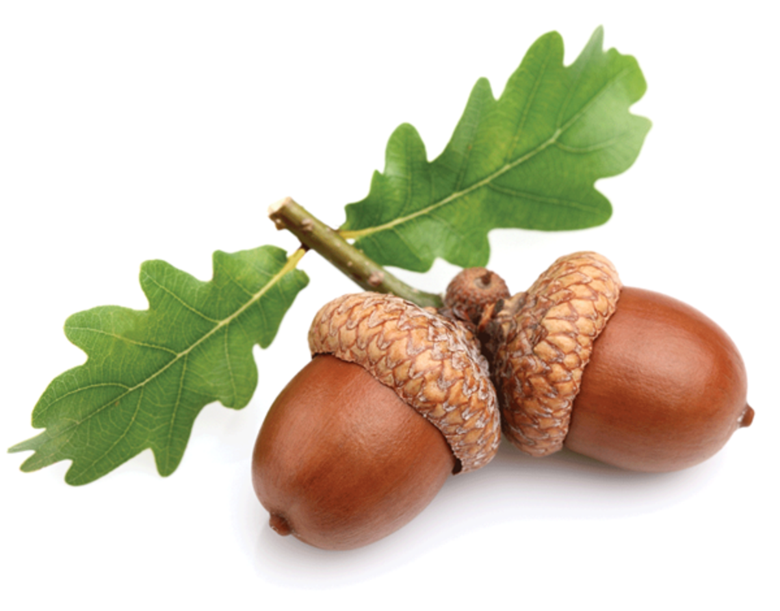
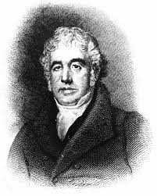
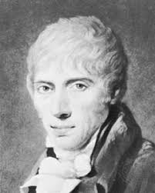
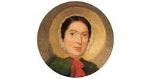
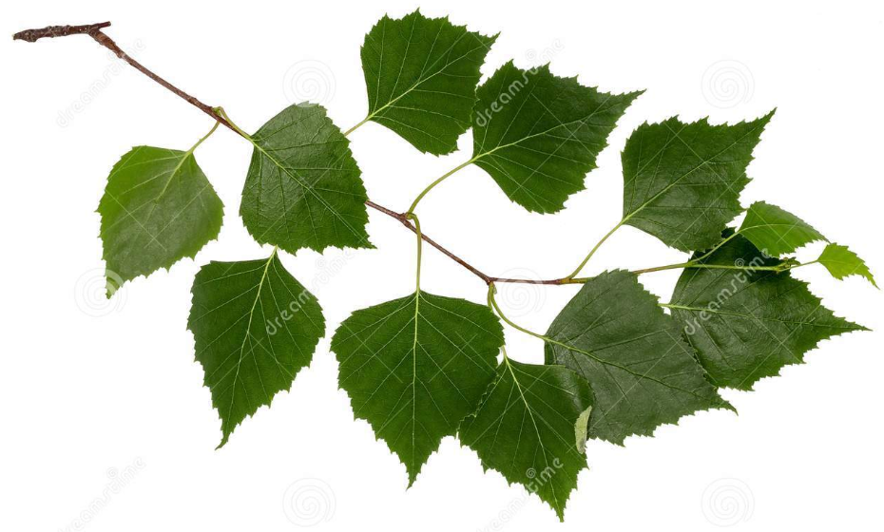
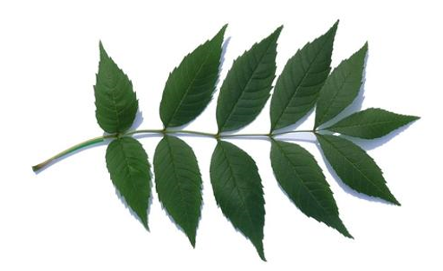
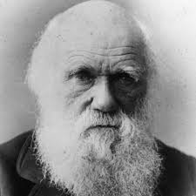
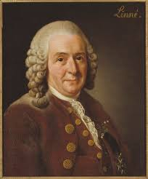
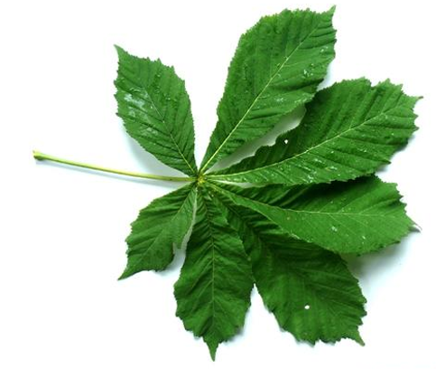
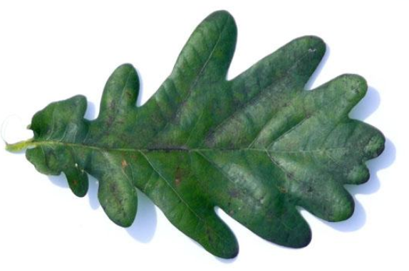
SCIENCE AT KEELBY
Willow Class
Everyday Materials, Seasonal Changes and Plants, Animals inc Humans
Identify, describe a variety of everday materials
Know the four seasons, Spring, Summer, Autumn, Winter
Common garden plants, deciduous trees and evergreen trees
Carnivores, herbivores , name and label body parts
Beech Class
Uses of Everyday Materials, Plants and Living things and their Habitats. Animals inc Humans
Distinguish objects from their matierials, wod, metal, plastic, grass, metal,water,rocks.
Seeds, bulbs, food crops, How humans grow, need for exercise, right amount of food, water
Acorn Class
Comment and ask questions about the world and where they live. Talk about what they have observed such as plants, animals, natural and found objects. Talk about why things happen and work.
Mary Anning
Jean
Charles Macintosh
John McAdam
Birch Class
Ash Class
Forces and Magnets,Light,Plants,Rocks,Animals inc Humans
Attract and repel,two poles, friction,gravity, reflection,
Light sources, sun, eyes, damage, life cycle of a plant, water, stem and roots,sedimentary, igneous rocks, physical properties.
Mary Anning
Animals inc Humans,States of matter,Electricity, Living things and their habitats, Sound
Teeth, digestive system, food chains, predators and prey,solids, liquids, gases, temperature, water, cycle, condense and evaporate, electrical circuit, batteries,power source, bulbs, buzzers, classification keys to help group, vertebrates, low and high sounds, vibration, pitch
.
Charles Darwin
All Classes
Chesnut Class
Carl Linnaeus
Every Lesson: Exploring and developing ideas, evaluating and developing work
Every Year: Scientific Investigations
Hands on experiences
Reasoning
Properties and changes of materials,
Earth and Space,Forces, Anumals inc Humans
Compare and group materials, reversible and irreversible, solids, liquids, gases, planets, solar system, Earth and moon, night and day, gravity, Galileo, resistance, friction, growing, puberty, old age, gestation periods
Oak Class
Evolution and Inheritence,Light,Living things, Electricity, Animals inc humans
Fossils, offspring, adaptation, straight lines, eye refelection, shadows, transparent, Classification system, microorganism, voltage cells, represent circuit, healthy body, heart, blood veessels and blood, circulatory system
Claude Monet
Notes:
© Copyright PresentationGO.com – The free PowerPoint and Google Slides template library

