Slide 1
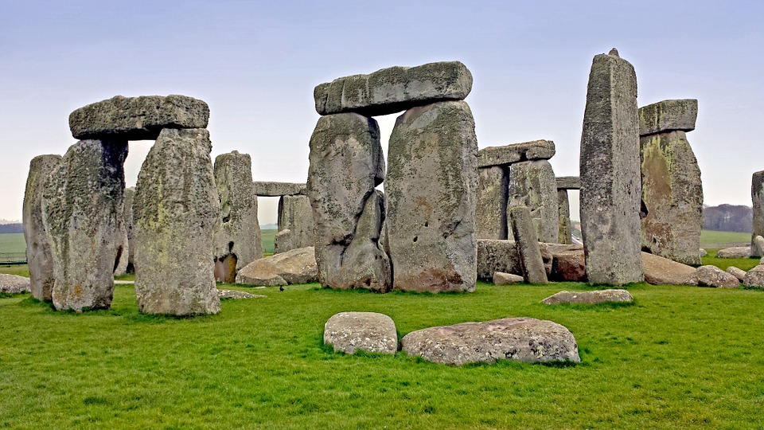
Maths
In Year 3 this term we will continue to consolidate our understanding of place value as well as further developing our problem solving skills. We will introduce numbers up to 1000 and the addition and subtraction of these.
Please continue to support your child to practise their recall of all times tables. We will be using TT Rockstars to aid this and your child will be working through a weekly plan. The ability to recall these facts more confidently would be hugely beneficial for your child in their Maths lessons.
English
In English we will be reading our Power of Reading text ‘UG boy genius of the stone age’ Our written work will focus upon poetry, setting and character descriptions and narrative writing in role. We will develop our knowledge of Year 3 grammar and punctuation. The Year 2 common exception words will be revisited and revised and year 3/4 words will be learned, these words are in homework books if you wish to practise spellings with your child at home. In school we will also be continuing to use www.spellingframe.co.uk, which is an exciting tool that can also be used at home.
During all lessons, we will continue to focus on a high standard of presentation, including joined handwriting.
Curriculum - History
This half term in Year 3, our History focus enquiry question will be,
‘Which period of the stone age was more successful and why?’
We shall build a rich bank of knowledge and understanding of the stone age including important dates which we will add to our timeline to show the historical events in our history.
Year 3 Newsletter
Autumn 1 2019
Science
This half term Year 3 will learn about ‘Forces and Magnets’. We will identify, compare and classify different materials depending on the magnetism and also the resistance of some materials/objects when a force is placed upon them.
Reading
Please continue to share the love of books with your child. Encourage them to read/share books 5 times per week. This can be recorded on one page per week of the Reading Record. Reads will be counted every Friday. Reading should be a delightful experience and we encourage you to revisit and reread favourite books and stories.
Happy readers become confident readers.
Learning Outcome
At the end of this half term, the children will present a planned presentation to inform other children about their chosen era of the stone age.
Wider Curriculum
RE –Would celebrating Diwali at home and in the community bring a feeling of belonging to a Hindu child?
ICT – Word processing.
PHSE – Being me in my world.
Music – Three Little Birds
PE – Gymnastics: body management/ Games: invasion
Our PE Days
Our PE afternoon will be Wednesday. Please ensure that children have a full outdoor and indoor PE kit in school all week. Long hair should be tied back and earrings removed as outlined in the school’s uniform policy on our website.
Homework
Each week the children will be set one piece of each English and Maths Homework on a Friday to be returned the following Thursday. An optional menu of creative ideas is also included in homework books. Remember that any pupil led ideas and work will be welcomed and celebrated.

Slide 2
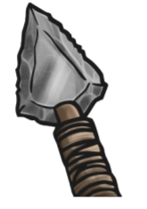
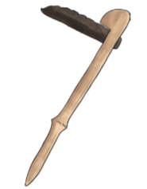
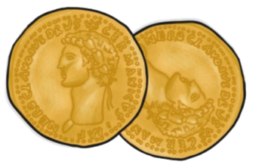
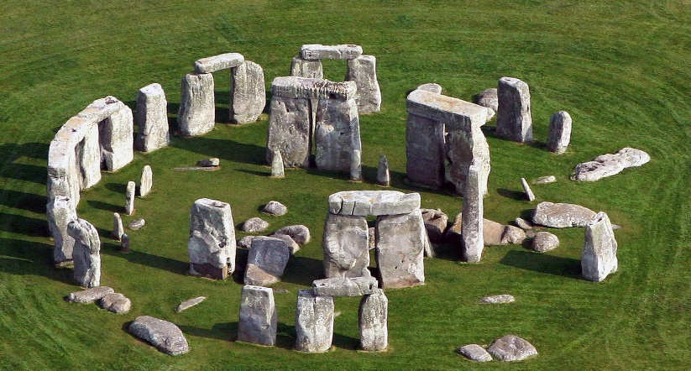
Year 3 – From Stone Age to Iron Age
BC and AD
BC | BC means ‘Before Christ’. A date such as 3000 BC means 3000 years before it was believed Jesus was born & 3000 years before the year 1 AD (there was no year zero).
AD | AD means Anno Domini in Latin which stands for ‘in the year of our lord’. A date such as 2019 AD means 2019 years after Jesus was believed to have been born.
Vocabulary Dozen
archaeologist | Person who learns about the past by digging up artefacts and studying them.
primary source | The main source of information about a topic.
period | A length of time covering many years.
settlement | A place where a group of people live together in many buildings.
forage | To search for food.
preserve | To keep something in good condition.
monument | Something built to remember an important person or event.
trading | The act of buying and selling goods and services (for example food).
alliances | A group of countries or groups of people who work together.
tribes | A group of people that live together for protection.
Hill forts | A settlement surrounded by ditches.
invade | To enter another country by force.
Stonehenge
Stonehenge is a famous monument located in Wiltshire, England.
It is a circle of very large stones standing upright.
It was built in the Stone Age.
Nobody knows why it exists.
Some people believe it was built to learn about the movements of the sun and moon. Some people believe it was a burial mound.
Timeline of Events
13,000 BC | People make cave paintings.
4500 – 3500 BC | Farming starts and begins to spread.
2500 BC | Metal starts to be used.
1200 – 800 BC | Metal tools are made and used.
1200 – 800 BC | People start to make alliances with others living in tribes.
800 – 700 BC | The first hill forts are made.
700 – 500 BC | Iron is used a lot more than before.
AD 43 | The Romans invade Britain –The Iron Age ends.
Important time periods
The Stone Age | When the first humans began to live in Europe. They used stones as tools.
The Iron Age | Humans now used iron to make tools, and farmed land instead of hunting. They lived in communities.
The Bronze Age | In this era, metals were used to make hunting tools. Humans also began to farm land.
Skara Brae
Skara Brae is an archaeological site in Orkney, Scotland.
It is a Stone Age village with 8 houses made of stone.
There is only one room in each house.
It is famous because it has been well preserved and has taught us a lot about life in the Stone Age.

