Slide 1



Safer Internet Day 2026

Slide 2
Have you celebrated
Safer Internet Day before?
Notes:
Hello everyone. In today’s assembly we’re going to be talking about Safer Internet Day. Have you celebrated Safer Internet Day before? What do you think Safer Internet Day is about?
Safer Internet Day happens every year and is a time for everyone to think about how we can make the internet a safer place.

Slide 3





What do you think Safer Internet Day might be about?
Notes:
Safer Internet Day is held every February all around the world. Last year, over 170 different countries celebrated the day! Safer Internet Day is a chance to think about any worries we might have about using technology and the internet, but it’s also about celebrating all the fantastic things technology can help us with. Last year, over half of the children in the UK heard about or joined in with Safer Internet Day.

Slide 4



Charities
The government
Sports Clubs
Companies who make your favourite apps and games
The police
Notes:
And it’s not just schools who join in with the day, lots of other people get involved too, including the government, lots of charities, sports clubs, the police and even the companies who make your favourite apps and games. By participating in this assembly, you’re joining thousands of others in celebrating the day!

Slide 5
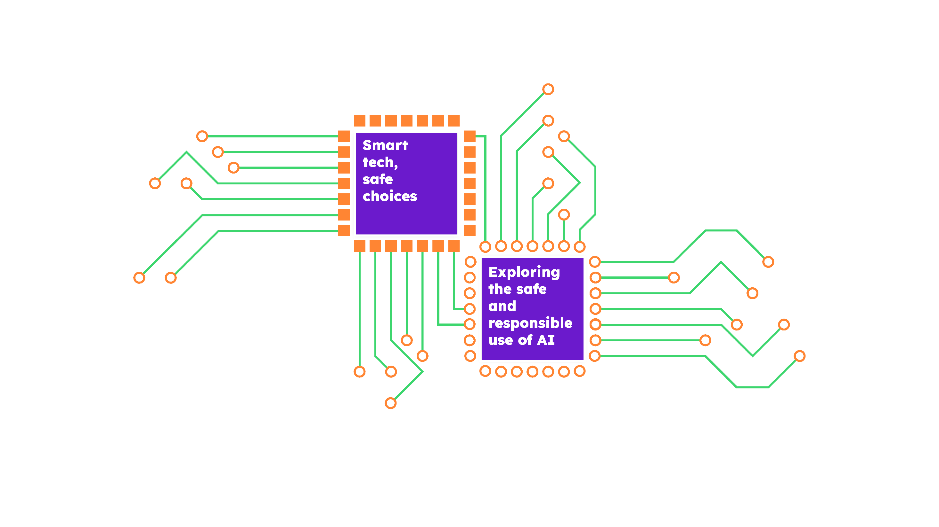


Notes:
This year for Safer Internet Day we are thinking about an exciting type of technology: AI. Who can explain what AI is?
[Take responses from learners.]

Slide 6
AI is a type of computer, which has been designed to try and do some of the things a human brain can do
Notes:
Great answers, everyone – AI stands for artificial intelligence. Artificial intelligence is a type of computer system, which has been designed to try and do some of the things a human brain can do.

Slide 7





‘They help us think, feel and make decisions’
‘Our brains are amazing!’
‘They use information from the world around us’
Notes:
Our brains are amazing! They are working all the time to help us think and understand things, move and talk, feel emotions and make decisions. Our brains use lots of information to help them do these things – signals and senses from our body, like what we can see and hear, but also from the world around us, and even things we’ve learnt in the past. Brains are really good at making connections and spotting patterns.

Slide 8


AI can be trained to do some
of the things a human brain
can do, like spot patterns and make decisions.
Notes:
Over time, computer scientists have developed AI to try and do some of the amazing things our brains can do. AI uses information too, but it’s normally called data. AI can be trained to spot patterns and make certain decisions, and as the technology improves, it is being used in all kinds of exciting ways.

Slide 9



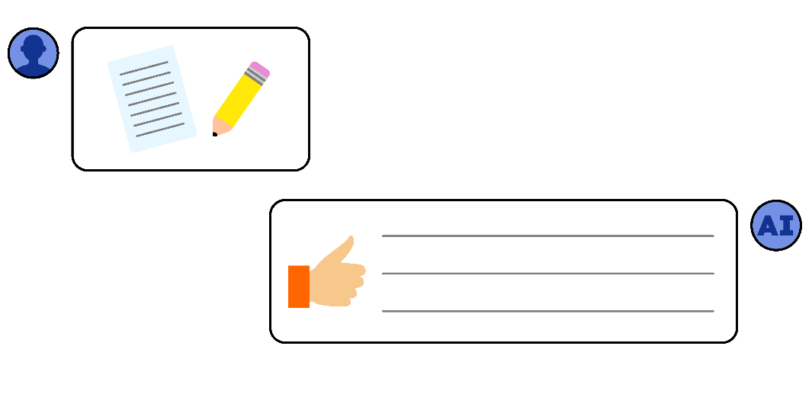
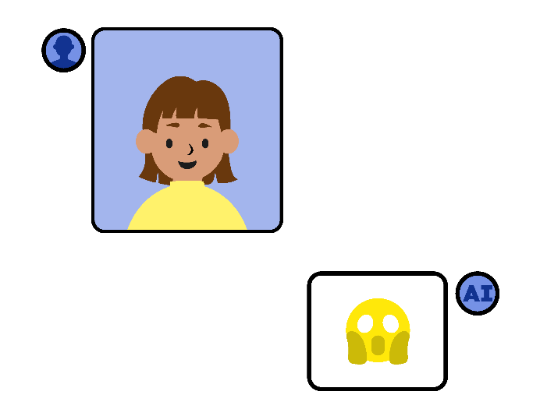
‘Sian uses AI to translate when
she talks to her friend’
‘Manu uses an AI speaker to play music’
‘Rory uses AI to help
with his homework’
‘Issa uses AI to create nicknames
for her classmates’
Notes:
Sian uses AI to help her talk to a new classmate who has moved from another country. They don’t speak the same language, but AI can help translate! Is this a good use of AI?
Manu uses an AI speaker to play a song for his baby sister when she’s crying. They dance to the music together! Is this a good use of AI?
Rory uses AI to help with his history homework. He types in the questions, and AI tells him the answers. He’s not sure if this is cheating, and some of the answers don’t look right… Is this a good use of AI?
Issa uses AI to make up nicknames for her classmates. She posts them in the group chat to make people laugh, but some people are upset.
Is this a good use of AI?

Slide 10
Safer Internet Day 2026

