Slide 1


Parent information session: PSHE, including RSE
What will my child be taught?

Slide 2
Aims during this session
We want to:
Share with parents what children will learn in PSHE and RSE

Slide 3
What is pshe?
Personal
Social
Health
Economic

Slide 4
What is Rse?
Relationships
Sex
Education
&

Slide 5
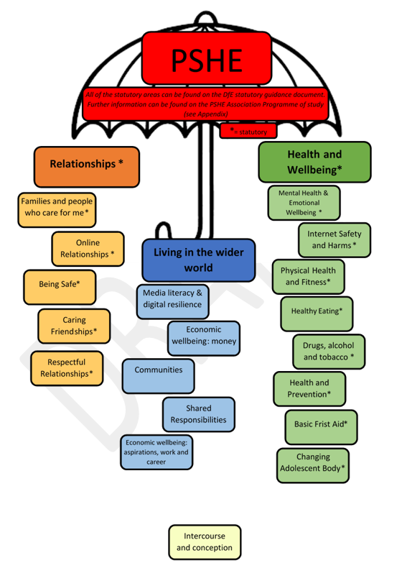

Slide 6
Last year, we consulted with parents about our RSE curriculum.
Thank you for your opinions and support.
They were all taken into account when crafting our curriculum.

Slide 7
Parents have always been able to withdraw their children from any non-statutory content taught at school. Some of this content is now statutory, so parents cannot withdraw their child from that lesson/s
‘Intercourse and Conception’ is non-statutory and some parents may choose to withdraw their child from this lesson.
From September 2020
Parents will not be able to withdraw their child from any aspect of Relationships Education or Health Education.
Parents will be able to withdraw their child (following discussion with the school) from any or all aspects of Sex Education, other than those which are part of the science curriculum, up to and until three terms before the age of 16.
Notes:
Details on this can be found on PSHE inc RSE Policy, found on school website

Slide 8


For more information:
Search ‘RSE FAQ’ on GOV.UK
Search ‘RSE Parent Guide’ on GOV.UK

Slide 9
What is RSE?
RELATIONSHIPS | SEX
Ways to help build and maintain caring friendships | CONCEPTION – ONE LESSON IN YEAR 6
Anti-bullying | PARENTS CAN WITHDRAW
Families and people who care for me
Showing respect
E-safety
Being safe, like the difference between appropriate and inappropriate touch
PARENTS CAN'T WITHDRAW

Slide 10
KS1- Science
(Covered in Year 1 and 2)
identify, name, draw and label the basic parts of the human body and say which part of the body is associated with each sense
notice that animals, including humans, have offspring which grow into adults

Slide 11
Year 2- PSHE
about the human life cycle and how people grow from young to old
how our needs and bodies change as we grow up
to identify and name the main parts of the body including external genitalia (e.g. vulva, vagina, penis, testicles)
about change as people grow up, including new opportunities and responsibilities
preparing to move to a new class and setting goals for next year

Slide 12
Year 3- pshe
No content that may have previously been regarded as ‘sex education’.

Slide 13
Year 4- pshe
Eg Growing and Changing
Physical and Emotional changes in puberty; external genitalia; personal hygiene routines; support with puberty.

Slide 14
Year 4- pshe
Following this lesson, pupils will be split into groups (by sex) so that they have the opportunity to ask any questions.
Girls will be given more information on managing menstruation.

Slide 15
Year 5- science
Living Things and their habitats
describe the differences in the life cycles of a mammal, an amphibian, an insect and a bird
describe the life process of reproduction in some plants and animals.
Animals, including humans
describe the changes as humans develop to old age.

Slide 16
Year 5- pshe
No content that may have previously been regarded as ‘sex education’.
To meet the needs of pupils in Year 5 this year, they will revisit the Year 4 objectives.

Slide 17
Year 6- PSHE
Eg Growing and Changing
Human reproduction and birth; increasing independence; managing transition
In Year 6, we also cover material recommended by the PSHE Association to be taught in Year 4. This specifically includes further detail on male puberty, including erections and nocturnal ejaculation (‘wet dreams’)

Slide 18
Mixed-aged classes
“My child is in a mixed-aged class. Will they be taught lessons for older children?”
Notes:
No, we have recently established 2 year rolling programme for PSHE. Most topic areas will just be adapted by the class teacher to meet the needs of the different aged children in their class. Any lessons that we have decided as a school community should be taught to only specific age groups will be delivered separately.

Slide 19
Mixed-aged classes- pshe
Eg Growing and changing
Year 2 – growing older; naming body parts; moving class or year
When Year 2 pupils are taught the scientific names for different parts of their body, Year 1 pupils will revisit their learning on privacy and staying safe (Au- Safe relationships) and do more work on recognising what makes them unique and special; feeling; managing when things go wrong (Su- Growing and changing)

Slide 20
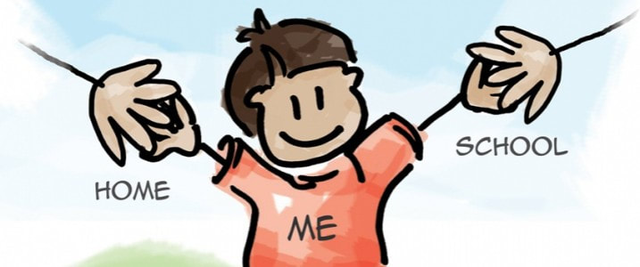
During all lessons, children are encouraged to discuss what they have learned with their parents at home.
With regard to the one lesson in Year 6 that some parents may choose to withdraw their child from, we cannot make any guarantees that pupils will not hear chatter on the playground, despite teachers telling pupils in class that they should only discuss the content of the lesson within the lesson and with a trusted adult at home.
Be mindful that withdrawing a child from the lesson on conception in Year 6 may lead to misinformation from peers if they do not already have a secure understanding provided by an alternative source (eg trusted adult at home).

Slide 21
Vocabulary
EYFS | Male, female, private – all statutory
Year 1 | Male, female, private, safe, permission – all statutory
Year 2 | Penis, vagina, testicles – all statutory
Year 3 | (Nothing additional)
Year 4 | Puberty, menstruation, genitalia, breasts, pubic hair (may be some mention of internal female anatomy when how periods occur is discussed in the single gender group, so that anyone who may menstruate in the future understands what’s happening to their body) – all statutory
Year 5 | (This year, Year 5 will cover Year 4 ‘changing adolescent body’ objectives)
Year 6 | Erection, wet dreams, testes, sperm, semen, ovaries, egg, uterus, vulva (Moved from Year 3/4) – all statutory Ejaculation - only in lesson on conception, non-statutory

Slide 22
What if another child asks something inappropriate?
Teacher skill
Ask it basket
Partnership with parents- parents are promoted as the child’s primary source of information
Support for parents

Slide 23
What support can we offer parents/ carers?
The PSHE programme is taught with the core belief that the child’s primary source of information comes from home. As a school, if we can support you in any way, we are open to suggestions and will try to help.

Slide 24
Any questions or concerns:
Please type any questions in the chat now. They will be answered following the meeting (if not answered immediately).
Miss L O’Brien (PSHE and RSE Subject Leader)
Mr S Pritchard (Head Teacher)
head@kennington.lancs.sch.uk

