Slide 1

Meet The Teacher Session
Welcome to Year 6
Sycamore Class
Class Teacher: Miss Clarke
Supported by Mrs Nutall

Slide 2
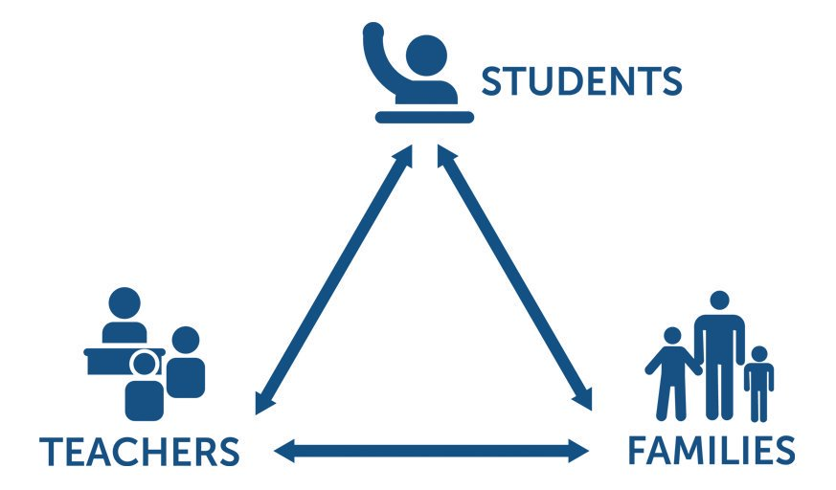
Pupil, family and teacher partnerships
Pupil, family and teacher partnerships
Your children achieve their full potential when all 3 work work well together.
Notes:
Explain the importance of partnership working

Slide 3
Children can arrive from 8:35am doors locked at 8:50am. During this time, children have the opportunity to practice and consolidate skills.
Children who are late and arrive after 8:50am or after miss up to 20 minutes of learning each day – equating to an hour lost over the course of a week and 37 hours lost in a year. Punctuality is important at Kennington.
Formal teaching starts at 8:50.
PE is on Mondays and Fridays this term. Please ensure children have both indoor and outdoor kits on these days.
Water bottles and healthy snacks. Water bottles must be small, plastic bottles which have a sports cap to prevent spillages in class.
End of day collection. Please wait on the junior playground . At the end of the day, we often have great things to tell our families so please feel relaxed if we call you over! It's more often than not to celebrate success! School finishes at 3:00pm

Slide 4
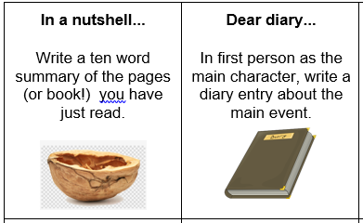
Reading in School
In Year 6 children have access to a wide variety of quality books from our classroom library, as well as Booktopia (in the corridor).
Children chose their reading books based on their ZPD which is a range of books determined by their reading Star Assessment each term.
Once a child has finished their reading book, they will quiz on Accelerated Reader. This helps to determine their understanding of the text.
If children have completed their reading book and are waiting to change it, they have activities which they can complete in their reading journal. Each task should take around 20 minutes to complete.
In class, children will read with an adult in school, in addition to whole class guided reading sessions.
Please ensure reading diaries are completed and signed even if children have read independently at home.

Slide 5
Reading in Year 6
Year Six children should be aiming to read five times a week for a minimum of 30 minutes. In preparation for SATS this year, your child will be expected to build this time up as we develop our reading stamina.
Please support your child through regular reading at home and discussing the text as they read. This helps develop a greater set of comprehension skills and also allows them to develop ideas for writing.
Reading at home is essential in Year 6 to allow them to make progress. Please record their reads in their reading records. These must be signed. This is good preparation for high school.
When choosing books, your child will need to be reading from the top end of their Z.P.D in order to challenge and stretch themselves. With some of the texts being longer in Upper KS2, your child will be provided with a reading journal that they can take home to jot and record notes about the chapters and the overall plot to help them when taking the quiz at the end of the book. We expect children to be completing at least one quiz every two weeks.

Slide 6
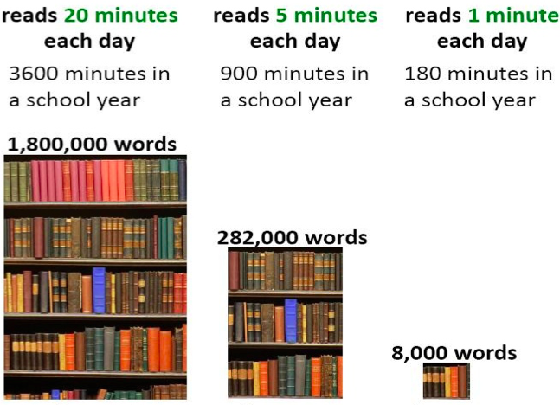
Reading At Home

Slide 7
Homework in Year 6
We want to make homework as straight forward and stress free for everyone!
In Year 6, we focus on getting your child high school ready. Therefore, there is an expectation that children take responsibility for managing their homework and ensuring it is completed on time.
Upper KS2 30-45 minutes per night
Reading – Daily 30 minutes minimum
Freckle – Min. 1 task, max 3 tasks per week.
TT Rockstar Maths practise 10 minutes, 3 times a week.
Spellings – Maximum 10 per week and spelling investigation
Grammar/English – 10 minute workouts from CGP books (children have their own copies of these to write in)
Spellings:
Spellings will be given out on Google Classroom, your child can pick a strategy to practise and learn each word using the laminated spelling strategies sheet that has been sent home. They can take photo of their spelling work and upload it to Google Classroom, or they can complete it on paper.
All Usernames and login details will be in the back of your child’s homework diary.

Slide 8
Communicating with class teachers
If you have anything you wish to discuss regarding school or your child, please do not hesitate to contact me.
I am always available at the end of the day on the playground
Reading records can be used as a method of communication
If you would like to arrange a more formal meeting, please contact the office.
TAs and Mrs Royale/Miss Broadbent can also always pass messages on if you ring school.
Parents evenings

Slide 9
Key Dates for Year
Monday 16th October – Thursday 19th October – Bikeability (more information to follow)
November (specific date TBC) – Parents Evening
BEFORE HALF TERM – Y6 PARENTS INFORMATION EVENING
31ST OCTOBER - APPLICATIONS FOR HIGH SCHOOL
SPRING TERM – BOOSTER CLASSES AFTER SCHOOL
February/March – MOCK SATS WEEK
MONDAY 13TH MAY – THURSDAY 16TH MAY 2023 – KS2 SATS WEEK
Wednesday 3rd July – Friday 5th July – Y6 Residential (TBC)

Slide 10
National Statutory Assessments
The KS2 tests assess children on:
GPS - English grammar, punctuation and spelling (2 papers)
Mathematics (reasoning and arithmetic)
Reading
MONDAY 13TH MAY – THURSDAY 16TH MAY 2023 – KS2 SATS WEEK
Teacher Assessment takes place throughout the year and is reported to you (July) in Writing and Science

Slide 11
How will you let me know how my child is doing throughout the year?
1 Sharing the curriculum and lesson content with you via class information sheets.
2. Via parents' evenings and the summer term school report.
3. By sharing assessment information with you via Pupil Information Sheets
4. Through informal communication at the doors and via phone or email when needed.
Parents of children with SEND have additional review points during the year.

Slide 12
Assessment Weeks
Your child will be assessed regularly throughout their time in Y6 to help prepare them for their SATs and also to identify any gaps in knowledge that need to be retaught.
Each term, they will complete STAR Assessments. Additionally, in Year 6, they will complete 3 sets of practice SATs.
One at the end of September as a baseline which will be discussed during parents evening. Another at the end of the Autumn term and the final MOCK in March.
Assessments are a key tool in finding out what strengths children have and what areas they need to develop further.
Assessments help to identify gaps in knowledge so that teachers can plan their future lessons. For example, if a whole class is struggling on the "fractions" element of maths, more lessons will focus on this. If all the class score well on times table questions, less time needs to be given to this.
Our internal assessments are "low stakes" and we approach them positively with the children.

Slide 13
Resolving Problems
We wish for a smooth year for each and every child and family but it is inevitable that at times, issues and complexities may arise. It is in everybody's interest that these are dealt with quickly and effectively. Our process for supporting families to resolve problems is outlined here:
Class Teacher
Key Stage Leaders
(KS1 Mr Sudell, KS2 Mrs Riley)
Deputy Head
Mrs Duffy
Head Teacher
If the issue concerns SEND our SENCo is Mrs Richardson

Slide 14
Celebrating Success
We celebrate success and effort in many ways at Kennington. These include:
Certificates
Dojos
Verbal Praise
Awards Assemblies
Book Tokens for the Book Machine
Postcards home

Slide 15
Any Questions
?

Slide 16
Thank you for coming to meet us this afternoon and we look forward to a great year working together!

