Slide 1

Meet The Teacher Session
Welcome to Hazel Class, Year 3
Class Teacher: Mrs Riley
Supported by: Mrs L Patel and Mrs S Patel

Slide 2
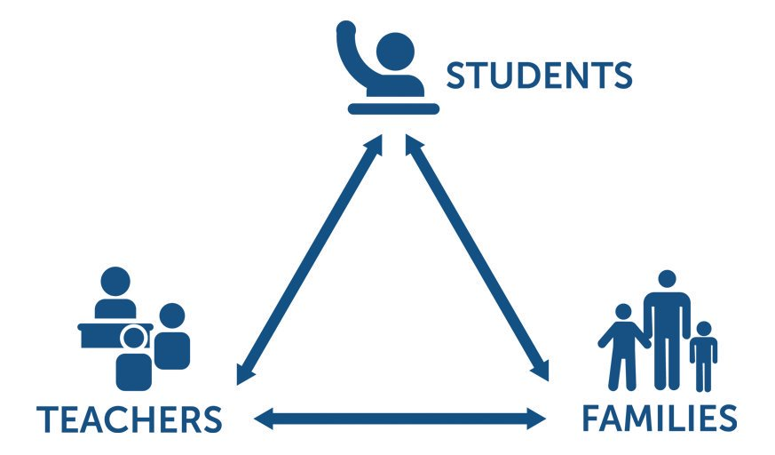
Pupil, family and teacher partnerships
Pupil, family and teacher partnerships
Your children achieve their full potential when we all work work well together.
Notes:
Explain the importance of partnership working

Slide 3
Start of the day
Children can arrive from 8:35am doors locked at 8:50am.
During this time children have the opportunity to practice and consolidate skills such as reading, Freckle, Arithmetic etc.
Punctuality is important at Kennington: Children who are late and arrive after 8:50am or after miss up to 20 minutes of learning each day – this is an hour lost over the course of a week and 37 hours lost in a year.
Formal teaching starts at 8:50.
PE is on Tuesday and Wednesday. Please ensure children have both indoor and outdoor kits on these days.
Healthy Me: Water bottles and healthy snacks.
End of the day collection. Please wait on the junior playground . School finishes at 3:00pm

Slide 4
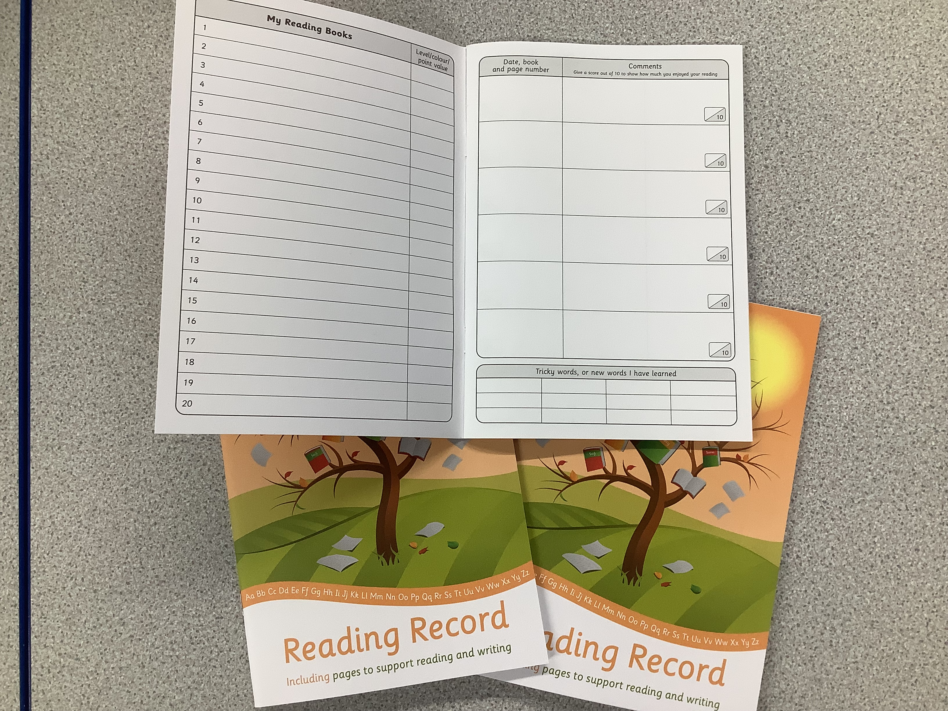
Reading in School
KS2 Accelerated Reader

Slide 5
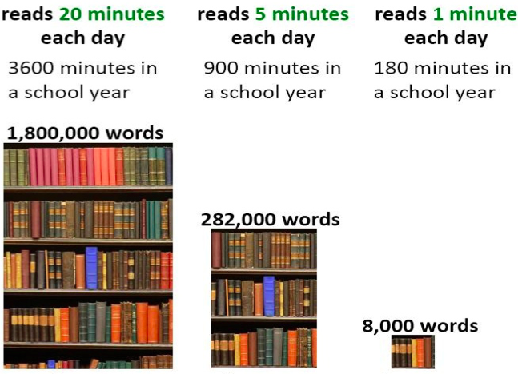
Reading At Home

Slide 6
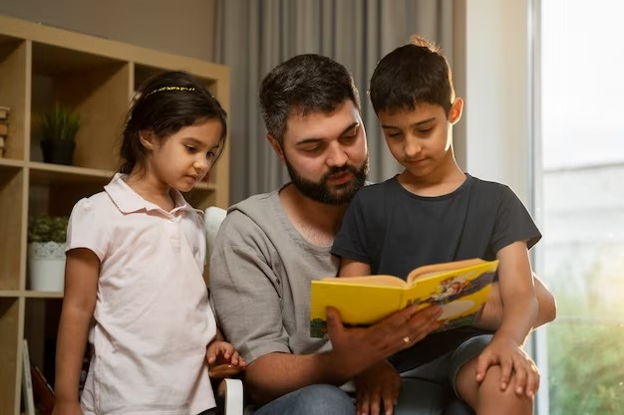
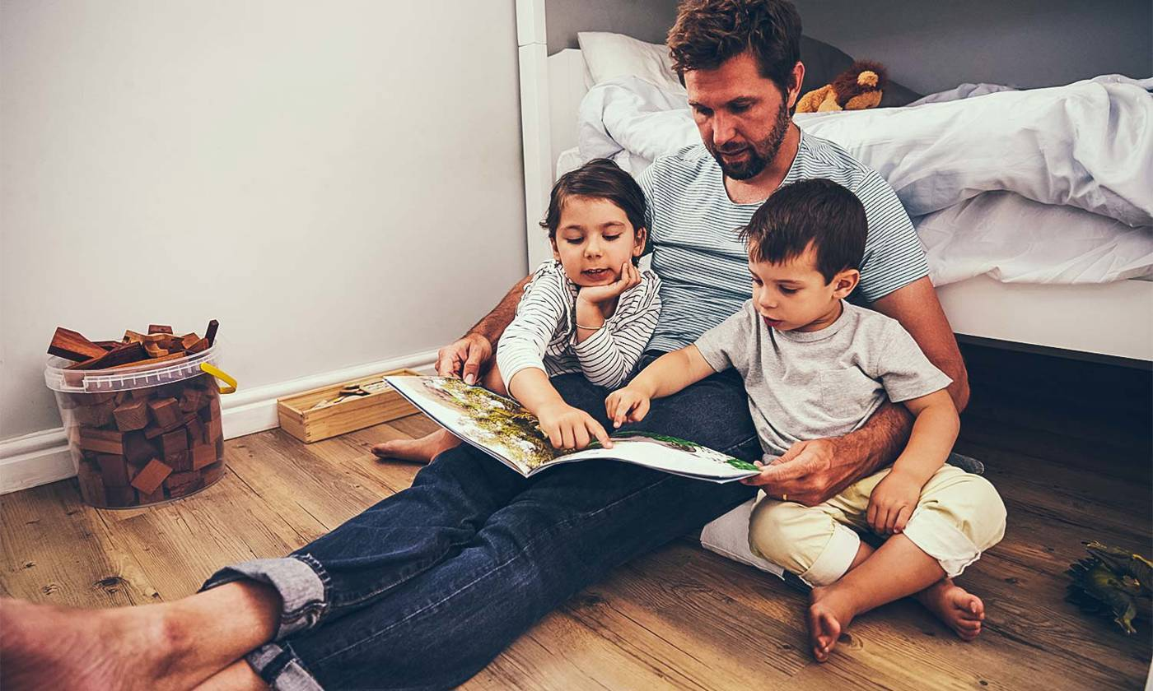
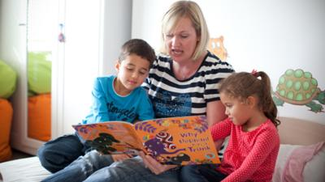
Reading At Home
Evidence from the Government, Ofsted, The National Literacy Trust and the Rowntree Foundation amongst other research groups suggest that:
If all children in the UK read for pleasure almost daily, the number getting five good GCSE grades could increase by 1.1 million over a generation.
- This would boost the average lifetime earnings of those individuals by an estimated £57,500.

Slide 7
Homework in Year 3
We want to make homework as straight forward and stress free for everyone!
Please listen to your child read every day for around 15 minutes.
Freckle Maths set each week.
TT Rock Stars each week- 3 times.
Usernames and logins will be in the Reading Record.
Suggested Websites for reading ideas:
https://www.penguin.co.uk/lit-in-colour
https://wordsforlife.org.uk/activities/filter/?age=5-8

Slide 8
Communicating with class teachers
At the beginning of the school day- staff on door duty
Phone or email the school office
At the end of the school day- staff with the children

Slide 9
Key Dates for Year 3
Swimming Lessons in School Time
Weeks beginning Monday 6th and Monday 13rd November
Also, weeks beginning Monday 13th May and Monday 20th May
Borwick Hall residential holiday (Years 3 and 4)
Thursday 7th and Friday 8th March 2024

Slide 10
How will you let me know how my child is doing throughout the year?
1. Sharing the curriculum and lesson content with you via class information sheets (newsletters).
2. Via parents' evenings and the summer term school report.
3. By sharing assessment information with you via Pupil Information Sheets.
4. Through informal communication at the doors and via phone or email when needed.
Parents of children with SEND have additional review points during the year.

Slide 11
Assessment Weeks
Termly Star Assessments in Reading and Maths
Summer assessments include paper based assessments in Maths and Arithmetic and Reading and Writing Assessments
Assessments are a key tool in finding out what strengths children have and what areas they need to develop further and to help to identify gaps in knowledge so that teachers can plan their future lessons. (For example, if a whole class is struggling on the "fractions" element of Maths, more lessons will focus on this. If all the class score well on times table questions, less time needs to be given to this.)
We approach all assessments positively with the children.

Slide 12
Resolving Issues
We wish for a smooth year for each and every child and family. However, it is inevitable that at times, issues and complexities may arise. It is in everybody's interest that these are dealt with quickly and effectively. Our process for supporting families to resolve problems is outlined here:
Class Teacher
Key Stage Leaders
KS1 Mr Sudell, KS2 Mrs Riley
Deputy Head
Mrs Duffy
If the issue concerns SEND our SENDCo is Mrs Richardson
Head Teacher
Mr Pritchard

Slide 13
Celebrating Success
We celebrate success and effort in many ways at Kennington. These include:
Daily in class celebrations of achievement e.g. Gold Star
Verbal Praise
Dojos- team treats
Certificates
Postcards home
Awards Assemblies
Book Tokens for the Book Machine
Wonder Wall

Slide 14
Any Questions
?

Slide 15
Thank you for coming to meet the staff this afternoon. We look forward to a great year working together!

