Slide 1

Meet The Teacher Session
Welcome to Year 6
Sycamore Class
Class Teacher: Miss Clarke
Supported by Miss Vaid

Slide 2
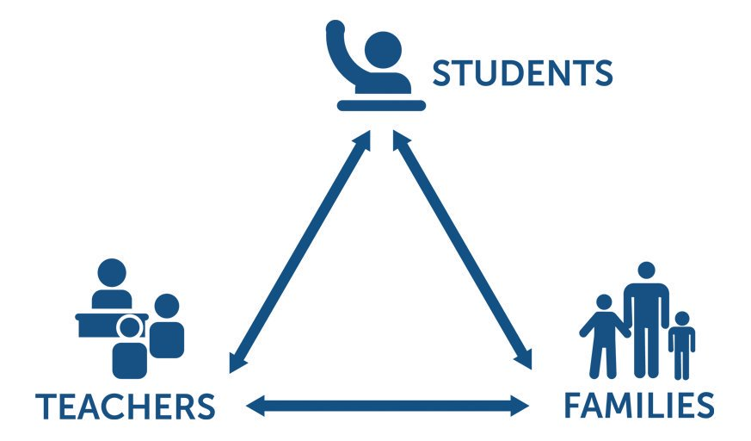
Pupil, family and teacher partnerships
Pupil, family and teacher partnerships
Your children achieve their full potential when all 3 work well together.
Notes:
Explain the importance of partnership working

Slide 3
Children can arrive from 8:35am doors locked at 8:50am. During this time, children have the opportunity to practice and consolidate skills.
Children who are late and arrive after 8:50am or after miss up to 20 minutes of learning each day – equating to an hour lost over the course of a week and 37 hours lost in a year. Punctuality is important at Kennington.
Formal teaching starts at 8:50.
PE is on Wednesdays and Fridays this term. Please ensure that your child comes into school in their PE kit on these days.
Water bottles and healthy snacks. Water bottles must be small, plastic bottles which have a sports cap to prevent spillages in class.
End of day collection. Please wait on the junior playground . At the end of the day, we often have great things to tell our families so please feel relaxed if we call you over! It's more often than not to celebrate success! School finishes at 3:20pm

Slide 4
Reading Journals
As we are a school that promotes reading for pleasure, we use reading journals to record reading. Each reading journal contains:
A question prompt sheet to help children respond to their reading book
A list of a variety of activities that the children can choose to complete in their reading journal
A reading tracker
A book review template
A reading book log to record their quiz scores
Reading journals allow our children to respond to a variety of texts in different ways.​
They provide space for reflection and evaluation as well as speculation and exploration of ideas, giving teachers valuable insight to their thinking and comprehension skills as they engage with text. Children will develop their reading skills through this approach as well as their ability to discuss and share recommendations, something which we value highly at Kennington.
We don’t expect the children to complete a large journal entry for ​ every single piece of reading they do. If they are short of time or​ the book hasn’t inspired them, they can just log the book as read.​ We will provide children with an opportunity to use their journals in our Accelerated Reader time as well as in our Book Club sessions. Entries into our journals will be shared weekly within our classes as well as in assemblies.

Slide 5
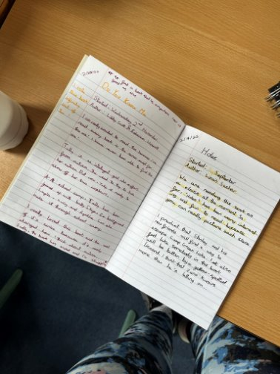
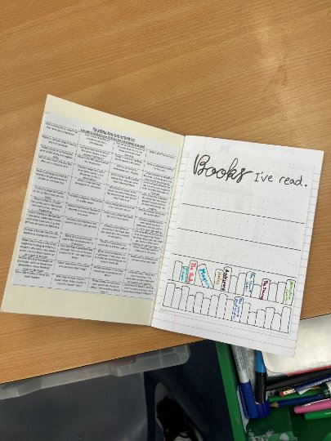
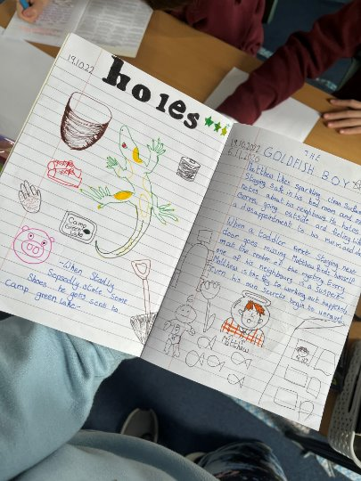
Examples of Reading Journals

Slide 6
Reading in School
In Year 6 children have access to a wide variety of quality books from our classroom library, as well as Booktopia (in the corridor).
Children chose their reading books based on their ZPD which is a range of books determined by their reading Star Assessment each term.
Once a child has finished their reading book, they will quiz on Accelerated Reader. This helps to determine their understanding of the text. We expect children to be quizzing a minimum of once every 2 weeks. As a parent, you can see your child’s progress with their quiz scores at home by using Renaissance Home Connect.
Across school, we ensure that our pupils receive a reading rich curriculum. Reading is at the core of our curriculum in order to instil an understanding in children that reading is a transferable skill and will benefit them in all subjects. We ensure that children read within and outside of reading lessons for a range of purposes. Teachers and teaching assistants listen to children read during our Accelerated Reader time.
Please support your child through regular reading at home and discussing the text as they read. This helps develop a greater set of comprehension skills and also allows them to develop ideas for writing. It is also beneficial for your child to see their parents as readers.

Slide 7
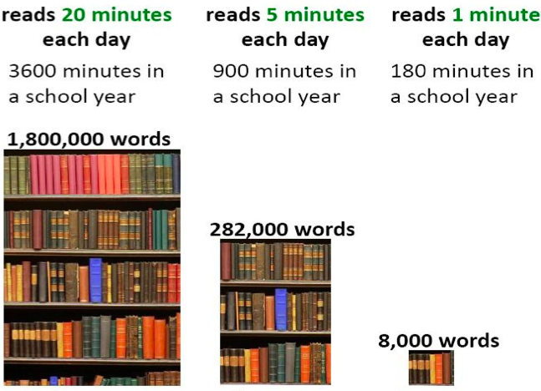
Reading At Home

Slide 8
Homework in Year 6
We want to make homework as straight forward and stress free for everyone!
In Year 6, we focus on getting your child high school ready. Therefore, there is an expectation that children take responsibility for managing their homework and ensuring it is completed on time.
Upper KS2 30-45 minutes per night
Reading – Daily 30 minutes minimum .
TT Rockstar Maths practise 10 minutes, 3 times a week.
Spellings/English/Maths – 10 minute workouts from CGP books (children have their own copies of these to write in)
During the Spring Term, children may receive additional homework tasks to the CGP books as we begin to focus on areas for revision.
All Usernames and login details have been sent home on their password card.

Slide 9
Communicating with class teachers
If you have anything you wish to discuss regarding school or your child, please do not hesitate to contact me.
I am always available at the end of the day on the playground
If you would like to arrange a more formal meeting, please contact the office.
TAs and Miss Broadbent/Miss Gavell can also always pass messages on if you ring school.
Parents evenings

Slide 10
Key Dates for Year
Monday 19th October – Thursday 22nd October – Bikeability
Wednesday 11th November – Parents Evening
BEFORE HALF TERM –
October Date TBC – HIGH SCHOOL ADMISSIONS AND SATS PARENT INFORMATION MEETING
31ST OCTOBER - APPLICATIONS FOR HIGH SCHOOL
SPRING TERM – BOOSTER CLASSES AFTER SCHOOL
February/March – MOCK SATS WEEK
MONDAY 10TH MAY – THURSDAY 13TH MAY 2027 – KS2 SATS WEEK
WEDNESDAY 23rd JUNE– FRIDAY 25TH JUNE 2027 Y6 Residential to PGL

Slide 11
Bikeability
Monday 19th October – Thursday 22nd October
Important Information
Children must already be able to ride a bike.
A roadworthy bike and helmet are required.
Bikes and helmets can be borrowed if needed.
Please indicate this on the consent form when completing it.
Why Take Part?
Build road safety awareness
Increase confidence when cycling
Learn practical cycling skills
Prepare for independent travel
We hope all Year 6 pupils will take advantage of this valuable opportunity!
Please complete the Bikeability consent form by Monday 5th October.
Scan the QR code below to complete the form

Slide 12
National Statutory Assessments
The KS2 tests assess children on:
GPS - English grammar, punctuation and spelling (2 papers)
Mathematics (reasoning and arithmetic)
Reading
MONDAY 10TH MAY – THURSDAY 13TH MAY 2027 – KS2 SATS WEEK
Teacher Assessment takes place throughout the year and is reported to you (July) in Writing and Science

Slide 13
PGL Centres
Outdoor education experts
A dedicated PGL groupie
24 on-centre support
Personalised programme
Children will be supervised by our teaching staff as well as PGL instructors throughout the day and evening. Any downtime will include adult supervision

Slide 14

What will we be doing?
Multi-activity Adventure
4 action packed adventure sessions per day
Exciting evening entertainment activities
3 delicious, nutritious meals a day

Slide 15
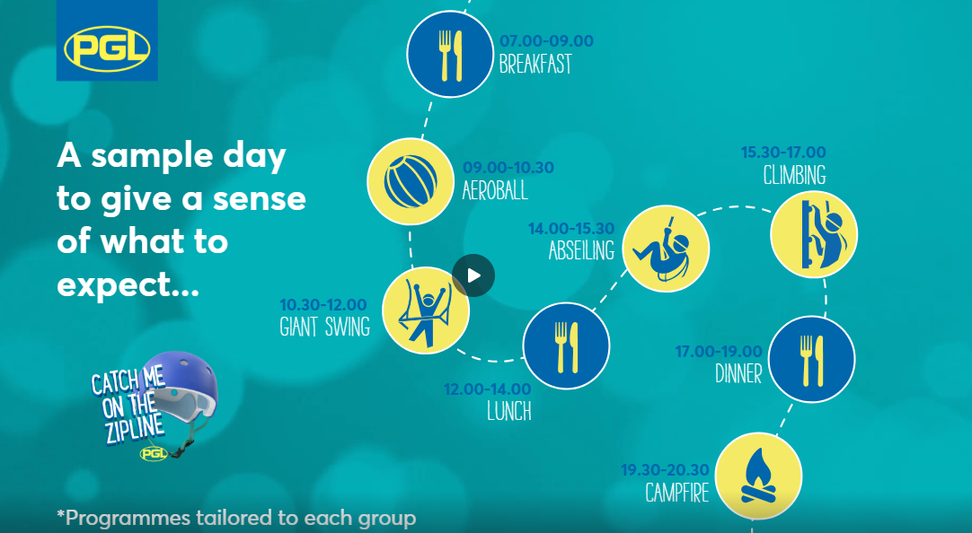

Slide 16
How will you let me know how my child is doing throughout the year?
1 Sharing the curriculum and lesson content with you via class information sheets.
2. Via parents' evenings and the summer term school report.
3. By sharing assessment information with you via Pupil Information Sheets
4. Through informal communication at the doors and via phone or email when needed.
Parents of children with SEND have additional review points during the year.

Slide 17
Assessment Weeks
Your child will be assessed regularly throughout their time in Y6 to help prepare them for their SATs and also to identify any gaps in knowledge that need to be retaught.
Each term, they will complete STAR Assessments. Additionally, in Year 6, they will complete 3 sets of practice SATs.
One at the end of September as a baseline which will be discussed during parents evening. Another at the end of the Autumn term and the final MOCK in March.
Assessments are a key tool in finding out what strengths children have and what areas they need to develop further.
Assessments help to identify gaps in knowledge so that teachers can plan their future lessons. For example, if a whole class is struggling on the "fractions" element of maths, more lessons will focus on this. If all the class score well on times table questions, less time needs to be given to this.
Our internal assessments are "low stakes" and we approach them positively with the children.

Slide 18
Resolving Problems
We wish for a smooth year for each and every child and family but it is inevitable that at times, issues and complexities may arise. It is in everybody's interest that these are dealt with quickly and effectively. Our process for supporting families to resolve problems is outlined here:
Class Teacher
Key Stage Leaders
(KS1 Mr Sudell, KS2 Miss Clarke)
Deputy Head
Mrs Duffy
Head Teacher
If the issue concerns SEND our SENCo is Mrs Duffy

Slide 19
Celebrating Success
We celebrate success and effort in many ways at Kennington. These include:
Certificates
Dojos
Verbal Praise
Awards Assemblies
Book Tokens for the Book Machine
Postcards home

Slide 20
Any Questions
?

Slide 21
Thank you for coming to meet us this afternoon and we look forward to a great year working together!

