Slide 1
Meet The Teacher Session
Welcome to Beech Class
Class Teacher: Mr Sudell
Supported by: Mrs Kaur

Slide 2
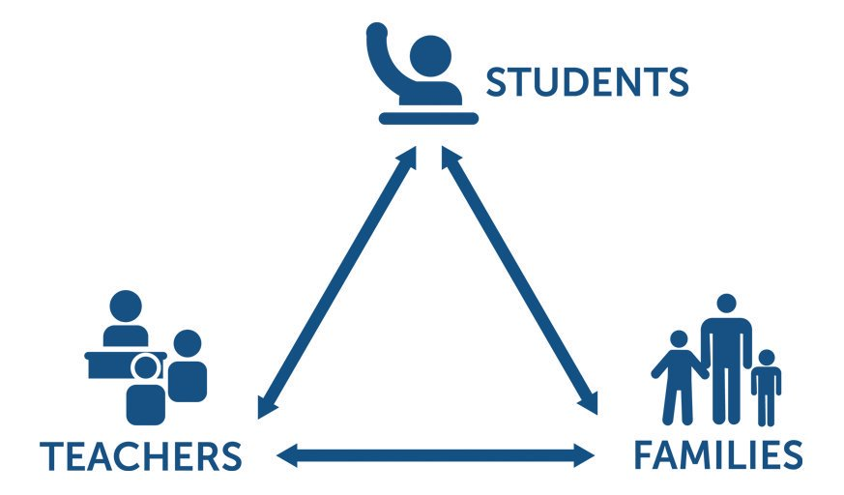
Pupil, family and teacher partnerships
Pupil, family and teacher partnerships
Your children achieve their full potential when all 3 work work well together.
Notes:
Explain the importance of partnership working

Slide 3
For your information…
Start Times:
Children can arrive from 8:35am. Doors will be locked at 8:50am. During this time children have the opportunity to practice and consolidate skills.
Children who are late and arrive after 8:35am could miss up to 20 minutes of learning each day – equating to an hour lost over the course of a week and 37 hours lost in a year. Punctuality is important at Kennington.
Formal teaching starts at 8:50am.
PE:
PE is currently on Thursdays and Fridays. Please ensure children have their PE kits on these days.
Water:
Water bottles can be brought in to school.
Hometime:
End of day collection: Please wait on the infant playground. Children will line up along the wall near the hall. At the end of the day, we often have great things to tell our families so please feel relaxed if we call you over. It's more often than not to celebrate success! School finishes at 3:00pm.

Slide 4
Reading in School
Last year, our reading scheme was updated with brand new phonics books and your child should now have a reading book to take home each day.
Reading in school (Guided Reading) books are linked to the new phonic sounds they are currently learning in phonic groups
Home reading books are related to phonic sounds they have previously been taught in earlier phases
Please aim to read every night with your child.
Little and often is best - it is not necessary to read the whole book in one night. Focus on talking about the book - the picture/story/characters/ if your child liked it or not -discuss why.
Share other stories together – books from home/the library and talk about the books

Slide 5
Reading continued
Reading diaries:
Please sign each time you read with your child.
Write down the pages read, add a comment about how they read or something they liked and then sign it.
If you read every night, you should have signed the diary 5 times in the week (or more including weekend)
When books are completed, comments will be reviewed, comprehension checked and then the book will be changed. If the diary isn’t signed, the book will not be changed. **Reading books will be changed on a Monday and Friday**
Reading Tokens- Each time your child completes a home reading book, they will be given a sticker on their reading rainbow. If they complete 2 arcs of the rainbow, they will receive a token to exchange for a new book from the vending machine in the hall.

Slide 6
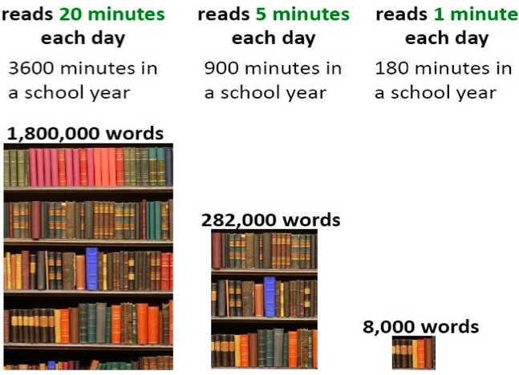
Reading At Home

Slide 7
Homework in Beech Class
We want to make homework as straight forward and stress free for everyone!
Reading – the main one! Every night.
Purplemash - child’s passwords and logins and passwords are stuck in the inside cover of your child’s reading diary. There will be 2 tasks set each week, linked to the Maths and Spellings done in class that week.
Homework will be given out on Mondays and will need to be completed by the following Monday.

Slide 8
Communicating with class teachers
Please talk to us if you have any questions, queries or problems – don’t let things brew and stew. We want to know so we can sort things out.
Write a message in the reading diary
Leave a message with the staff member on duty in a morning – messages are passed on when they come in
Talk to us at the end of the day (or if we are unable to talk there and then, we can arrange a suitable time)
Arrange a meeting with us

Slide 9
Resolving Problems
We wish for a smooth year for each and every child and family but it is inevitable that at times, issues and complexities may arise. It is in everybody's interest that these are dealt with quickly and effectively. Our process for supporting families to resolve problems is outlined here:
Class Teacher
Key Stage Leaders
(KS1 Mr Sudell, KS2 Mrs Riley)
Deputy Head
Mrs Duffy
Head Teacher
Mr Pritchard
If the issue concerns SEN our SENCo is Mrs Richardson

Slide 10
National Statutory Assessments
Phonics: Children will have completed a Phonics screening check in Year 1. Children who didn’t achieve the pass mark will have another chance to reach the pass mark at the end of Year 2.
KS1 SATS: These are no longer statutory- meaning they are now optional for us as a school
Standard assessment tests in May 2024
Assessing Maths, Reading, Grammar, Punctuation and Spelling
They are marked internally and they are used to support the overall teacher assessment.

Slide 11
Informing you of progress…
1. Sharing the curriculum and lesson content with you via class information sheets (newsletters) each term
2. Two in-person parents' evenings and the summer term school report.
3. By sharing assessment information with you via Pupil Information Sheets.
4. Through informal communication at the doors and via phone or email when needed.
Parents of children with SEND have additional review points during the year.

Slide 12
Assessment Weeks
Autumn and Spring term:
Maths – End of Term Tests- using NFER Assessments
Reading – End of Term Tests- using NFER Assessments
Writing – 4 written pieces of work, 1 per half term.
Summer Term
Maths- Mock Assessments and SATS: Arithmetic and reasoning Papers Reading- Mock Assessments and SATS: 2 Reading Papers Writing – 2 written pieces of work, 1 per half term.
Assessments are a key tool in finding out what strengths children have and what areas they need to develop further.
Assessments help to identify gaps in knowledge so that teachers can plan their future lessons. For example, if a whole class is struggling on the "fractions" element of maths, more lessons will focus on this. If all the class score well on times table questions, less time needs to be given to this.

Slide 13
Celebrating Success
We celebrate success and effort in many ways at Kennington. These include:
Certificates- Star of the Week and Reader of the Week
Dojos
Verbal Praise
Awards Assemblies
Attendance Incentives
Postcards home
Book Tokens for the Book Machine

Slide 14
Any Questions
?

Slide 15
Thank you for coming to meet us this afternoon and we look forward to a great year working together!

