Slide 1

Meet The Teacher Session
Welcome to Cherry Class.
Class Teachers:
Miss Hartley (Mon-Thurs)
Mrs Hayward (Friday)
Supported by:
Mrs Iqbal (Mon-Fri)
Miss Patel (Wed pm)

Slide 2
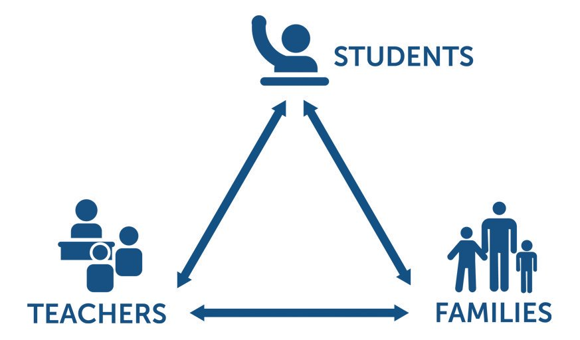
Pupil, family and teacher partnerships
Pupil, family and teacher patnerships
Your children achieve their full potential when all 3 work work well together.
Notes:
Explain the importance of partnership working

Slide 3
Children can arrive from 8:35am doors locked at 8:50am. during this time children have the opportunity to practice and consolidate skills.
Children who are late and arrive after 8:50am or after miss up to 20 minutes of learning each day – equating to an hour lost over the course of a week and 37 hours lost in a year. Punctuality is important at Kennington
Formal teaching starts at 8:50.
PE is on Tuesdays and Thursdays. Please ensure children have their PE kits on these days:
Navy blue shorts, white t-shirt and black pumps. Named. No earrings and long hair should be tied up.
Please have water bottles in school each day.
End of day collection. Please wait at the blue fence in the KS1 playground.
At the end of the day, we often have great things to tell our families so please feel relaxed if we call you over! It's more often than not to celebrate success!
School finishes at 3:00pm

Slide 4
Reading
Our reading scheme is currently being updated with brand new phonics books and books will be allocated very soon.
Reading in school (Guided Reading) books are linked to the new phonic sounds they are currently learning in phonic groups
Home reading books are related to phonic sounds they have previously been taught in earlier phases
Read every night with your child.
Little and often is best - it is not necessary to read the whole book in one night. Focus on talking about the book - the picture/story/characters/ if your child liked it or not -discuss why.
Share other stories together – books from home/the library and talk about the books

Slide 5
Reading continued
Reading diaries:
Please sign each time you read with your child.
Note the pages read, add a comment about how they read or something they liked and then sign it.
If you read every night, you should have signed the diary 5 times in the week (or more including weekend)
See example
When books are completed, comments will be reviewed, comprehension checked and then the book will be changed. If the diary isn’t signed, the book will not be changed.
Reading Dojos - if your child reads at least three time over the week – this includes weekends – and there are 3 comments/signatures in the diary, they will be awarded bonus reading dojos. These will be marked in the diary for you to see.

Slide 6
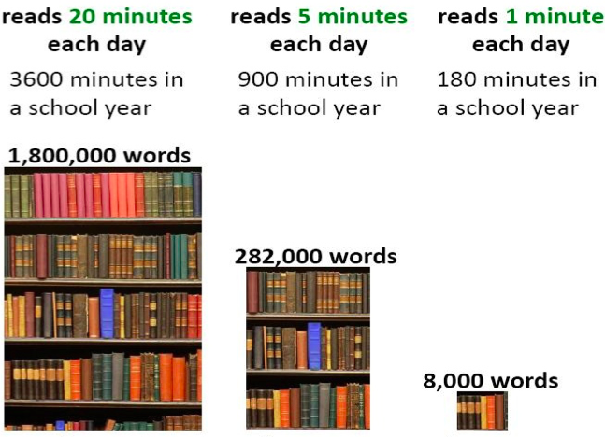
Reading At Home

Slide 7
Homework in Cherry Class
We want to make homework as straight forward and stress free for everyone!
Reading – the main one! Every night.
Tricky word flash cards – these will be in an envelope in your child’s reading diary.
6 words for your child to practise reading by sight (not sounding out). These will
be changed when your child can read them as a sight word.
Purple mash – your child’s passwords and logins are stuck in the inside cover of your child’s reading diary.
English activity (related to phonics or grammar work we are doing in class)
Maths activity (counting, number recognition, number bonds, basic addition/subtraction)
Purplemash will be set on a Friday to be completed by the following Thursday

Slide 8
Communicating with class teachers
We are a team –parents, staff and your children.
Please talk to us if you have any questions, queries or problems – don’t let things brew and stew. We want to know so we can sort things out.
Write a message in the reading diary
Leave a message with the staff member on duty in a morning – messages are passed on when they come in
Talk to us at the end of the day (or if we are unable to talk there and then, we can arrange a suitable time)
Arrange a meeting with us

Slide 9
National Statutory Assessments
Phonics Screening Check – June 2023
Reading a list of a mix of 40 real and alien (not real) words
Segmenting and blending to read words
Eg
c-a-t = cat
Sh-i-p =ship
B-r-u-sh = brush
The pass mark is allocated to us by the DfE after the check takes place
Informal setting 1 to 1 with the class teacher
Lots of practise within phonics sessions

Slide 10
How will you let me know how my child is doing throughout the year?
1 Sharing the curriculum and lesson content with you via class information sheets.
2. Via parents' evenings and the summer term school report.
3. By sharing assessment information with you via Pupil Information Sheets
4. Through informal communication at the doors and via phone or email when needed.
Parents of children with SEND have additional review points during the year.

Slide 11
Assessment Weeks
Autumn term:
Maths – teacher assessment tasks linked with our maths scheme (in small groups)
Reading – teacher assessment during Guided Reading sessions and one-to-one reading
Writing – an assessed written piece
Spring and Summer terms:
Maths – a White Rose (our maths scheme) assessment paper– completed in small groups
Reading – a comprehension assessment paper (completed in small groups step by step)
Assessments are a key tool in finding out what strengths children have and what areas they need to develop further.
Assessments help to identify gaps in knowledge so that teachers can plan their future lessons. For example, if a whole class is struggling on the "fractions" element of maths, more lessons will focus on this. If all the class score well on times table questions, less time needs to be given to this.
Our internal assessments are "low stakes" and we approach them positively with the children.

Slide 12
Resolving Problems
We wish for a smooth year for each and every child and family but it is inevitable that at times, issues and complexities may arise. It is in everybody's interest that these are dealt with quickly and effectively. Our process for supporting families to resolve problems is outlined here:
Class Teacher
Key Stage Leaders
(KS1 Mr Sudell, KS2 Mrs Riley)
Deputy Head
Mrs Duffy
Head Teacher
If the issue concerns SEND our SENCo is Mrs Richardson

Slide 13
Celebrating Success
We celebrate success and effort in many ways at Kennington. These include:
Certificates
Dojos
Verbal Praise
Awards Assemblies
Postcards home
Book Tokens for the Book Machine

Slide 14
Any Questions
?

Slide 15
Thank you for coming to meet us this afternoon and we look forward to a great year working together!

