Slide 1

Meet The Teacher Session
Welcome to Cherry Class
Class Teacher: Miss Bellusci

Slide 2
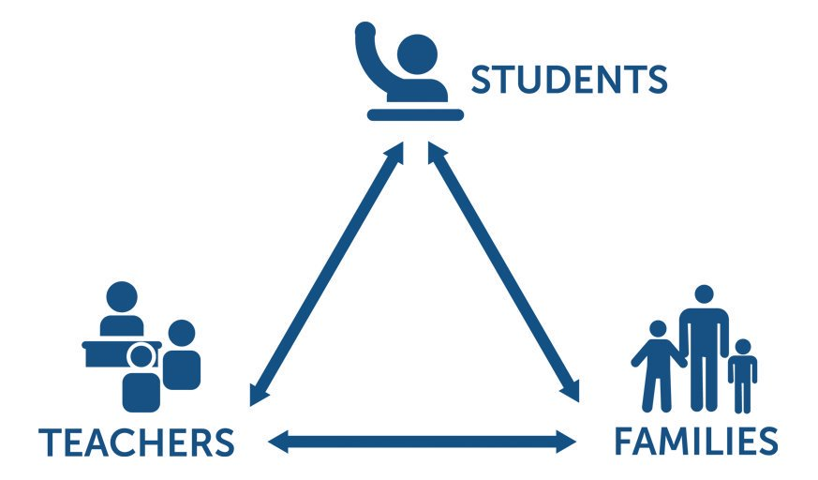
Pupil, family and teacher partnerships
Pupil, family and teacher partnerships
Your children achieve their full potential when all 3 work well together.
Notes:
Explain the importance of partnership working

Slide 3
For your information…
Start Times:
Children can arrive from 8:35am. Gates will be locked at 8:55am.
During this time children have the opportunity to practice and consolidate skills.
Formal teaching starts at 8:55am.
PE:
PE is currently on Tuesdays and Thursdays
Please ensure children are in their PE kits on these days.
End of day collection:
Please wait on the infant playground, children will wait on the Oak outdoor area, where children will wait by the blue gate. Children know not to leave until I have seen you!
At the end of the day, we often have great things to tell our families so please
feel relaxed if we call you over. It is usually to celebrate success!
School finishes at 3:20pm.
Hometime:

Slide 4
Reading in School
Your child should now have a reading book to take home each day.
Home reading books are related to phonic sounds they have previously been taught in earlier phases
Reading in school (Guided Reading) books are linked to the new phonic sounds they are currently learning in Phonics groups
Please aim to read every night with your child.
Little and often is best - it is not necessary to read the whole book in one night. Focus on talking about the book - the picture/story/characters/ if your child liked it or not -discuss why.
Share other stories together – books from home/the library and talk about the books

Slide 5
Reading continued
Reading diaries:
Please sign each time you read with your child.
Write down the pages read, add a comment about how they read or something they liked and then sign it.
When books are completed, comments will be reviewed, comprehension checked and then the book will be changed. If the diary isn’t signed, the book will not be changed.
Please bring reading books and diaries into school each day.
**Reading books will be changed on a Monday and Wednesday**
Reading Tokens- Each time your child completes a home reading book, they will be given a sticker on their reading rainbow. If they complete 2 arcs of the rainbow, they will receive a token to exchange for a new book from the vending machine in the hall.

Slide 6
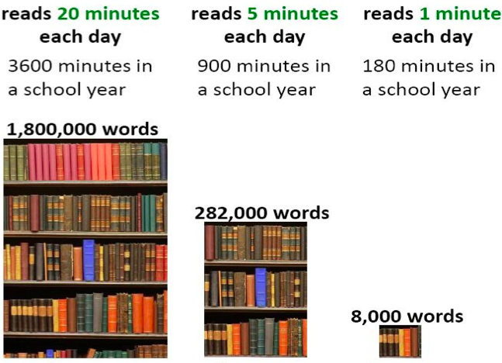
Reading At Home

Slide 7
Homework in Cherry Class
We want to make homework as straight forward and stress free for everyone!
Reading – the main one- every night if possible!
Purplemash - child’s passwords and usernames are stuck in back of your child’s reading diary.
There will be 1 task set each week, linked to the Maths or English done in class that week.
Homework will be given out on Mondays and will need to be completed by the following Monday.

Slide 8

Routines
-Morning activities during registration
-Phonics- in groups
-Maths- in groups
-Breaktime
-English
-Lunch
-Handwriting and Number Sense
-Topic lessons- Science, History, Geography, DT, Art, Music, PSHE, PE, RE
-Short break and snack
-Story/ Singing
*Thursdays look sightly different with PE in the morning, meaning that English is in the afternoon.

Slide 9
Communicating with class teachers
Please talk to us if you have any questions, queries or problems.
We want to know so we can sort things out.
Write a message in the reading diary
Leave a message with the staff member on duty in a morning – messages are passed on when they come in
Talk to us at the end of the day
(or if we are unable to talk there and then, we can arrange a suitable time)
Arrange a meeting with us by phoning the office

Slide 10
Resolving Problems
We wish for a smooth year for each and every child and family but it is inevitable that at times, issues and complexities may arise. It is in everybody's interest that these are dealt with quickly and effectively. Our process for supporting families to resolve problems is outlined here:
Class Teacher
Key Stage Leaders
(KS1 Mr Sudell, KS2 Miss Clarke)
Deputy Head
Mrs Duffy
Head Teacher
Mr Pritchard
If the issue concerns SEN our current SENCo is Mrs Duffy

Slide 11
National Statutory Assessments
Phonics:
Year 1 children will complete their Phonics screening check in May 2027- usually a pass mark of 32 out of 40.
Year 2 Children will have completed a Phonics screening check in Year 1. Children who didn’t achieve the pass mark will have another chance to reach the pass mark at the end of Year 2.

Slide 12
Passing on any information…
1. Class information sheets (newsletters) are shared each term.
2. Two in-person parents' evenings, termly Pupil Information Sheets and the summer term school report will communicate progress.
Parents of children with SEND have additional review points during the year.

Slide 13
Celebrating Success
We celebrate success and effort in many ways at Kennington. These include:
Certificates- Star of the Week and Reader of the Week
Dojos
Gold Star on the traffic light
Verbal Praise
Attendance Incentives
Postcards home
Book Tokens for the Book Machine
Stickers

Slide 14
Any Questions
?

Slide 15
Thank you for coming this afternoon and we look forward to a great year working together!

