Slide 1
Meet The Teacher Session
Acer Class
Welcome to Year 4
Class Teacher: Miss O’Brien
Supported by Miss Bellusci
Supported by Miss Griffin

Slide 2
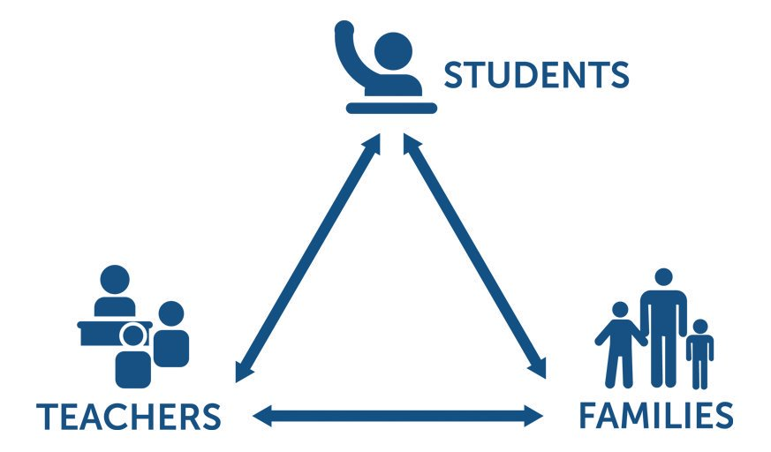
Pupil, family and teacher partnerships
Pupil, family and teacher partnerships
Your children achieve their full potential when all 3 work work well together.
Notes:
Explain the importance of partnership working

Slide 3
Children can arrive from 8:35am doors locked at 8:50am. during this time children have the opportunity to practice and consolidate skills.
Children who are late and arrive after 8:50am or after miss up to 20 minutes of learning each day – equating to an hour lost over the course of a week and 37 hours lost in a year. Punctuality is important at Kennington.
Formal teaching starts at 8:50.
Water bottles and healthy snacks.
End of day collection. Please wait on the junior playground . At the end of the day, we often have great things to tell our families so please feel relaxed if we call you over! It's more often than not to celebrate success! School finishes at 3:00pm

Slide 4
PE and Swimming
PE is on Monday and occasionally Wednesdays (when no swimming). Please ensure children have both indoor and outdoor kits on these days.
Swimming dates:
Week beginning 17th October (every day)
Week beginning 31st October (every day)
Week beginning 20th March (every day)
Week beginning 27th March (every day)
We encourage children to bring a snack on swimming days as we often find they get very hungry!

Slide 5
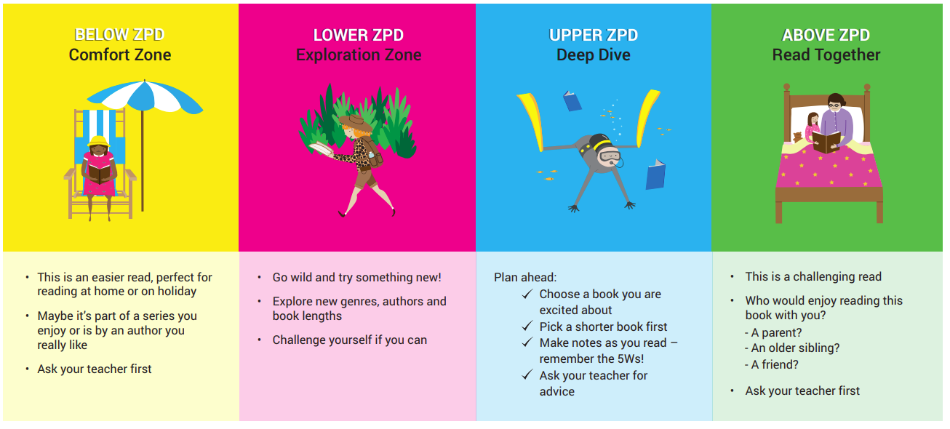
Reading in School
Accelerated reader
Quiz termly for ZPD
The Zone of Proximal Development (ZPD) defines the readability range within which pupils should read to best develop their reading, while avoiding frustration.

Slide 6
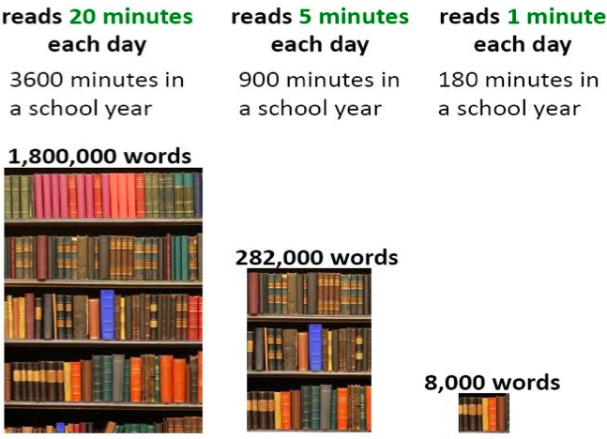
Reading At Home

Slide 7
Completed books
Book changing days:
Monday
Wednesday
Friday
Not their day/ not quizzed before cut-off time?
Reading journal activities
Read another book at home/ re-read favourite part

Slide 8
Homework in Year 4
We want to make homework as straight forward and stress free for everyone!
Usernames and logins will be in your child's homework diary.
Homework is set on a Thursday and expected to be completed by the following Friday.
In year 4, this looks like...
Freckle or MyMaths task (min 1, max 2)
Accessing TTRockstars at least 3 times a week at home.
This is in addition to reading daily, ideally to an adult at home for 15 minutes

Slide 9
Communicating with class teachers
Any day-to-day messages:
- Staff member on door duty in the morning
- End of day
Private/ lengthier conversations:
- Please contact office for an appointment

Slide 10
Key Dates for Year
Swimming block 1: 17-21st October
Swimming block 2: 31st October- 4th November
Borwick Hall visit: tbc- March 2023
Multiplication check: 6-24th June

Slide 11
National Statutory Assessments
The multiplication tables check (MTC) is statutory for all primary schools.
The purpose of the MTC is to determine whether pupils can recall their times tables.
Schools must administer the MTC to all eligible year 4 pupils between Monday 6 June and Friday 24 June.
We do lots of work in school to help your child to learn their times tables.
Proven that 'little and often' is most effective in retaining this information.

Slide 12
1 Sharing the curriculum and lesson content with you via class information sheets.
2. Via parents' evenings and the summer term school report.
3. By sharing assessment information with you via Pupil Information Sheets
4. Through informal communication at the doors and via phone or email when needed.
5. Parents of children with SEND have additional review points during the year.
How will you let me know how my child is doing throughout the year?

Slide 13
Assessment Weeks
Formal testing termly (Au, Sp- STAR, Su-NFER)
Informal test at the end of each unit in maths
Assessed piece at the end of each writing unit
Assessments are a key tool in finding out what strengths children have and what areas they need to develop further.
Assessments help to identify gaps in knowledge so that teachers can plan their future lessons. For example, if a whole class is struggling on the "fractions" element of maths, more lessons will focus on this. If all the class score well on times table questions, less time needs to be given to this.
Our internal assessments are "low stakes" and we approach them positively with the children.

Slide 14
Resolving Problems
We wish for a smooth year for each and every child and family but it is inevitable that at times, issues and complexities may arise. It is in everybody's interest that these are dealt with quickly and effectively. Our process for supporting families to resolve problems is outlined here:
Class Teacher
Key Stage Leaders
(KS1 Mr Sudell, KS2 Mrs Riley)
Deputy Head
Mrs Duffy
Head Teacher
If the issue concerns SEND our SENCo is Mrs Richardson

Slide 15
Celebrating Success
We celebrate success and effort in many ways at Kennington. These include:
Certificates
Dojos
Verbal Praise
Awards Assemblies
Book Tokens for the Book Machine

Slide 16
Any Questions
?

Slide 17
Thank you for coming to meet us this afternoon and we look forward to a great year working together!

