Slide 1

Meet The Teacher Session
Welcome to Year 5
Class Teacher: Miss Kuczera
Supported by Mrs Nutall
Supported by Mrs Bentley

Slide 2
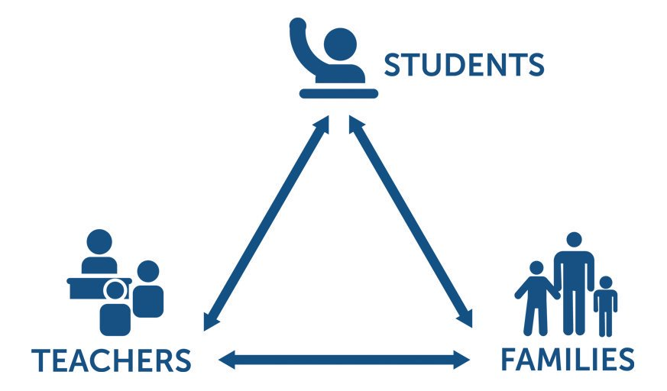
Pupil, family and teacher partnerships
Pupil, family and teacher partnerships
Your children achieve their full potential when all 3 work work well together.
Notes:
Explain the importance of partnership working

Slide 3
Children can arrive from 8:35am doors locked at 8:50am. during this time children have the opportunity to practice and consolidate skills.
Children who are late and arrive after 8:50am or after miss up to 20 minutes of learning each day – equating to an hour lost over the course of a week and 37 hours lost in a year. Punctuality is important at Kennington
Formal teaching starts at 8:50.
PE is on Wednesdays and Thursdays. Please ensure children have both indoor and outdoor kits on these days.
Water bottles and healthy snacks.
End of day collection. Please wait on the junior playground . At the end of the day, we often have great things to tell our families so please feel relaxed if we call you over! It's more often than not to celebrate success! School finishes at 3:00pm

Slide 4
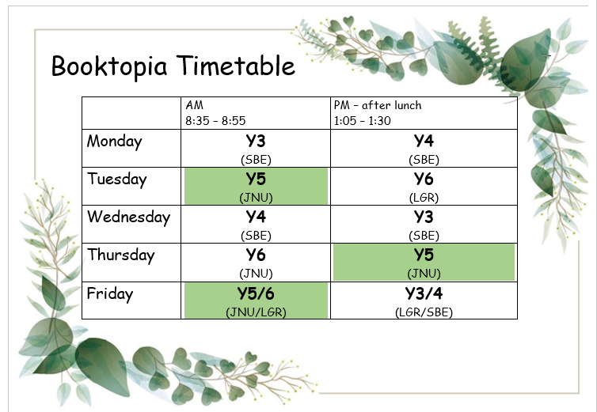
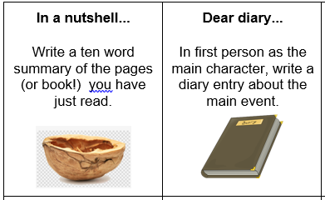
Reading in School
In Year 5 children have access to a wide variety of quality books from our classroom library, as well as Booktopia (in the corridor).
Children chose their reading books based on their ZPD which is a range of books determined by their reading Star Assessment each half term.
Once a child has finished their reading book, they will quiz on Accelerated Reader. This helps to determine their understanding of the text.
If children have completed their reading book but it is not their day to change it, they have activities they can complete in their reading journal. Each task should take around 20 minutes to complete.
In class, all children read at least twice a week with an adult in school, in addition to whole class guided reading sessions.

Slide 5
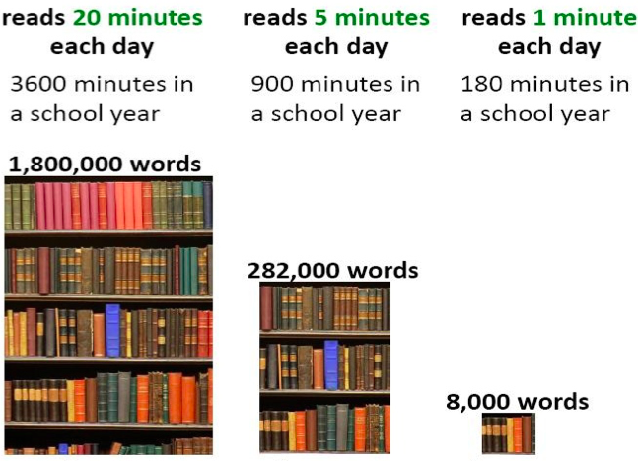
Reading At Home

Slide 6
Homework in Year 5
We want to make homework as straight forward and stress free for everyone!
Upper KS2 30-45 minutes per night
Currently our homework policy is being revised and when it is finalised this will be sent out to you.
Reading – Daily 30 minutes minimum
Freckle – Min. 1 task, max 3 tasks per week.
TT Rockstar Maths practise 10 minutes, 3 times a week.
Spellings – Maximum 10 per week and spelling investigation
Spellings:
Spellings will be given out on Google Classroom, your child can complete the spellings on paper and upload a photo to Google Classroom, or they can complete it on Google Classroom.
All Usernames and login details will be in the back of your child’s homework diary.

Slide 7
Communicating with class teachers
At the beginning of the school day- staff on door duty
Communicating through homework diaries
Phone or email the school office
At the end of the school day- staff with the children

Slide 8
Key Dates for Year
16th September Tempest photographs
30th September Coffee Afternoon
19th October Parents evening
17th March Sports day
As further events are organised within school you will be informed through parent app.
Corpus Chrsiti Open evening Tuesday 20th September

Slide 9
How will you let me know how my child is doing throughout the year?
1 Sharing the curriculum and lesson content with you via class information sheets.
2. Via parents' evenings and the summer term school report.
3. By sharing assessment information with you via Pupil Information Sheets
4. Through informal communication at the doors and via phone or email when needed.
Parents of children with SEND have additional review points during the year.

Slide 10
Assessment Weeks
Year 5 is beginning to prepare your children for SATs
Ongoing teacher assessments across the curriculum e.g. end of unit assessments (maths)
Termly Star assessments in Reading and Maths
Summer term assessments: NFeR paper based assessments for reading, spelling, punctuation and grammar. White rose paper assessments for Maths.
Assessments are a key tool in finding out what strengths children have and what areas they need to develop further.
Assessments help to identify gaps in knowledge so that teachers can plan their future lessons. For example, if a whole class is struggling on the "fractions" element of maths, more lessons will focus on this. If all the class score well on times table questions, less time needs to be given to this.
Our internal assessments are "low stakes" and we approach them positively with the children.

Slide 11
Resolving Problems
We wish for a smooth year for each and every child and family but it is inevitable that at times, issues and complexities may arise. It is in everybody's interest that these are dealt with quickly and effectively. Our process for supporting families to resolve problems is outlined here:
Class Teacher
Key Stage Leaders
(KS1 Mr Sudell, KS2 Mrs Riley)
Deputy Head
Mrs Duffy
Head Teacher
If the issue concerns SEND our SENCo is Mrs Richardson

Slide 12
Celebrating Success
We celebrate success and effort in many ways at Kennington. These include:
Certificates
Dojos
Verbal Praise
Awards Assemblies
Postcards home
Work to be proud of display
Book Tokens for the Book Machine

Slide 13
Any Questions
?

Slide 14
Thank you for coming to meet us this afternoon and we look forward to a great year working together!

