Slide 1

Meet The Teacher Session
Welcome to Ash Class Year 5
Class Teacher: Miss Kuczera
Supported by:
Mrs Iqbal and Miss Vade

Slide 2
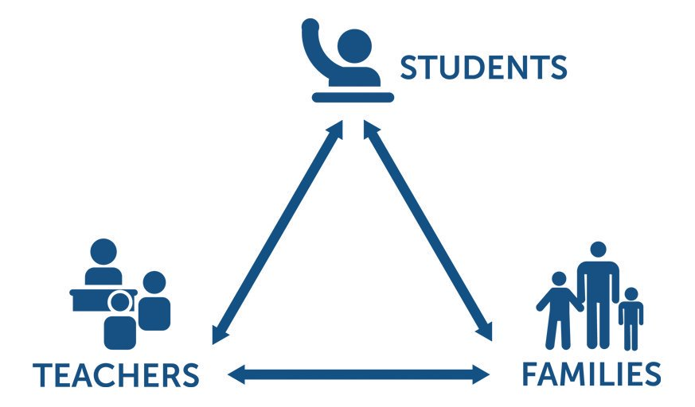
Pupil, family and teacher partnerships
Pupil, family and teacher partnerships
Your children achieve their full potential when all 3 work well together.
Notes:
Explain the importance of partnership working

Slide 3
Children can arrive from 8:35am doors locked at 8:55am. During this time children have the opportunity to practice and consolidate skills.
Children who are late and arrive after 8:55am or after miss up to 20 minutes of learning each day – equating to an hour lost over the course of a week and 37 hours lost in a year. Punctuality is important at Kennington.
Formal teaching starts at 8:50.
PE is currently on Tuesdays and Wednesdays. Please ensure children come to school in their PE kits on these days.
Water bottles and healthy snacks. Water bottles must be small, plastic bottles which have a sports cap to prevent spillages in class.
End of day collection. Please wait on the junior playground . At the end of the day, we often have great things to tell our families so please feel relaxed if we call you over! It's more often than not to celebrate success! School finishes at 3:20pm

Slide 4
Reading Journals
As we are a school that promotes reading for pleasure. Instead of reading diaries, each child will have their own reading journal. Each reading journal will contain:
A question prompt sheet to help children respond to their reading book
A list of a variety of activities that the children can choose to complete in their reading journal
A reading tracker
A book review template
A reading book log to record their quiz scores
Reading journals allow our children to respond to a variety of texts in different ways.​
They provide space for reflection and evaluation as well as speculation and exploration of ideas, giving teachers valuable insight to their thinking and comprehension skills as they engage with text. Children will develop their reading skills through this approach as well as their ability to discuss and share recommendations, something which we value highly at Kennington.
We don’t expect the children to complete a large journal entry for ​ every single piece of reading they do. If they are short of time or​ the book hasn’t inspired them, they can just log the book as read.​ We will provide children with an opportunity to use their journals in our Accelerated Reader time as well as in our Book Club sessions. Entries into our journals will be shared weekly within our classes as well as in assemblies.

Slide 5
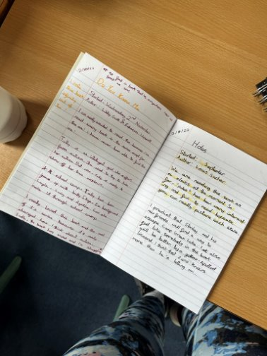
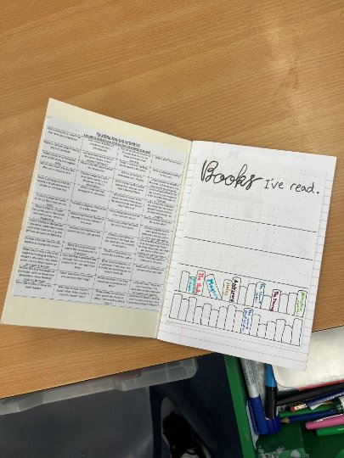
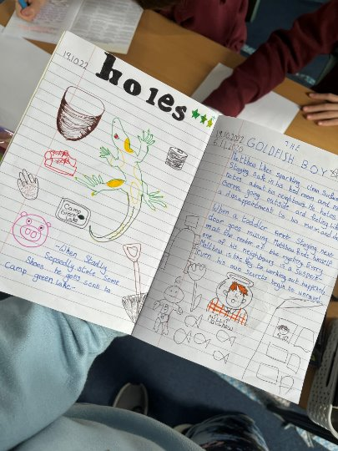
Examples of Reading Journals

Slide 6
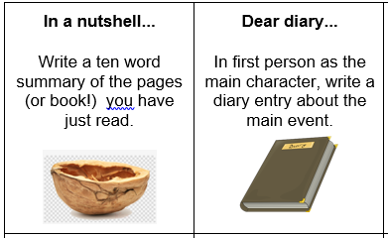
Reading in School
In Year 5 children have access to a wide variety of quality books from our classroom library, as well as Booktopia (in the corridor).
Children choose their reading books based on their ZPD which is a range of books determined by their reading Star Assessment each half term.
Once a child has finished their reading book, they will quiz on Accelerated Reader. This helps to determine their understanding of the text. As a parent, you can see your child’s progress with their quiz scores at home by using Renaissance Home Connect.
If children have completed their reading book but it is not their day to change it, they have activities they can complete in their reading journal. Each task should take around 20 minutes to complete.
In class, all children read regularly with an adult in school, in
addition to whole class guided reading sessions.
Please support your child through regular reading at home and discussing the text as they read. This helps develop a greater set of comprehension skills and also allows them to develop ideas for writing. It is also beneficial for your child to see their parents as readers.

Slide 7
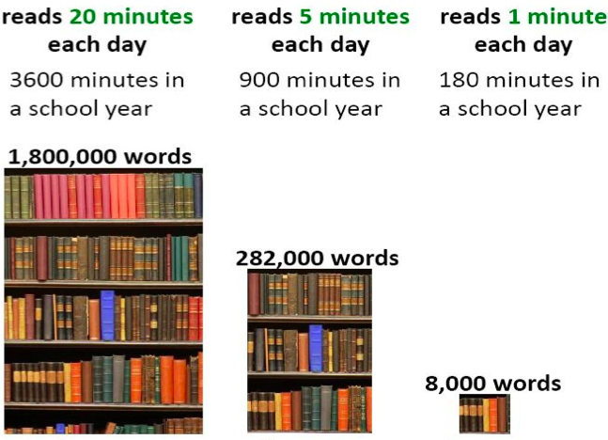
Reading At Home

Slide 8
Homework in Year 5
We want to make homework as straight forward and stress free for everyone!
Upper KS2 30-45 minutes per night
Reading – Daily 15 minutes minimum
TT Rockstar Maths practise- 10 minutes, 3 times a week
Spelling or Grammar – 1 task per week
Maths – One CGP workout per week
All Usernames and login details have been sent home on their password card.

Slide 9
Communicating with class teachers
If you have anything you wish to discuss regarding school or your child, please do not hesitate to contact me.
I am always available at the end of the day on the playground
If you would like to arrange a more formal meeting, please contact the office.
TAs and Miss Broadbent can also always pass messages on if you ring school.
Parents evenings

Slide 10



Linking School Project
This is a national programme that brings together children from different schools and communities to learn about one another, celebrate diversity and develop friendships. The project aims to: Build understanding, respect and empathy for others. Help children recognise and celebrate similarities and differences. Develop confidence in speaking, listening and sharing ideas. Encourage curiosity about different backgrounds, cultures and experiences. Promote positive relationships and a sense of belonging. We are looking forward to seeing the friendships, confidence and understanding that grow through this exciting project.

Slide 11
Key Dates for Year
Friday 25th September – Kennington Bake Off
Friday 25th September – Macmillan coffee afternoon
Tuesday 6th October PNE visit
High school open evenings
Hutton: Thursday 1st October, 5:30pm-8pm
Penwortham Girls: Thursday 8th October from 5pm - 8pm
Corpus Christi Catholic High School: Thursday, 1 October 2026, from 4:00 PM to 6:00pm
Our Lady's Catholic High School: Thursday 1st October from 6pm - 8:30pm
The Eden Boys' School: Thursday, 1st October 2026 from 5:00 PM to 8:00 PM
As further events are organised within school you will be informed through parent app.

Slide 12
How will you let me know how my child is doing throughout the year?
1 Sharing the curriculum and lesson content with you via class information sheets.
2. Via parents' evenings and the summer term school report.
3. By sharing assessment information with you via Pupil Information Sheets
4. Through informal communication at the doors and via phone or email when needed.
Parents of children with SEND have additional review points during the year.

Slide 13
Assessment Weeks
Your child will be assessed regularly throughout their time in Y5 to identify any gaps in knowledge that need to be retaught.
Ongoing teacher assessments across the curriculum e.g. end of unit assessments (maths)
Termly Star assessments in Reading
Termly Lancashire maths assessments
Summer term assessments: NFeR paper based assessments for reading, spelling, punctuation and grammar and Maths.
Assessments are a key tool in finding out what strengths children have and what areas they need to develop further.
Assessments help to identify gaps in knowledge so that teachers can plan their future lessons. For example, if a whole class is struggling on the "fractions" element of maths, more lessons will focus on this. If all the class score well on times table questions, less time needs to be given to this.
Our internal assessments are "low stakes" and we approach them positively with the children.

Slide 14
Resolving Problems
We wish for a smooth year for each and every child and family but it is inevitable that at times, issues and complexities may arise. It is in everybody's interest that these are dealt with quickly and effectively. Our process for supporting families to resolve problems is outlined here:
Class Teacher
Key Stage Leaders
(KS1 Mr Sudell, KS2 Miss Clarke)
Deputy Head
Mrs Duffy
Head Teacher
If the issue concerns SEND our SENCo is Mrs Duffy

Slide 15
Celebrating Success
We celebrate success and effort in many ways at Kennington. These include:
Certificates
Dojos
Verbal Praise
Awards Assemblies
Postcards home
Book Tokens for the Book Machine

Slide 16
Any Questions
?

Slide 17
Thank you for coming to meet us this afternoon and we look forward to a great year working together!

