Slide 1
Meet The Teacher Session
Welcome to Reception
Oak Class
Class Teachers: Mrs J Harris &
Mrs J Duffy
Supported by Miss C Broadbent
Supported by Miss S Bellusci

Slide 2
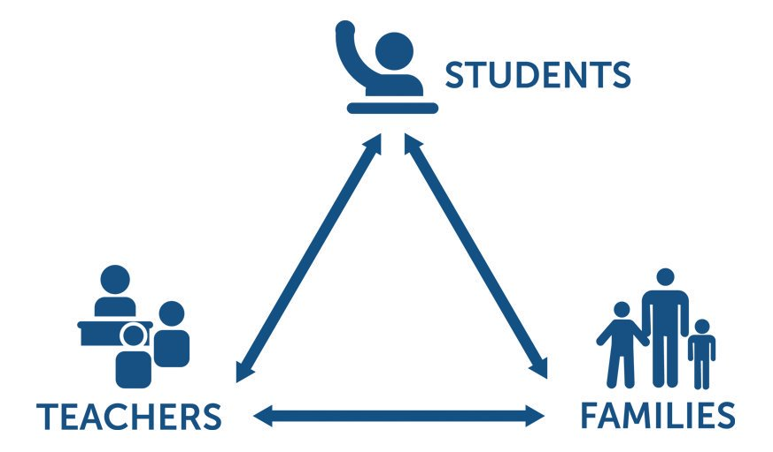
Pupil, family and teacher partnerships
Pupil, family and teacher patnerships
Your children achieve their full potential when all 3 work work well together.
Notes:
Explain the importance of partnership working

Slide 3
Children can arrive from 8:35am doors locked at 8:50am. during this time children have the opportunity to practice and consolidate skills.
Children who are late and arrive after 8:50am or after miss up to 20 minutes of learning each day – equating to an hour lost over the course of a week and 37 hours lost in a year. Punctuality is important at Kennington
Formal teaching starts at 8:50.
PE is on Thursdays. Please ensure children have both indoor and outdoor kits on these days.
Water bottles and healthy snacks.
End of day collection. Please wait on the infant playground. At the end of the day, we often have great things to tell our families so please feel relaxed if we call you over! It's more often than not to celebrate success!
When collecting your child, please can you stand back away from the door. This is to ensure that we can see all parents and gives children a clear pathway towards their parent.
School finishes at 3:00pm

Slide 4
Reading in School
We can not express how important reading from an early age is.
Reading makes up a fundamental part of language development in early childhood. Not only does it help with a child’s ability to understand words, it also ignites the spark for imagination. Reading also plays a crucial role for speech development and introduces children to the world around them as well as new concepts.
Please try to make reading a part of your child’s daily routine at home.
Reading should be fun and not just another chore to get through. Children to enjoy listening to stories as well as looking at books independently. This builds the foundations for a continued love for reading as they start school and progress into adulthood. If we can get the reading journey right from a young age, we are setting children up for life.
We will be sending home reading books next week. Later in the term children will bring home a library book each week. At this stage, library books will generally be beyond their word reading skills and are intended to be read to the children and enjoyed together.

Slide 5
Reading At Home

Slide 6
Wordless books
The first books we will send home will be wordless, picture books. This is because children haven’t learnt enough phonic sounds and words to read books with text.
You may think- wordless books? What’s the point?
Picture books are a great way to introduce young children to the world of reading.
They develop the following skills:
Comprehension Skills
2. Confidence and Independence
3. Verbal Skills and Discussion
4. Acquisition of New Vocabulary
5. Visual Appreciation
6. Story Structure and Sequencing
7. Writing Skills

Slide 7
Phonics
Early years phonics is a method of teaching children how to read and write by focusing on the sounds and letters that form words.
Phonics involves matching the sounds of spoken English with individual letters or groups of letters. For example, the sound k can be spelled as c, k, ck or ch. Teaching children to blend the sounds of letters together helps them decode unfamiliar or unknown words by sounding them out.
Through learning phonics, children are working towards meeting the Early Learning Goals for reading and writing (commonly referred to as ‘Literacy’).
By the end of Reception then children should use their phonics knowledge to be able to:
-Continue a rhyming string (eg. bat, hat, cat…mat).
-Hear and say the initial sound in words.
-Segment the sounds in simple words and blend them together and know which letters represent some of them.
-Link sounds to letters, naming and sounding the letters of the alphabet.
-Begin to read words and simple sentences

Slide 8
Homework in Reception
We want to make homework as straight forward and stress free for everyone!
In Oak class, we set the following homework:
Reading- with and to your child
Self-care
Encourage your child to become independent with self-care. We are well equipped to deal with accidents but please teach them independence when using the toilet. Show them how to wash their hands when dirty, how to use aprons to protect their clothing, and how to clean up after themselves, too.
Getting dressed
For P.E. lessons, outdoor learning, or even just to remove a layer when hot, it is important that your child is able to dress and undress independently.
Name recognition
Before they can begin to write their own name, children need to be able to recognise the patterns and shapes of letters within their name. Once they have mastered this, begin to practise writing their name.
Simple counting
Encourage your child to practise counting so that number patterns become second nature to them. See if you can spot numbers in your day-to-day environment and encourage children to identify them. Learning numbers doesn’t have to be boring!
Let them rest
In the first half term of school, your child will be very, very tired. For many, this is their first time in a full-time educational setting and it can be a big shock to the system.

Slide 9
Communicating with class teachers
In Oak class, we like to greet the children and yourselves at the door each morning.
We are available for a brief chat, if there are any issues but please be aware that we have 35 children awaiting us.
Our daily teaching routines, involving all staff members, start right at the beginning of each day so we need to get in and get teaching.
If you have anything to discuss in depth, let us know and we can arrange a meeting.
After school, we are also available for parents to discuss any issues.
Please could you let us see the main bulk of the class out first? The children are eager to be reunited with their parents!

Slide 10
Key Dates for Year
Friday 29th September- THE GREAT KENNINGTON BAKE OFF!
Thursday 19th October – Halloween Disco
Friday 20th October- Break up for half term
Tuesday 31st October- Return to school after half term
Oak class ‘Stay and learn’ coffee morning- date to be arranged
Phonics meeting for parents- date to be arranged

Slide 11
How will you let me know how my child is doing throughout the year?
1 Sharing the curriculum and lesson content with you via class information sheets.
2. Via parents' evenings and the summer term school report.
3. By sharing assessment information with you via Pupil Information Sheets
4. Through informal communication at the doors and via phone or email when needed.
Parents of children with SEND have additional review points during the year.

Slide 12
Resolving Problems
We wish for a smooth year for each and every child and family but it is inevitable that at times, issues and complexities may arise. It is in everybody's interest that these are dealt with quickly and effectively. Our process for supporting families to resolve problems is outlined here:
Class Teacher
Key Stage Leaders
(KS1 Mr Sudell, KS2 Mrs Riley)
Deputy Head
Mrs Duffy
Head Teacher
If the issue concerns SEND our SENCo is Mrs Richardson

Slide 13
Celebrating Success
We celebrate success and effort in many ways at Kennington. These include:
Certificates
Dojos
Verbal Praise
Awards Assemblies
Book Tokens for the Book Machine

Slide 14
Any Questions
?

Slide 15
Thank you for coming to meet us this afternoon and we look forward to a great year working together!

