Slide 1

Meet The Teacher Session
Welcome to Willow Class.
Class Teachers:
Mrs Harrison (Mon-Weds)
Mrs Buxton (Thurs-Fri)
Supported by:
Mrs Broadbent

Slide 2
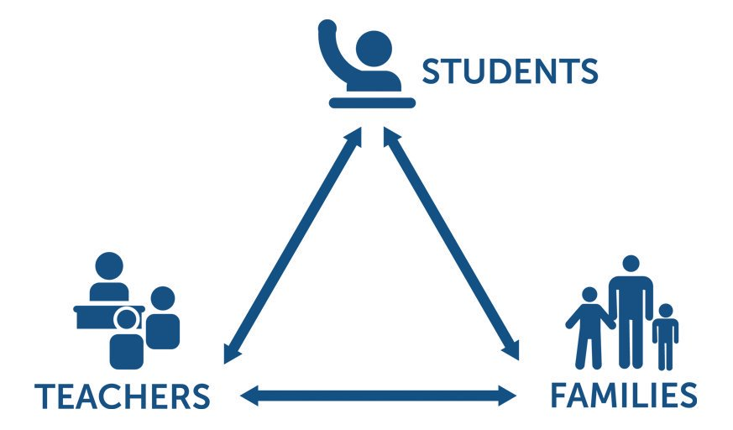
Pupil, family and teacher partnerships
Pupil, family and teacher partnerships
Your children achieve their full potential when all 3 work work well together.
Notes:
Explain the importance of partnership working

Slide 3
Children can arrive from 8:35am doors locked at 8:50am. during this time children have the opportunity to practice and consolidate skills.
Children who are late and arrive after 8:50am or after miss up to 20 minutes of learning each day – equating to an hour lost over the course of a week and 37 hours lost in a year. Punctuality is important at Kennington.
Formal teaching starts at 8:50.
PE is on Wednesdays and Fridays. Please ensure children have their PE kits on these days:
Navy blue shorts, white t-shirt and black pumps. Named. No earrings and long hair should be tied up.
Please have water bottles in school each day.
End of day collection. Please wait at the white line in the KS1 playground.
At the end of the day, we often have great things to tell our families so please feel relaxed if we call you over! It's more often than not to celebrate success!
School finishes at 3:00pm

Slide 4
Reading
Our reading scheme is currently being updated with brand new phonics books and books will be allocated very soon.
Reading in school (Guided Reading) books are linked to the new phonic sounds they are currently learning in phonic groups
Home reading books are related to phonic sounds they have previously been taught in earlier phases
Read every night with your child.
Little and often is best - it is not necessary to read the whole book in one night. Focus on talking about the book - the picture/story/characters/ if your child liked it or not -discuss why.
Share other stories together – books from home/the library and talk about the books

Slide 5
Reading continued
Reading diaries:
Please sign each time you read with your child.
Note the pages read, add a comment about how they read or something they liked and then sign it.
If you read every night, you should have signed the diary 5 times in the week (or more including weekend)
When books are completed, comments will be reviewed, comprehension checked and then the book will be changed. If the diary isn’t signed, the book will not be changed.
The Reading Rainbow Reward Display. When your child reads at home, they will gain stickers to attach to their rainbow chart. After completing some of the rainbow, they will receive a token so they can collect a book from the machine in the hall.

Slide 6
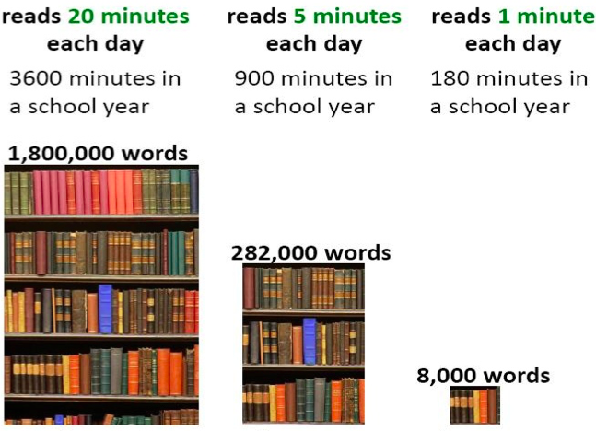
Reading At Home

Slide 7
Homework in Willow Class
We want to make homework as straight forward and stress free for everyone!
KS1 (Infants)
10-20 minutes per night during the week.
Reading – daily 10 minutes minimum with an adult
Purplemash – 1 task per week + Mental Maths activities e.g. number bonds etc
Y2 Only TT Rockstar practise 2s, 5s, 10s
Usernames and logins will be in the homework diaries.
Purplemash will be set on a Friday to be completed by the following Friday.

Slide 8
Willow Bear
Science in real life – observing changes during the seasons
Willow Bear lives in Willow Class at Kennington. She loves going on adventures and looking at the weather.
Children will bring her home for the night at some point during the year.
Children need to record their name, what the weather was like, a few sentences about what they did with Willow Bear and what time she went to bed.
Important Science Rules!
Willow must go to bed as soon as it is dark. (A grown up might need to do this in the summer months!)
We are then going to look at our data gathered and talk about the different times of day that it gets dark during the year and look for weather patterns and behaviour patterns (e.g playing inside in the winter/possibly more outside activities in the summer months).

Slide 9
Communicating with class teachers
We are a team –parents, staff and your children.
Please talk to us if you have any questions, queries or problems. We want to know so we can sort things out.
Write a message in the reading diary
Leave a message with the staff member on duty in a morning – messages are passed on when they come in
Talk to us at the end of the day (or if we are unable to talk there and then, we can arrange a suitable time)
Arrange a meeting with us

Slide 10
National Statutory Assessments
Phonics Screening Check – June 2023
Reading a list of a mix of 40 real and alien (not real) words
Segmenting and blending to read words
Eg: c-a-t = cat, Sh-i-p =ship, B-r-u-sh = brush
The pass mark is allocated to us by the DfE after the check takes place
Informal setting 1 to 1 with the class teacher
Lots of practise within phonics sessions
End of KS1 SATs for Year 2 Children – May/ June – date to be confirmed.

Slide 11
How will you let me know how my child is doing throughout the year?
1 Sharing the curriculum and lesson content with you via class information sheets.
2. Via parents' evenings and the summer term school report.
3. By sharing assessment information with you via Pupil Information Sheets
4. Through informal communication at the doors and via phone or email when needed.
Parents of children with SEND have additional review points during the year.

Slide 12
Assessment Weeks
Autumn term:
Maths – teacher assessment tasks linked with our maths scheme (in small groups)
Reading – teacher assessment during Guided Reading sessions and one-to-one reading
Writing – an assessed written piece
Spring and Summer terms:
Maths – a White Rose (our maths scheme) assessment paper– completed in small groups
Reading – a comprehension assessment paper (completed in small groups step by step)
Assessments are a key tool in finding out what strengths children have and what areas they need to develop further.
Assessments help to identify gaps in knowledge so that teachers can plan their future lessons. For example, if a whole class is struggling on the "fractions" element of maths, more lessons will focus on this. If all the class score well on times table questions, less time needs to be given to this.
Our internal assessments are "low stakes" and we approach them positively with the children.

Slide 13
Resolving Problems
We wish for a smooth year for each and every child and family but it is inevitable that at times, issues and complexities may arise. It is in everybody's interest that these are dealt with quickly and effectively. Our process for supporting families to resolve problems is outlined here:
Class Teacher
Key Stage Leaders
(KS1 Mr Sudell, KS2 Mrs Riley)
Deputy Head
Mrs Duffy
Head Teacher
If the issue concerns SEND our SENCo is Mrs Richardson

Slide 14
Celebrating Success
We celebrate success and effort in many ways at Kennington. These include:
Certificates
Dojos
Verbal Praise
Awards Assemblies
Postcards home
Book Tokens for the Book Machine

Slide 15
Any Questions
?

Slide 16
Thank you for coming to meet us this afternoon and we look forward to a great year working together!

