Slide 1

Meet The Teacher Session
Welcome to Acer Class Year 4
Class Teacher: Mr Housley
Supported by:
Mr Burton and Miss Hull

Slide 2
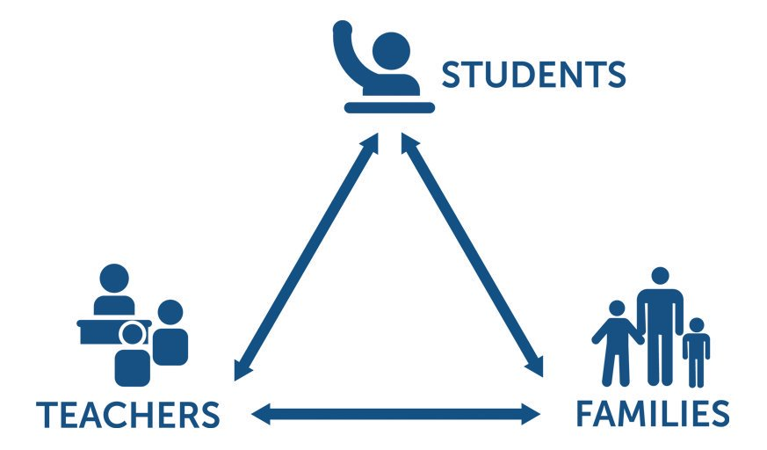
Pupil, family and teacher partnerships
Pupil, family and teacher partnerships
Your children achieve their full potential when all 3 work work well together.
Notes:
Explain the importance of partnership working

Slide 3
Children can arrive from 8:35am doors locked at 8:50am. During this time children have the opportunity to practice and consolidate skills.
Children who are late and arrive after 8:50am or after miss up to 20 minutes of learning each day – equating to an hour lost over the course of a week and 37 hours lost in a year. Punctuality is important at Kennington.
Formal teaching starts at 8:50.
PE is on Mondays and Thursdays. Please ensure children come to school in their PE kits on these days.
Water bottles and healthy snacks. Water bottles must be small, plastic bottles which have a sports cap to prevent spillages in class. Water bottles are kept in the trays at the back of the class throughout the day.
End of day collection. Please wait on the junior playground . At the end of the day, we often have great things to tell our families so please feel relaxed if we call you over! It's more often than not to celebrate success! School finishes at 3:20pm

Slide 4
Our Class Norms
We follow the traffic light system in our classroom to support behaviour.
Our class norms are displayed on the whiteboard next to the traffic lights to allow for children to remind themselves of the expectations if they need it.
Children who need more than 1 reminder are asked to move their name to amber. Any further examples of not following our norms will be lead to moving their name to red.
Children are told why they are moving their name when it happens.
To avoid conversations at the end of the day always being behaviour based, the email received will give details of any incidents leading to names being on red.

Slide 5
Reading Journals
As we are a school that promotes reading for pleasure. Instead of reading diaries, each child will have their own reading journal. Each reading journal will contain:
A question prompt sheet to help children respond to their reading book
A list of a variety of activities that the children can choose to complete in their reading journal
A reading tracker
A book review template
A reading book log to record their quiz scores
Reading journals allow our children to respond to a variety of texts in different ways.​
They provide space for reflection and evaluation as well as speculation and exploration of ideas, giving teachers valuable insight to their thinking and comprehension skills as they engage with text. Children will develop their reading skills through this approach as well as their ability to discuss and share recommendations, something which we value highly at Kennington.
We don’t expect the children to complete a large journal entry for ​every single piece of reading they do. If they are short of time or​ the book hasn’t inspired them, they can just log the book as read.​ We will provide children with an opportunity to use their journals in our Accelerated Reader time as well as in our Book Club sessions. Entries into our journals will be shared weekly within our classes as well as in assemblies.

Slide 6
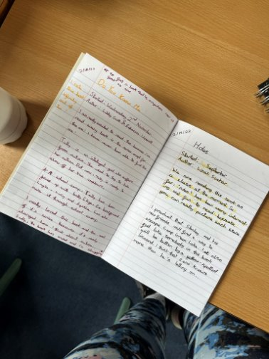
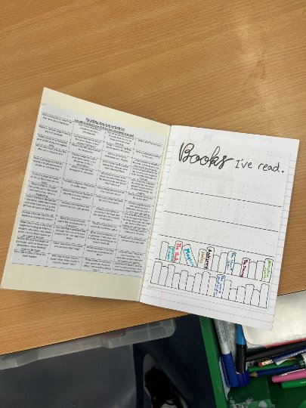
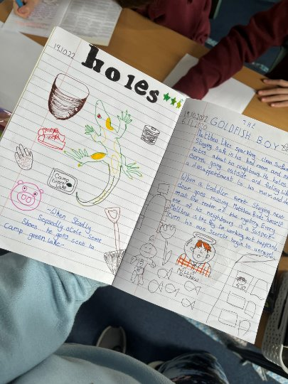
Examples of Reading Journals

Slide 7
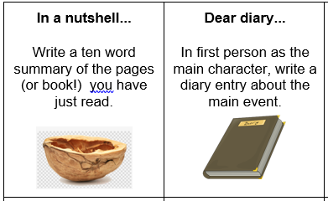
Reading in School
In Year 4, children have access to a wide variety of quality books from our classroom library, as well as Booktopia (in the corridor).
Children choose their reading books based on their ZPD which is a range of books determined by their reading Star Assessment each half term.
Once a child has finished their reading book, they will quiz on Accelerated Reader. This helps to determine their understanding of the text. As a parent, you can see your child’s progress with their quiz scores at home by using Renaissance Home Connect.
If children have completed their reading book but it is not their day to change it, they have activities they can complete in their reading journal. Each task should take around 20 minutes to complete.
In class, all children read regularly with an adult in school, in
addition to whole class guided reading sessions.
Please support your child through regular reading at home and discussing the text as they read. This helps develop a greater set of comprehension skills and also allows them to develop ideas for writing. It is also beneficial for your child to see their parents as readers.

Slide 8
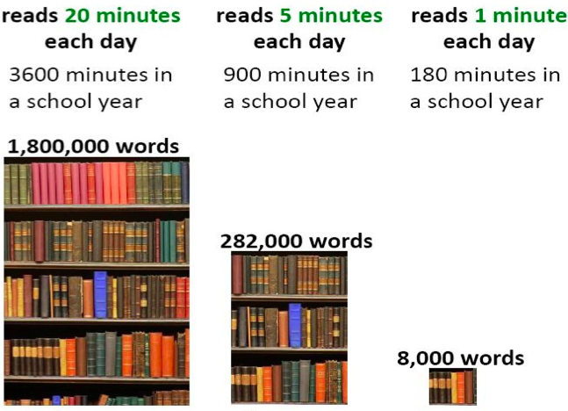
Reading At Home

Slide 9
Homework in Year 4
We want to make homework as straight forward and stress free for everyone!
Lower KS2 20-25 minutes per night
Reading – Daily 15 minutes minimum
TT Rockstar Maths practise- 10 minutes, 3 times a week
Purple mash- 1 or 2 tasks per week
Homework will be handed out and collected on a Friday
All Usernames and login details will be sent home on their password card.

Slide 10
Communicating with class teachers
If you have anything you wish to discuss regarding school or your child, please do not hesitate to contact me.
I am always available at the end of the day on the playground after dismissing all the children.
If you would like to arrange a more formal meeting, please contact the office.
TAs and the Office can also always pass messages on if you ring school.
Parents evenings

Slide 11
Key Dates for Year
Year 3 Reading Parent Workshop (date TBC)
Swimming –
19th – 23rd October
3rd – 6th November
12th – 23rd April
Abbystead Trip –
15th October
November (specific date TBC) – Parents Evening
As further events are organised within school you will be informed through parent app.

Slide 12
How will you let me know how my child is doing throughout the year?
1 Sharing the curriculum and lesson content with you via class information sheets.
2. Via parents' evenings and the summer term school report.
3. By sharing assessment information with you via Pupil Information Sheets
4. Through informal communication at the doors and via phone or email when needed.
Parents of children with SEND have additional review points during the year.

Slide 13
Assessment Weeks
Your child will be assessed regularly throughout their time in Y4 to identify any gaps in knowledge that need to be retaught.
Ongoing teacher assessments across the curriculum e.g. end of unit assessments (maths)
Termly Star assessments in Reading
Termly Lancashire maths assessments
Summer term assessments: NFeR paper based assessments for reading, spelling, punctuation and grammar and Maths.
Assessments are a key tool in finding out what strengths children have and what areas they need to develop further.
Assessments help to identify gaps in knowledge so that I can plan their future lessons. For example, if a whole class is struggling on the “statistics" unit of maths, more lessons will focus on this. If all the class score well on times table questions, these will still appear as retrieval to ensure the class remain strong in this area of the subject.
Our internal assessments are "low stakes" and we approach them positively with the children.

Slide 14
Resolving Problems
We wish for a smooth year for each and every child and family but it is inevitable that at times, issues and complexities may arise. It is in everybody's interest that these are dealt with quickly and effectively. Our process for supporting families to resolve problems is outlined here:
Class Teacher
Key Stage Leaders
Deputy Head
Mrs Duffy
Head Teacher
If the issue concerns SEND our SENCo is Mrs Duffy

Slide 15
Celebrating Success
We celebrate success and effort in many ways at Kennington. These include:
Certificates (Parents invited in to watch)
Dojos
Verbal Praise
Awards Assemblies
Postcards home
Book Tokens for the Book Machine

Slide 16
Swimming
19th – 23rd October
3rd – 6th November
12th – 23rd April
We will be swimming every day in the allocated weeks.
We will walk down to the library and get a bus from there.
Children will get changed there after the lesson and we should be back to school by lunchtime.
It is advised that you provide an extra snack for the children in these weeks as they tend to be more hungry.

Slide 17

Multiplication Check
Checks children’s knowledge of their times tables up to 12 × 12.
Completed online on a computer or tablet.
Children answer 25 multiplication questions.
They have 6 seconds to answer each question, with a short pause between questions.
The check takes less than 5 minutes in total.
There is no pass mark – the result helps show how securely children know their multiplication tables.
Throughout Year 4, we will practise times tables regularly so children become quick, accurate and confident. We have our daily times table race, fluent in 5 and number sense which all support the learning of times tables.

Slide 18
Any Questions
?

Slide 19
Thank you for coming to meet us this afternoon and we look forward to a great year working together!

