Slide 1
Phonics - 3.03.2021
L.O: Use rhyming words within sentences.

Slide 2
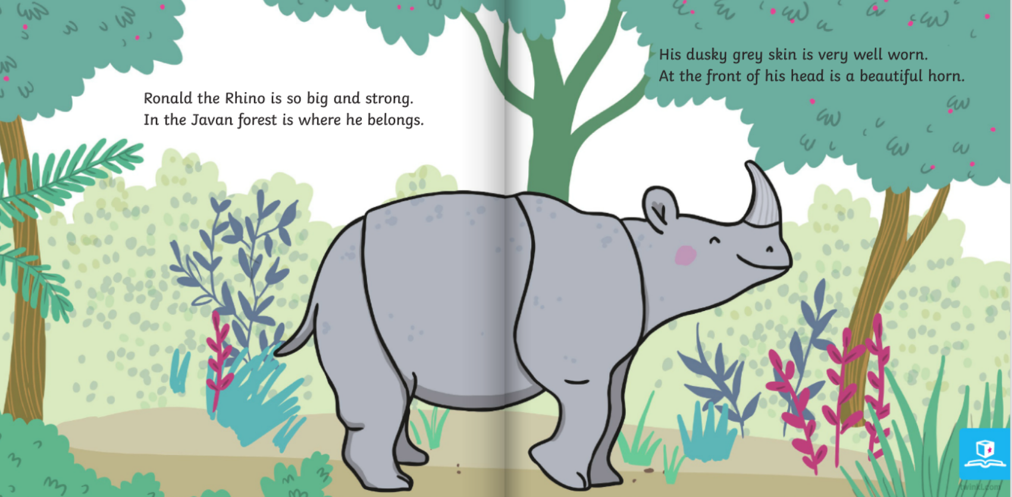

Slide 3
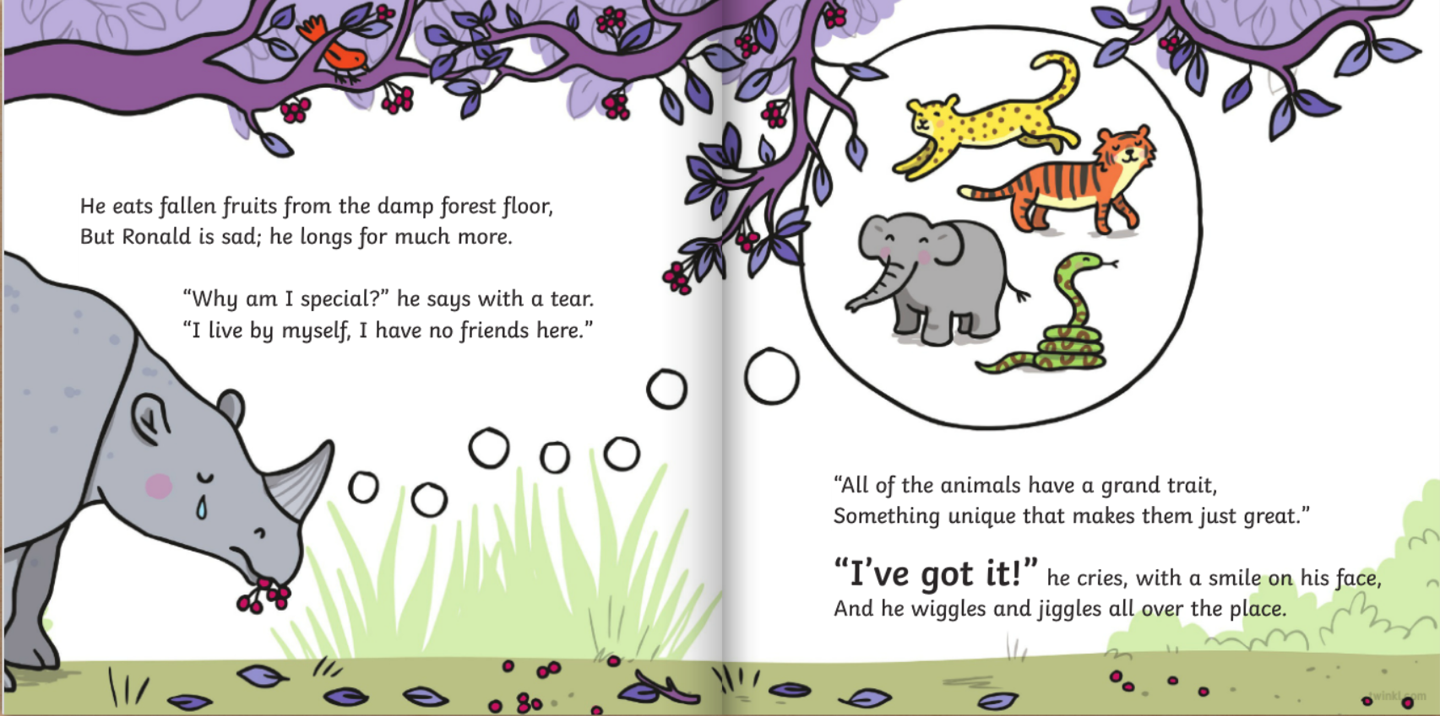

Slide 4
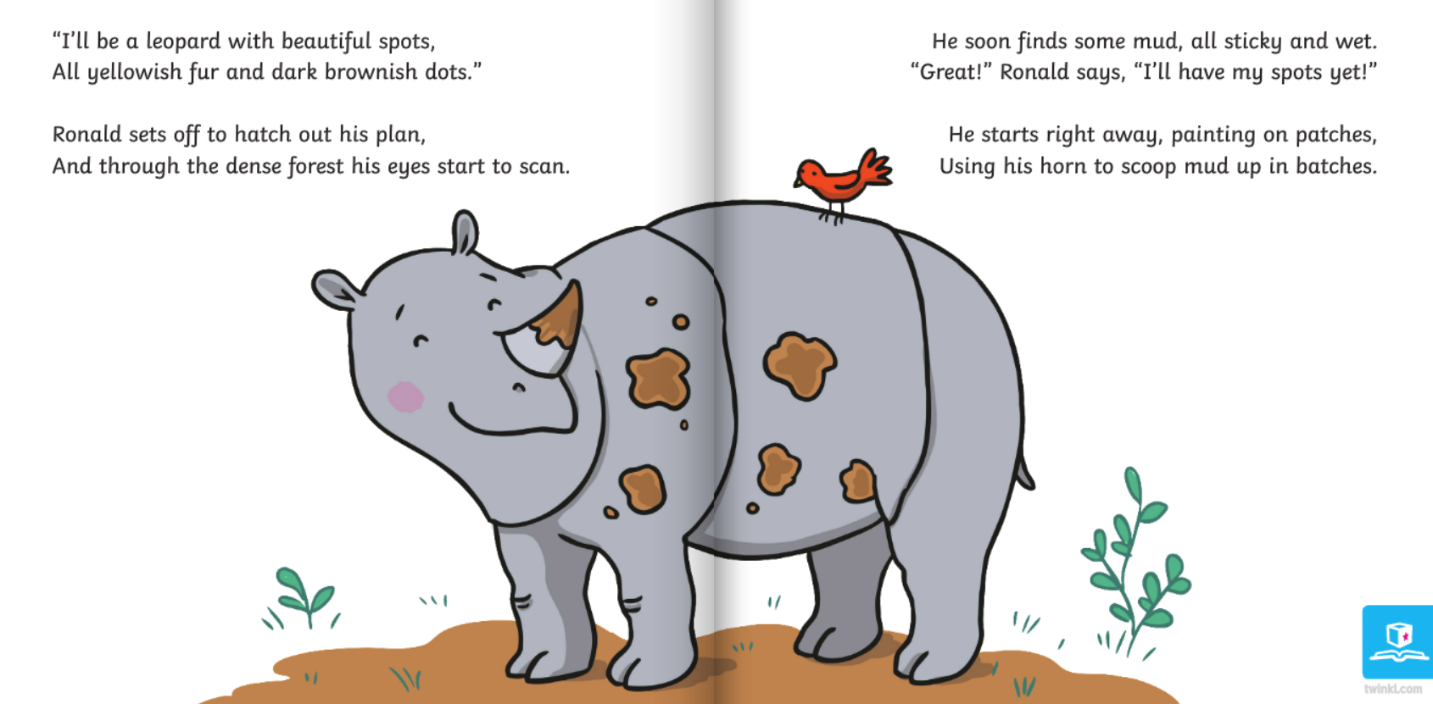

Slide 5
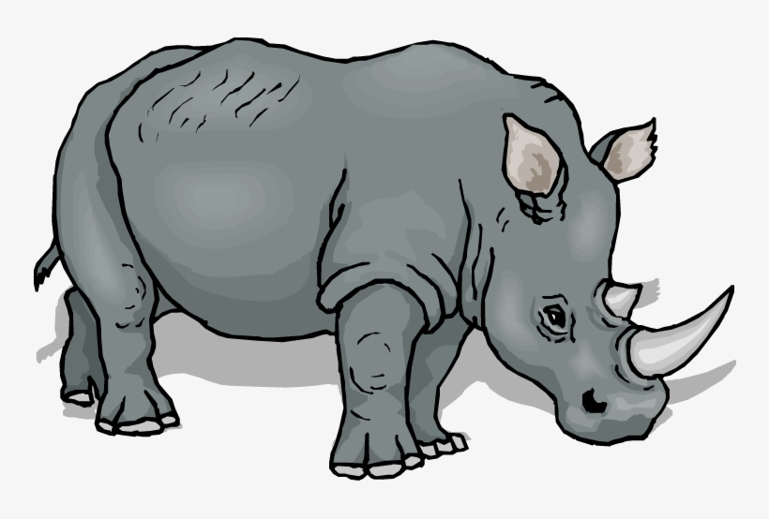
Rhyming Words
-ong | -Or/ore/aw/ | -Ear/ere/eer | -ot | -an
Long | Floor | Dear | Pot | Fan
How many words can you think of with the endings in the table?

Slide 6
Rhyming Words
-ong | -Or/ore/aw/ | -Ear/ere/eer | -ot | -an
Long | Floor | Dear | Pot | Fan
Strong | More | Fear | Lot | Pan
Belong | Paw | Deer | Cannot | Man
Wrong | Tore | Here | Robot | Plan
along | before | peer | trot | van
Here are some I came up with!

Slide 7
Activity
-ong | -Or/ore/aw/ | -Ear/ere/eer | -ot | -an
Long | Floor | Dear | Pot | Fan
Strong | More | Fear | Lot | Pan
Belong | Paw | Deer | Cannot | Man
Wrong | Tore | Here | Robot | Plan
along | before | peer | trot | van
Have a go at putting some of these words in sentences. Remember these words should be at the end.
Model:
The rhino has a horn that is long,
It is also very strong.
He ate some food off the floor,
But he needed some more.
He spotted a deer,
It was frozen with fear.

Slide 8
Remote Learning Tracking
https://forms.office.com/Pages/ResponsePage.aspx?id=eCY4lN73r0G0KV1rDWITzRhTQ2IZqpBOsW8cFVoooF9UNVlMS1dCVkdaM0k0WlhFTE9WVFBTWEg1Ti4u

