Slide 1
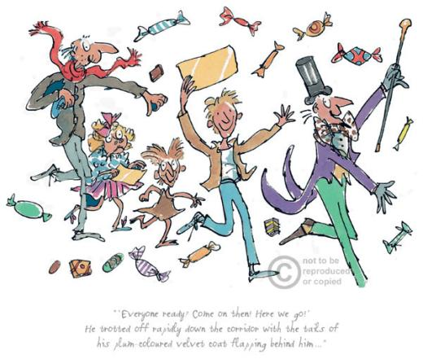
Charlie and the Chocolate Factory

Slide 2
Use expanded noun phrases to describe a setting
Use a determiner
Use at least one adjective
Use a noun
Use a verb
Use a prepositional phrase
Use a relative clause

Slide 3
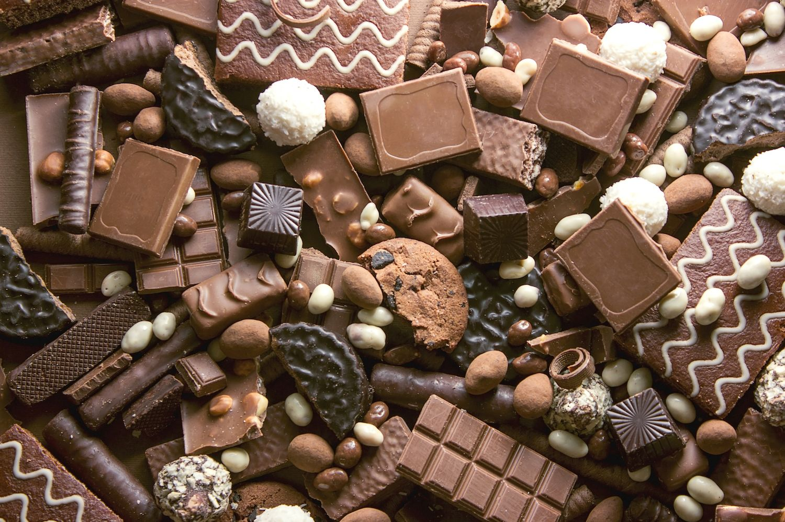

Slide 4
Narrative
What does a narrative have to include?
What is the structure of a narrative?

Slide 5
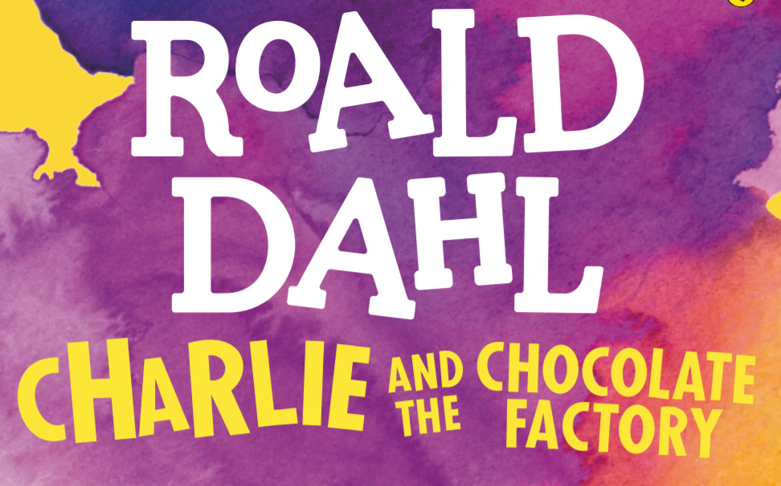
What features can you spot in the first chapter?

Slide 6
Setting
The whole of this family – the six grown-ups (count them) and little Charlie Bucket – live together in a small wooden house on the edge of a great town. The house wasn’t nearly large enough for so many people and life was extremely uncomfortable for them all. There were only two rooms in the place altogether, and there was only two rooms in the place altogether and there was only one bed…
Find the adjectives and verbs used to describe Charlie Bucket’s house.

Slide 7
Setting
And it wasn't simply an ordinary enormous chocolate factory, either. It was the largest and most famous in the whole world! It was WONKA'S factory, owned by a man called Mr Willy Wonka, the greatest inventor and maker of chocolates that there has ever been. And what a tremendous, marvellous place it was! It had huge iron gates leading into it, and a high wall surrounding it, and smoke belching from its chimneys and strange whizzing sounds coming from deep inside it. And outside the walls, for half a mile around in every direction, the air was scented with the heavy, rich smell of melting chocolate!
Find the adjectives and verbs used to describe the chocolate factory.

Slide 8
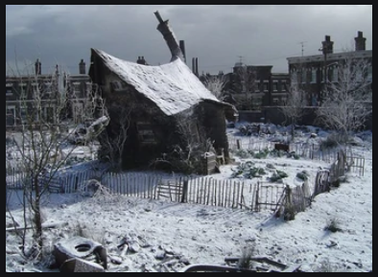
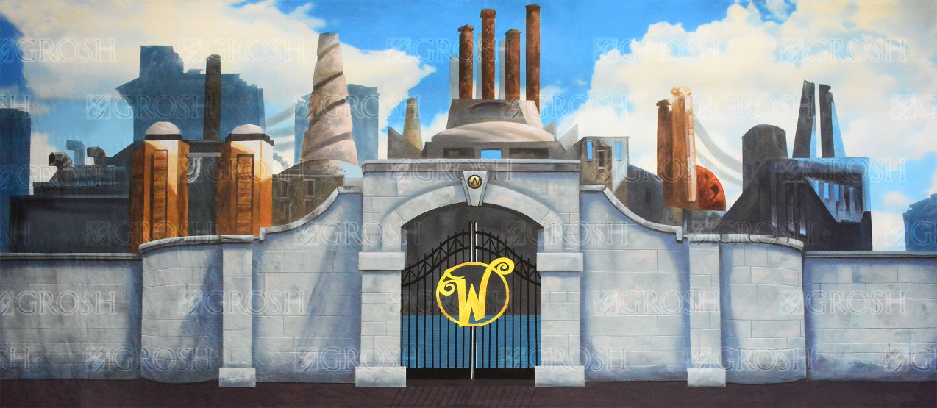
How are the two descriptions different?
Why do you think Roald Dahl has done this?

Slide 9
Nouns | Adjectives | Verbs

Slide 10
The creaky, wooden shack sits in the freezing snow.
The derelict, draughty house is in front of the large, brick houses.
Use a determiner
Use at least one adjective
Use a noun
Use a verb
Use a prepositional phrase

Slide 11
Your turn
Use a determiner
Use at least one adjective
Use a noun
Use a verb
Use a prepositional phrase

Slide 12
Write a description of the Buckets’ house or the Chocolate factory.
Use a determiner
Use at least one adjective
Use a noun
Use a verb
Use a prepositional phrase

Slide 13
Determiner | Adjectives | Noun | Verb | Prepositional Phrase
the a an some many its | wonky small wooden snowy cold draughty run-down neglected lop-sided | house shack fence snow roof chimney trees | is sits stands | in the snow. in front of the brick houses. beneath a cloudy sky. beside the trees. next to the chocolate factory.

