Slide 1
Friday 22nd January 2021
English
Year Five

Slide 2
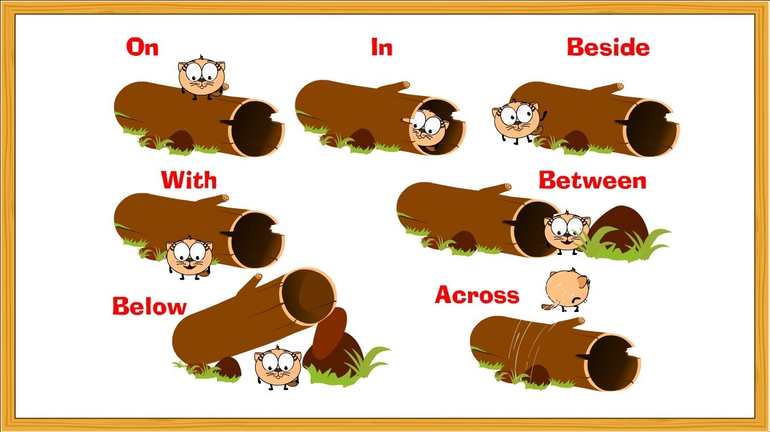
Use a range of prepositions.

Slide 3
Preposition is a word, which is used before a noun, a noun phrase or a pronoun , connecting it to another word.
Prepositions of place
Prepositions of time
Prepositions of direction

Slide 4
Prepositions of place
Some prepositions show where something happens. They are called prepositions of place.
Bob was sitting under a tree.
There’s a wooden floor underneath the carpet.
Some geese flew over their house.
John and Sarah were hiding inside the wardrobe.
There was a tree beside the river.
I have a friend who lives in America.

Slide 5
Prepositions of place
Some prepositions show where something happens. They are called prepositions of place.
Bob was sitting under a tree.
There’s a wooden floor underneath the carpet.
Some geese flew over their house.
John and Sarah were hiding inside the wardrobe.
There was a tree beside the river.
I have a friend who lives in America.

Slide 6
Prepositions of time
Some prepositions show when something happens. They are called prepositions of time.
School starts at nine o’clock.
We’re going to the zoo on Saturday.
I visited my grandparents during the summer.
You must finish the work by Friday.
I’ll do my homework before dinner.

Slide 7
Prepositions of time
Some prepositions show when something happens. They are called prepositions of time.
School starts at nine o’clock.
We’re going to the zoo on Saturday.
I visited my grandparents during the summer.
You must finish the work by Friday.
I’ll do my homework before dinner.

Slide 8
Prepositions of direction
Some prepositions show where something is going. They are called prepositions of direction.
The boys chased after each other.
The football rolled down the hill.
A man was walking his dog along the riverbank.
The road goes right through the town centre.
We were travelling towards Chatteris.

Slide 9
Prepositions of direction
Some prepositions show where something is going. They are called prepositions of direction.
The boys chased after each other.
The football rolled down the hill.
A man was walking his dog along the riverbank.
The road goes right through the town centre.
We were travelling towards Chatteris.

Slide 10
Over to you…
The cat was sitting _______the roof of my car. (place)
Some people were talking ___the movie. (time)
A man was coming ____ us on his bike. (direction)
The party starts _____ six o’clock. (time)
She put the book ____her bag. (place)
We walked ____ the street to the park. (place)
She keeps her slippers ____ her bed. (place)
We always wash our hands ____meals. (time)
She ran ____ the dog because he slipped his lead. (direction)

Slide 11
Over to you…
She ran after the dog because he slipped his lead. (direction)

Slide 12
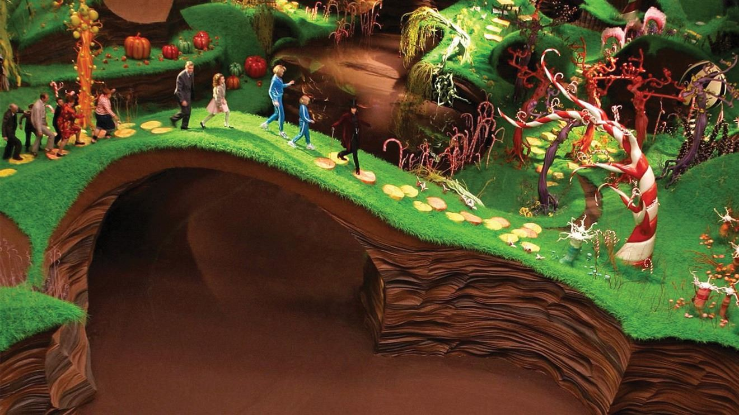

Slide 13
Challenge One: Using the word bank provided, create sentences to describe the scene by the chocolate river.
Challenge Two: Write several paragraphs to describe the scene by the chocolate river.
Challenge Three: Write several paragraphs to describe the scene by the chocolate river and aim to include some dialogue between Mr Wonka and the group.

Slide 14
As the group entered the room filled with sweet treats, they ran excitedly towards the river flowing with chocolate. The river snaked its way around the grass-covered landscape and the children looked in awe at the velvety liquid before turning to Mr Wonka to ask permission to dip their fingers into it. Mr Wonka led the children over the bridge and nodded, giving his permission for the children to taste the sweet chocolate. With great glee and enthusiasm, they ran across the grass and plunged their hands into the flowing chocolate lake.

Slide 15
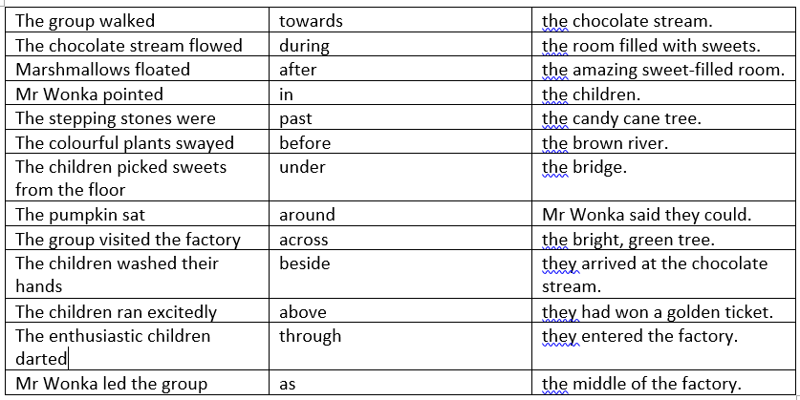

Slide 16
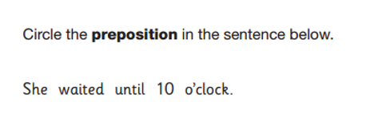
Plenary

Slide 17
Plenary

