Slide 1
Monday 18th January 2021 English

Slide 2
Monday 18th January 2021 LO: Explore the features of a persuasive text.

Slide 3
Writing to Persuade
When you are writing to persuade, you are trying to convince your reader to do something or buy something. You can do this by using your words to encourage or influence them.
Can you think of a time when you read or heard something really persuasive?

Slide 4
Features of Writing to Persuade
To try to influence your reader, you could include some of the following features:
Repeat the Main Ideas
Facts or Key Information
Expanded Noun Phrases

Slide 5
Repeat the Main Idea
Mentioning the main ideas more than once will help you to get your point across to the reader.
I have tried very hard to be good this year.
I have also been very helpful all year.

Slide 6
Facts or Key information
Add facts or key information to support your ideas.
Come to our school fair on Friday 12th July at 3 o’clock.

Slide 7
Expanded Noun Phrases
Use expanded noun phrase with amazing adjectives or modifying nouns to persuade the reader.
A shiny, red scooter
Some fun maths games

Slide 8
Can you spot the features in the following texts?
Are the main ideas repeated?
Did you spot any facts or key information?
Are there any expanded noun phrases?

Slide 9
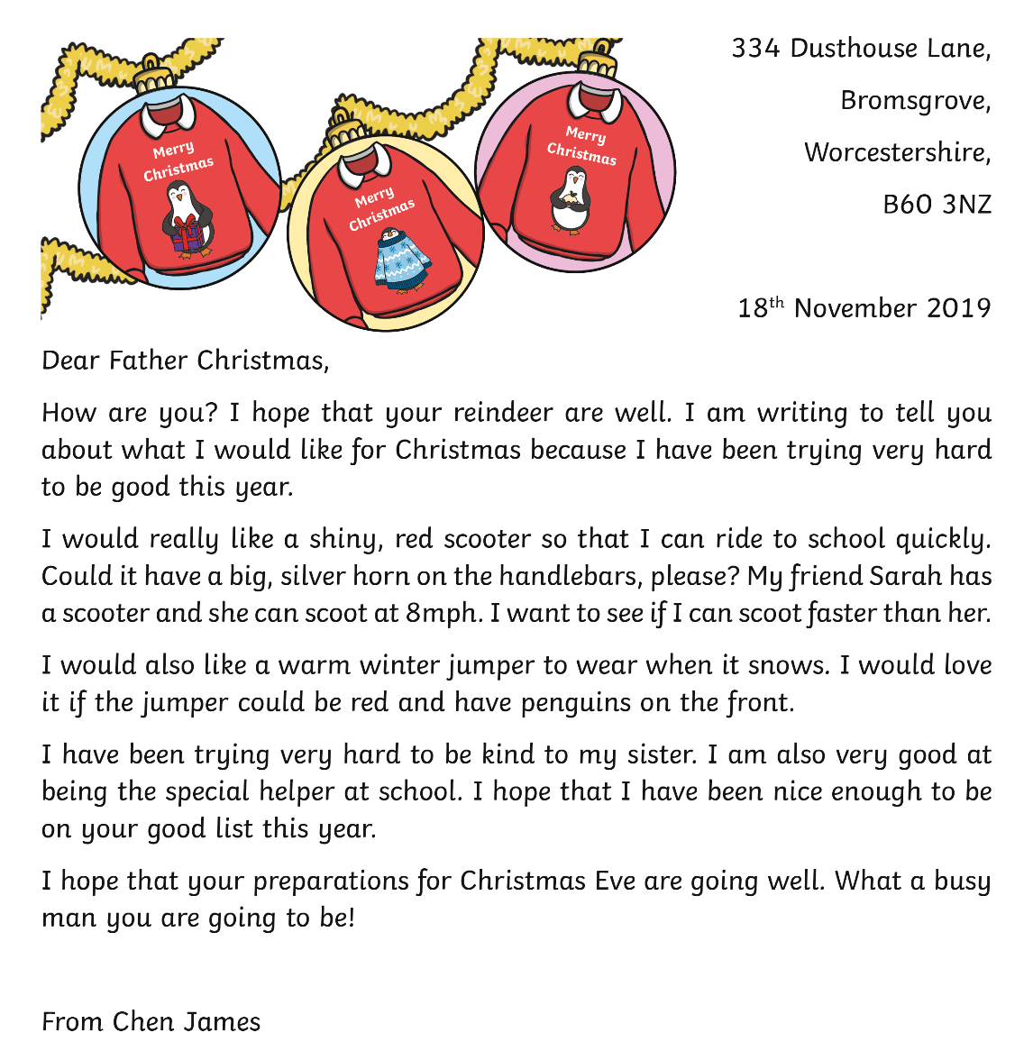

Slide 10
Repeating the main ideas

Slide 11
Expanded noun phrases

Slide 12
Facts or key information

Slide 13
Activity time!
Think about your favourite toy or teddy.
Write a letter to your teacher to tell them about your favourite toy.
Try to use all the key features that you have just learned about.
Start your letter with
Dear Miss Reid or Dear Miss Rushmer.

