Slide 1
Friday 5th March 2021
English GPS
Year Six

Slide 2
L.O. To use relative pronouns
Identify relative pronouns in sentences
Use relative pronoun to connect a clause or phrase to a noun or pronoun in a sentence
Use the following relative pronouns : who, whom, which, whoever, where, when, and that.

Slide 3
Relative pronouns
Do you know what a relative pronoun is?
A relative pronoun is used to connect a clause or phrase to a noun or pronoun. You see them used every day with the most common relative pronouns being: who, whom, which, whoever, where, when, and that.

Slide 4
Identify the relative pronouns in these sentences
1. The lady, who was here to see you yesterday, called again this morning.
2. Bring me the letters that lie on the table.
3. Is this the train which leaves for New York at six o'clock?
4. The church, where the carol service was held, is always busy.

Slide 5
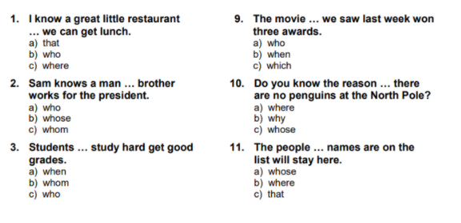
Put the correct relative pronoun into the sentences.

Slide 6
Task
Challenge 1 – Write a character description of one of the characters below using the relative pronouns who and that.
Challenge 2 – Write a character description of one of the characters below using the relative pronouns who, that, whose and where.
Challenge 3 – Write a character description of one of the characters below using as many relative pronouns as you can think of. Use brackets, dashes and commas to include parenthesis in your writing.

Slide 7
Stuart is a Minion of average height. His goggles, that cover his lone eye, are made of super strength metal and glass and protect his all-important vision. This Minion wears blue dungarees and stylish black gloves which match his comfortable footwear. When he wakes up in the morning, Stuart’s first thought is his hair; he hates how he can’t get it to stick up like his friend Kevin’s does. Stuart, who is the most creative and talented Minion in the group, often serenades his two friends - much to their dislike.

Slide 8
Test style question
Circle the relative pronoun in this sentence.
The birthday cake was on a plate which was decorated with flowers.

Slide 9
Remote learning tracking
Please follow the link below so that we can track who is accessing online PowerPoint learning.
https://forms.office.com/Pages/ResponsePage.aspx?id=eCY4lN73r0G0KV1rDWITzRhTQ2IZqpBOsW8cFVoooF9UNVlMS1dCVkdaM0k0WlhFTE9WVFBTWEg1Ti4u

