Slide 1
Addition and Subtraction
Add 3 numbers using number facts and doubles
Maths
Friday 5th March

Slide 2
Addition and Subtraction
Add 3 numbers using number facts and doubles
Starter
Doubles
https://www.youtube.com/watch?v=NDqbCfplYrg
Number blocks –
https://www.youtube.com/watch?v=Bot83VxMLqM

Slide 3
Addition and Subtraction
Add 3 numbers using number facts and doubles
Objectives
Friday
Add three numbers, using doubles and number bonds.

Slide 4
Day 2: Add three numbers, using doubles and number bonds.
Now we need to work out 8 add 3.
There isn’t a pair to 10, but there are two 4s.
What is double 4?
Is there an efficient way to add these?
4
3
4
8

Slide 5
Day 2: Add three numbers, using doubles and number bonds.
+ 3
8
11
Where have we landed?
4 + 4 + 3 = 11

Slide 6
Day 2: Add three numbers, using doubles and number bonds.
Hold 3 fingers up. We had 8 so now we add on 3...
Now try adding the numbers by counting on your fingers.
… 9, 10, 11

Slide 7
Day 2: Add three numbers, using doubles and number bonds.
9 is quite a big number to count on at the end, so let’s put it first.
Let’s take out another set of 3 cards.
There isn’t a pair to 10 or a double this time.
How could we add them?
2
3
9

Slide 8
Day 2: Add three numbers, using doubles and number bonds.
+ 3
+ 2
9
14
Where have we landed?
9 + 3 + 2 = 14

Slide 9
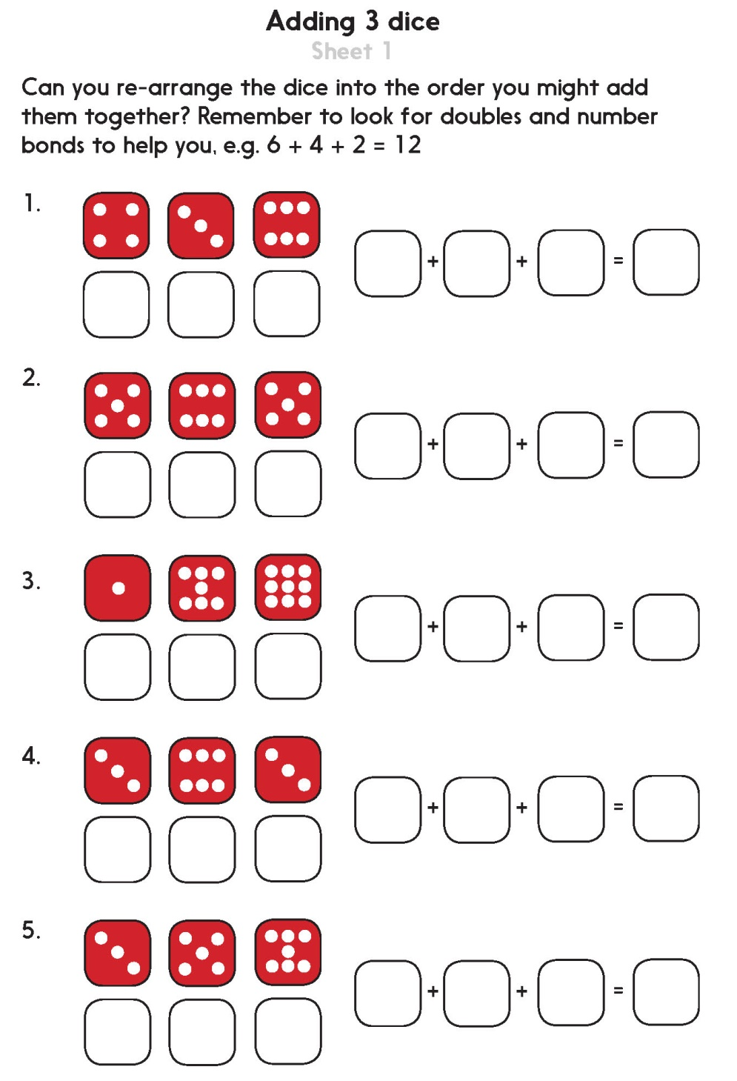
Notes:
The Practice Sheet on this slide is suitable for most children.

Slide 10
Problem solving and reasoning questions
Choose 3 number cards.
Choose an efficient strategy to add them.
Write the answer.
Tell me why you added them in that order.
Choose three more and do it again…
7
3
5
7
4
6

Slide 11
Problem solving and reasoning questions answers
Choose 3 number cards.
Choose an efficient strategy to add them.
Write the answer.
Tell me why you added them in that order.
Choose three more and do it again…
Strategies to look for include….
• Number bonds to 10 (e.g. 7 + 3, 6 + 4).
• Using place value to add to 10, e.g. 10 + 5 = 15.
• Using a double (7 + 7) or near double (5 + 6).
• Counting on from a larger number, e.g. 5 + 3 rather than 3 + 5.
7
3
5
4
7
6

Slide 12
Please follow the link below and fill in the online form to show that you have completed the lesson.
https://forms.office.com/Pages/ResponsePage.aspx?id=eCY4lN73r0G0KV1rDWITzRhTQ2IZqpBOsW8cFVoooF9UNVlMS1dCVkdaM0k0WlhFTE9WVFBTWEg1Ti4u

