Slide 1
Maths 04.03.21

Slide 2
Fractions

Slide 3
WORD OF THE WEEK Numerator
A numerator is the top number in a fraction. It tells us how many parts of the whole we have.
Challenge
Create a poster that could be used on the working wall to explain what a numerator is.

Slide 4
LO: Calculate fractions of a quantity.
Success Criteria:
Divide the quantity by the denominator.
Multiply one part by the numerator.
Compare the value of the fraction with the value of another fraction.

Slide 5
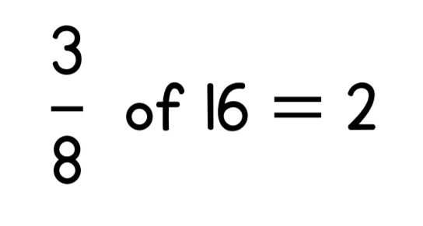

Slide 6
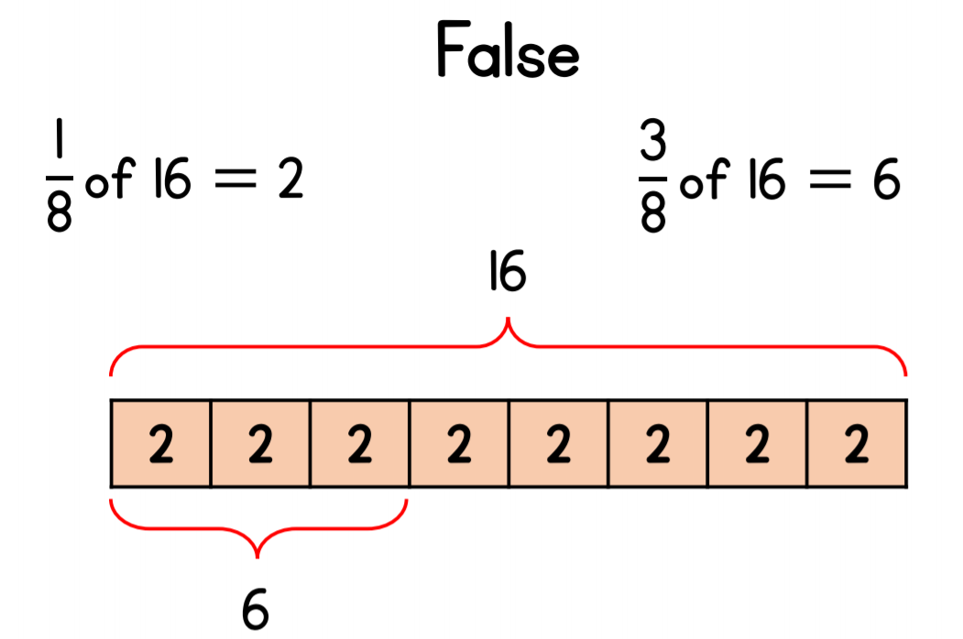

Slide 7
$\frac{\text{1}}{\text{3}}$ of 93 $=$
$\frac{\text{1}}{\text{4}}$ of 56 $=$
$\frac{\text{3}}{\text{4}}$ of 16 $=$

Slide 8
93
$\frac{\text{1}}{\text{3}}$ of 93 $=$
$\frac{\text{1}}{\text{4}}$ of 56 $=$
$\frac{\text{3}}{\text{4}}$ of 16 $=$
31
31
31 | 31 | 31
31 | 31 | 31
14
16
12
4 | 4 | 4 | 4
4 | 4 | 4 | 4
12

Slide 9
12
$\frac{\text{1}}{\text{6}}$ of 12 $=$
$\frac{\text{1}}{\text{6}}$ of 24 $=$
$\frac{\text{1}}{\text{6}}$ of 48 $=$
Have a think
2
2 | 2 | 2 | 2 | 2 | 2
24
4
4 | 4 | 4 | 4 | 4 | 4
48
8
8 | 8 | 8 | 8 | 8 | 8

Slide 10
12
$\frac{\text{1}}{\text{6}}$ of 12 $=$
$\frac{\text{1}}{\text{6}}$ of 24 $=$
$\frac{\text{1}}{\text{6}}$ of 48 $=$
2
2 | 2 | 2 | 2 | 2 | 2
$×$2
$×$2
24
$×$4
4
$×$4
4 | 4 | 4 | 4 | 4 | 4
48
8
8 | 8 | 8 | 8 | 8 | 8
What do you notice?
What’s stayed the same? What’s changed?
Have a think

Slide 11
what is $\frac{\text{1}}{\text{3}}$ of 63?
what is $\frac{\text{1}}{\text{3}}$ of 210?
If $\frac{\text{1}}{\text{3}}$ of 21 is 7,
Have a think

Slide 12
$\frac{\text{1}}{\text{3}}$ of 21 $=$ 7
$\frac{\text{1}}{\text{3}}$ of 63 $=$
$\frac{\text{1}}{\text{3}}$ of 210 $=$
$×$3
$×$3
$×$10
21
$×$10
70

Slide 13
25
$\frac{\text{1}}{\text{5}}$ of 25 $=$
$\frac{\text{2}}{\text{5}}$ of 25 $=$
$\frac{\text{4}}{\text{5}}$ of 25 $=$
Have a think
5
5 | 5 | 5 | 5 | 5
25
10
5 | 5 | 5 | 5 | 5
5 | 5 | 5 | 5 | 5
10
25
20
5 | 5 | 5 | 5 | 5
5 | 5 | 5 | 5 | 5
20

Slide 14
25
$\frac{\text{1}}{\text{5}}$ of 25 $=$
$\frac{\text{2}}{\text{5}}$ of 25 $=$
$\frac{\text{4}}{\text{5}}$ of 25 $=$
5
5 | 5 | 5 | 5 | 5
$×$2
$×$2
25
$×$4
10
$×$4
5 | 5 | 5 | 5 | 5
5 | 5 | 5 | 5 | 5
10
25
20
5 | 5 | 5 | 5 | 5
5 | 5 | 5 | 5 | 5
20
Have a think
What do you notice?
What’s stayed the same? What’s changed?

Slide 15
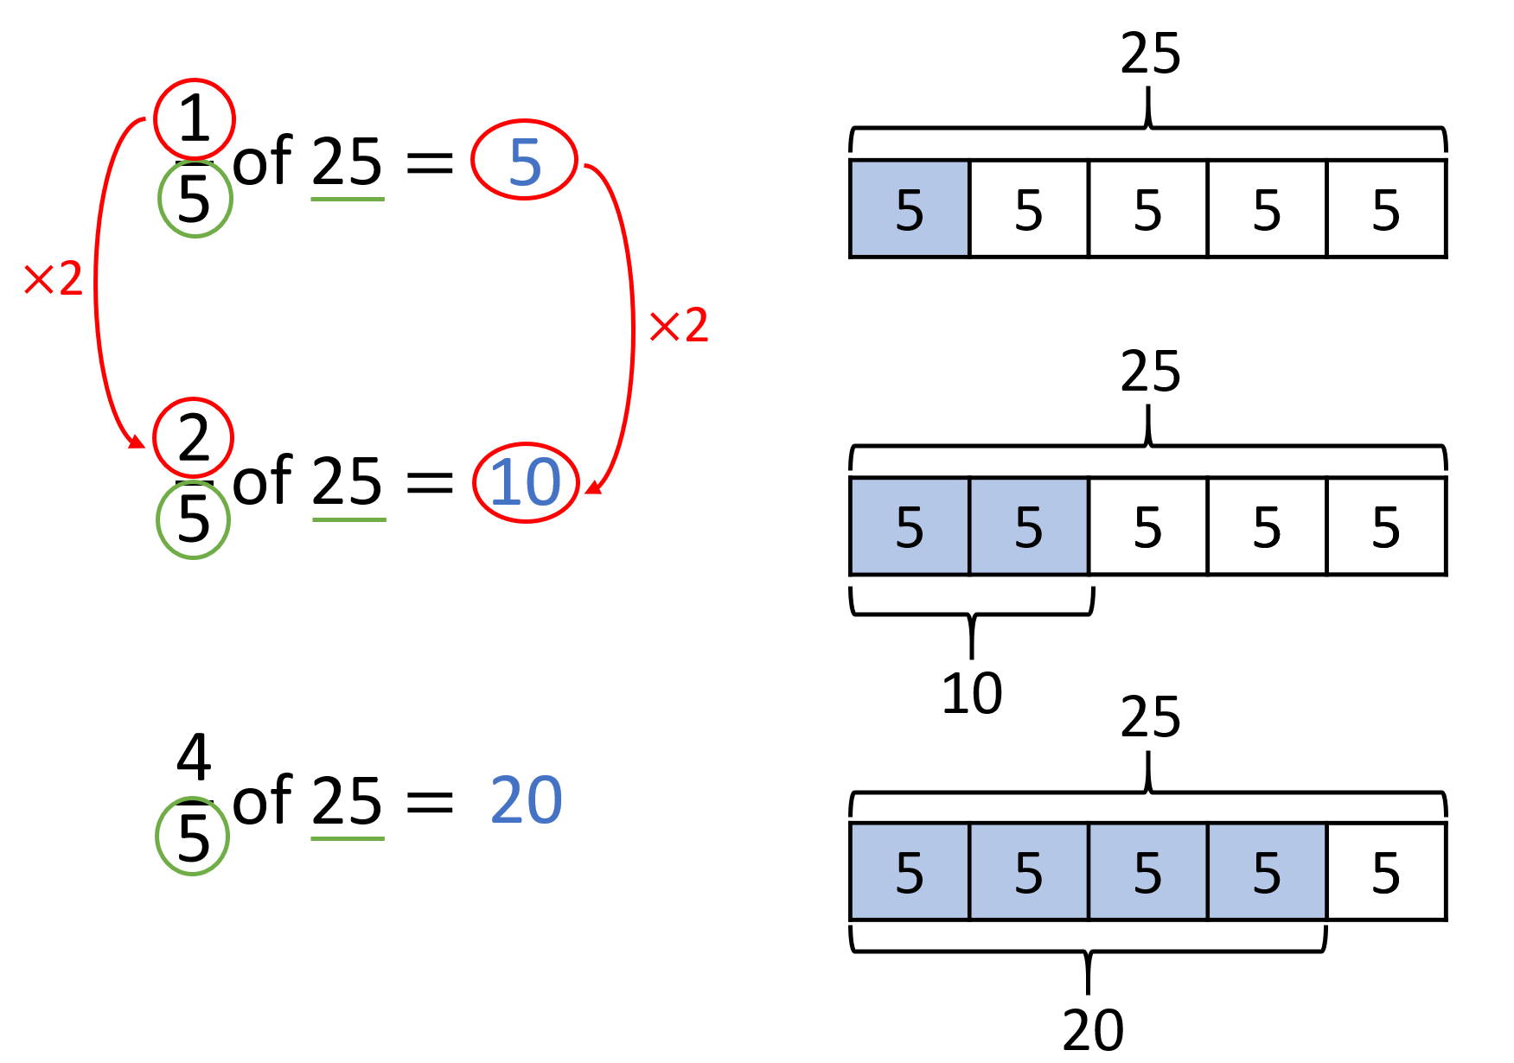
what is $\frac{\text{4}}{\text{9}}$ of 27?
what is $\frac{\text{8}}{\text{9}}$ of 27?
what is $\frac{\text{6}}{\text{9}}$ of 27?
If $\frac{\text{2}}{\text{9}}$ of 27 is 6,
Have a think

Slide 16
$\frac{\text{2}}{\text{9}}$ of 27 $=$ 6
$\frac{\text{4}}{\text{9}}$ of 27 $=$
$\frac{\text{8}}{\text{9}}$ of 27 $=$
$\frac{\text{6}}{\text{9}}$ of 27 $=$
$×$2
$×$2
12
$×$3
$×$2
$×$3
$×$2
24
18

Slide 17
Have a think
$\frac{\text{2}}{\text{5}}$ of 45 $\frac{\text{2}}{\text{9}}$ of 45
$\frac{\text{5}}{\text{6}}$ of 36 $\frac{\text{5}}{\text{6}}$ of 54
$\frac{\text{3}}{\text{4}}$ of 20 $\frac{\text{1}}{\text{2}}$ of 42
$\frac{\text{2}}{\text{3}}$ of 15 $\frac{\text{1}}{\text{3}}$ of 30
$$>$$
$$<$$
$\frac{\text{1}}{\text{2}}$ of 40 $=$ 20
$$<$$
42 $>$ 40
$÷$2
$\frac{\text{1}}{\text{2}}$ of 42 $>$ 20
$$=$$
$×$2

Slide 18
Your turn…
Mild – questions 1 – 3
Medium – questions 1 – 6
Spicy – questions 1 – 6 and the challenge

Slide 19
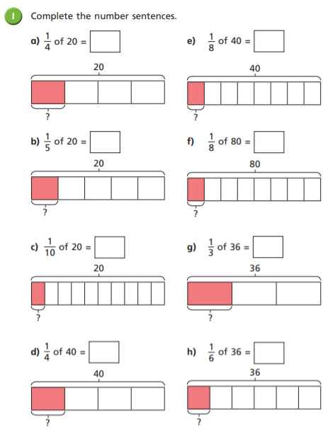
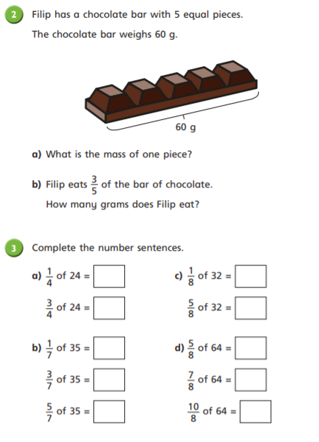

Slide 20
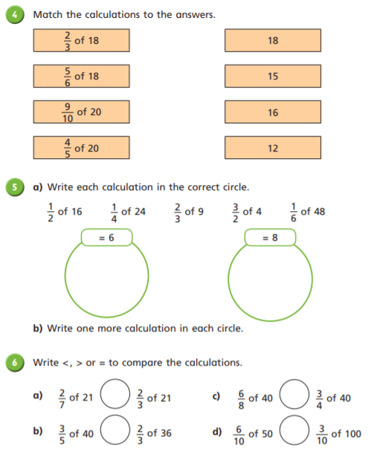
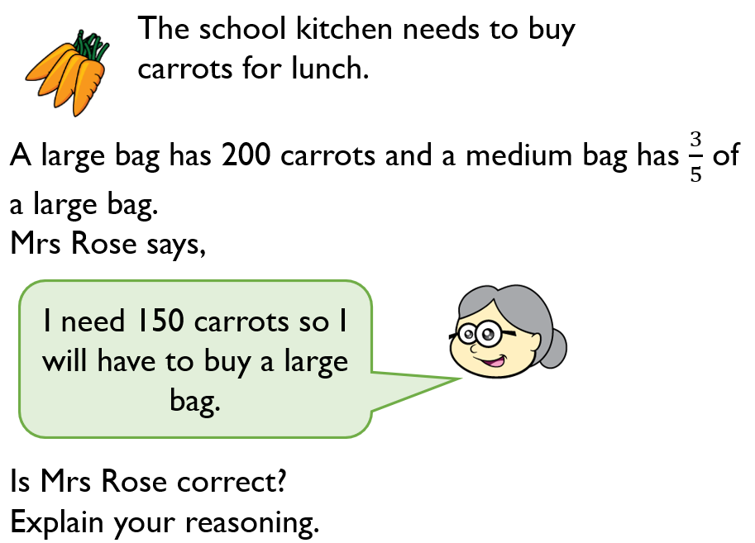
CHALLENGE

Slide 21
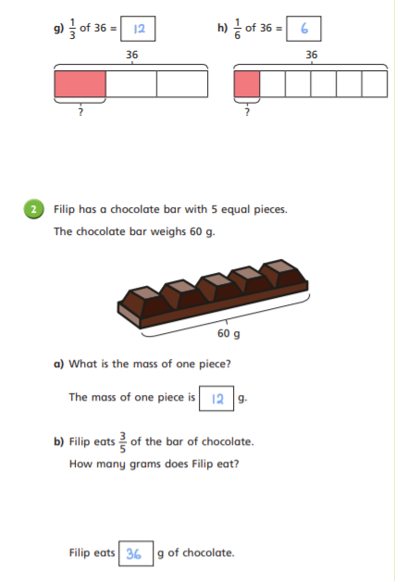
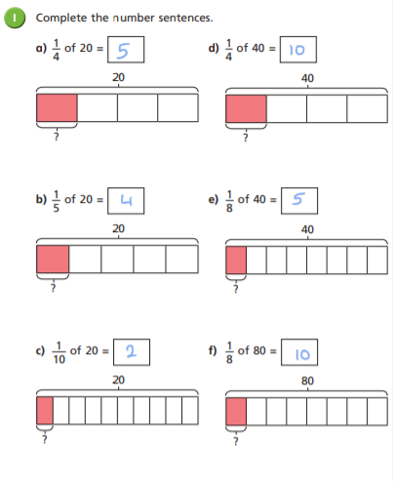
Answers

Slide 22
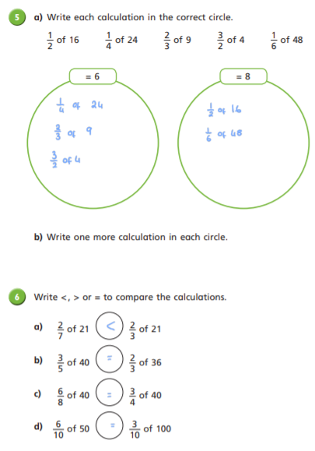
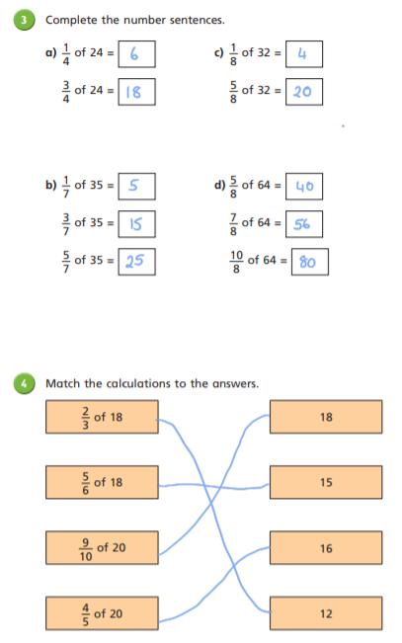
Answers

Slide 23
Challenge Answer
Mrs Rose is correct. 3/5 of 200 = 120 Mrs Rose will need a large bag.

Slide 24
Remote Learning Tracking
Click on the link to let us know that you have completed the lesson:
https://forms.office.com/Pages/ResponsePage.aspx?id=eCY4lN73r0G0KV1rDWITzRhTQ2IZqpBOsW8cFVoooF9UNVlMS1dCVkdaM0k0WlhFTE9WVFBTWEg1Ti4u

