Slide 1
Maths 22.01.21

Slide 2
L.O: Calculate the perimeter of rectilinear shapes.
Starter: True or false?
Success Criteria:
-Describe what ‘perimeter’ is.
-Understand how to work out the perimeter.
-Identify the unit of measurement needed when finding the perimeter.
-Calculate missing lengths.

Slide 4
Find the perimeter of the rectilinear shape.
1 cm
A rectilinear
shape is a
shape where all the sides meet at right angles.
1 cm
2 cm
3 cm
5 cm
3 cm
2 cm
5 cm
2 cm
+ 3 cm
+ 3 cm
+ 2 cm
+ 5 cm
+ 5 cm
= 20 cm

Slide 5
6 cm
4 cm
4 cm
7 cm
? cm
5 cm
3 cm
3 cm
1 cm
= 26 cm
7 cm $+$ 6 cm $+$ 4 cm $+$ 5 cm$+$3 cm $+$ 1 cm

Slide 6
13 cm
13 cm
3 cm
8 cm
8 cm
9 cm
6 cm
13 cm $−$ 8 cm
= 5 cm
$=$ 13 + 13
13 + 5 + 8
$=$ 26
5 cm
3 + 6 + 9
$=$ 9 + 9
$=$ 18
26 cm + 18 cm $=$ 44 cm

Slide 7
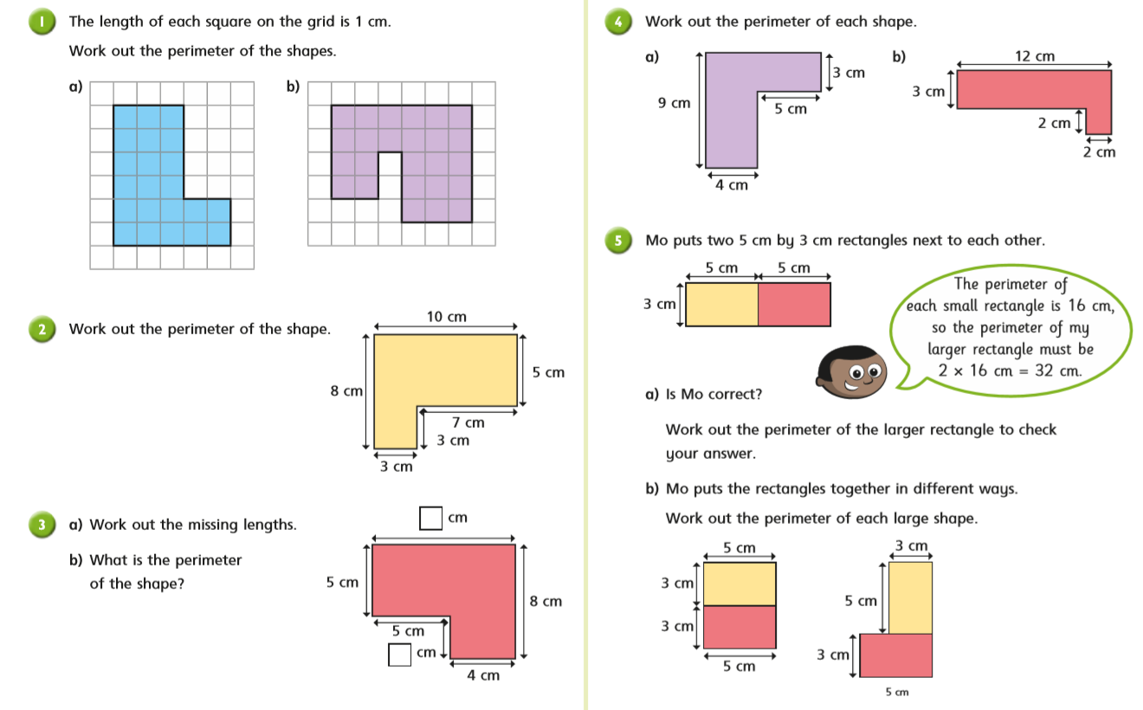
Questions
Set 1

Slide 8
Challenge

Slide 9
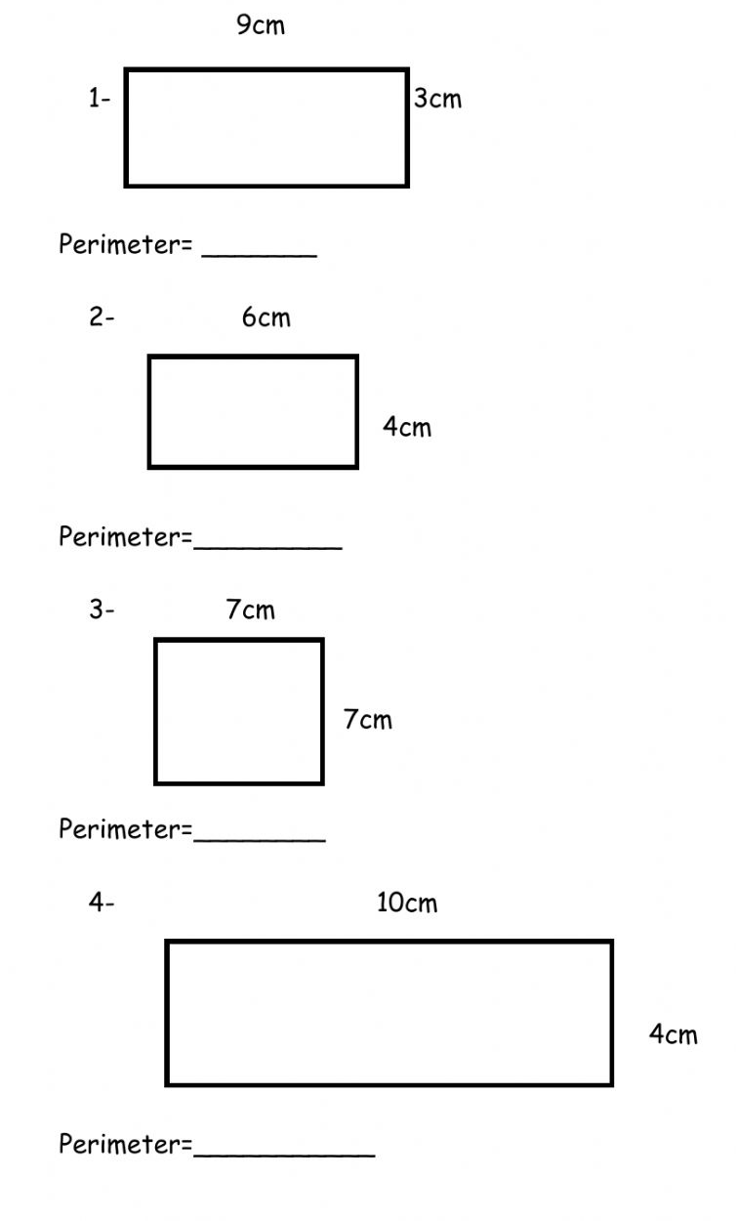
Questions
Set 2

Slide 10
Answers
Set 1

Slide 11
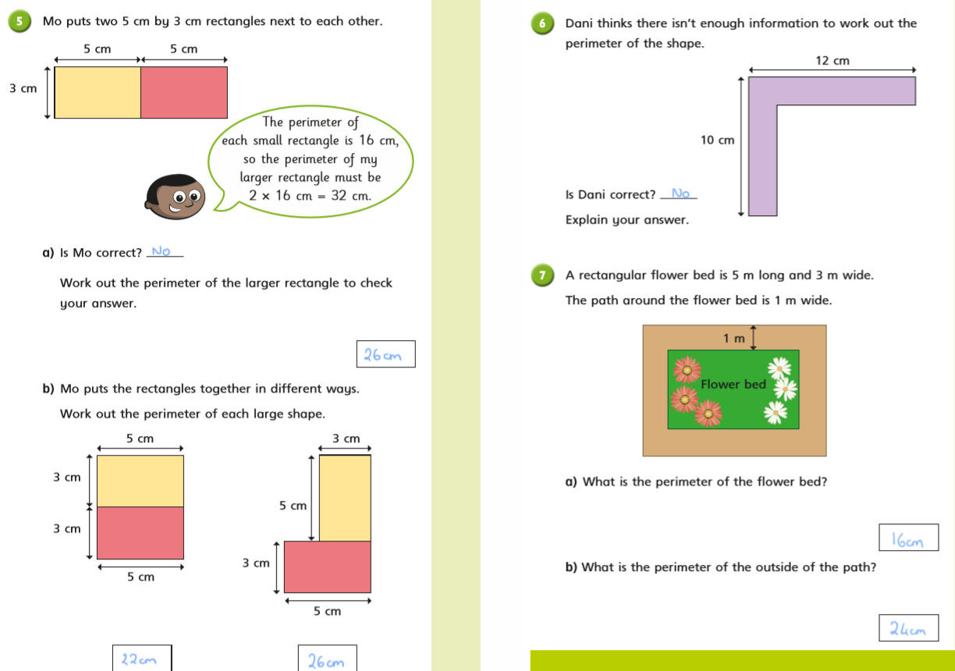
Challenge:
42cm

Slide 12
Answers
Set 2
1. 24cm
2. 20cm
3. 28cm
4. 28cm

