Slide 1
PSHE
Wednesday 3rd March 2021

Slide 2
LO: recognise own mood and behaviours this may cause.
Success Criteria:
Recognise feelings.
Make links between a situation, feeling and behaviours using a feelings tree.

Slide 3
He’s moody.
I’m in a bad mood.
She’s in a funny mood.
I’m in a good mood.

Slide 6
Feelings Tree
Hearts pump faster.
Stamp feet.
Clench fists.
Tense up.
Clench teeth.
Annoyed
Your drink spilled over your clothes.

Slide 8
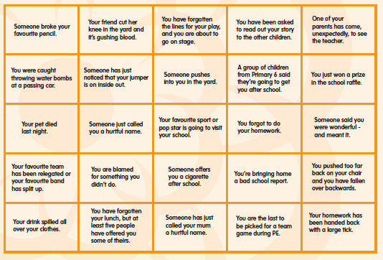

Slide 9
Challenge
Think back to the scenarios on the previous slide:
Are any of the scenarios situations you have been in?
If so – what happened?
Would you choose a different action next time?
Did you talk to anyone about your feelings? If so, who? If not, why not?
Does the idea of the Feelings tree make sense to you?

Slide 10
Next lesson…
Next lesson we are going to look at relaxation techniques we can use to calm ourselves down when we are struggling with our feelings and emotions.
In preparation for this, think about how you choose to relax.
I look forward to hearing about them soon.

Slide 11
Remote Learning Tracking
Please click on the link below to let us know that you have accessed the lesson.
https://forms.office.com/Pages/ResponsePage.aspx?id=eCY4lN73r0G0KV1rDWITzRhTQ2IZqpBOsW8cFVoooF9UNVlMS1dCVkdaM0k0WlhFTE9WVFBTWEg1Ti4u

