Slide 1
Pshe-04.03.21

Slide 2
PSHE
L.O: Know that there is a range of ways to pay for things.
Success Criteria:
- Know about other forms of money, e.g. cheque books, credit cards, debit cards and how payment is made in these cases.
-Begin to understand debt or credit ‘borrowing’.
-Understand that if you ‘borrow’ money you usually have to pay back more (interest).

Slide 3
How many ways can we pay for things?

Slide 4
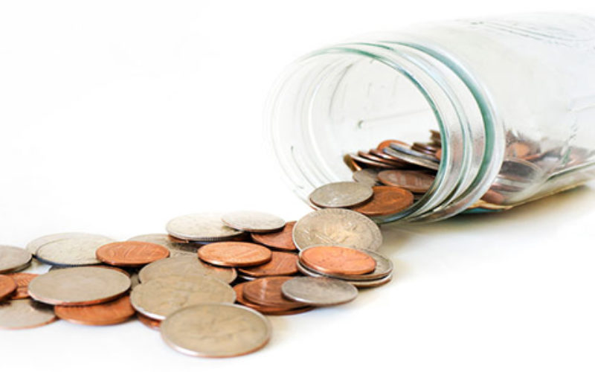
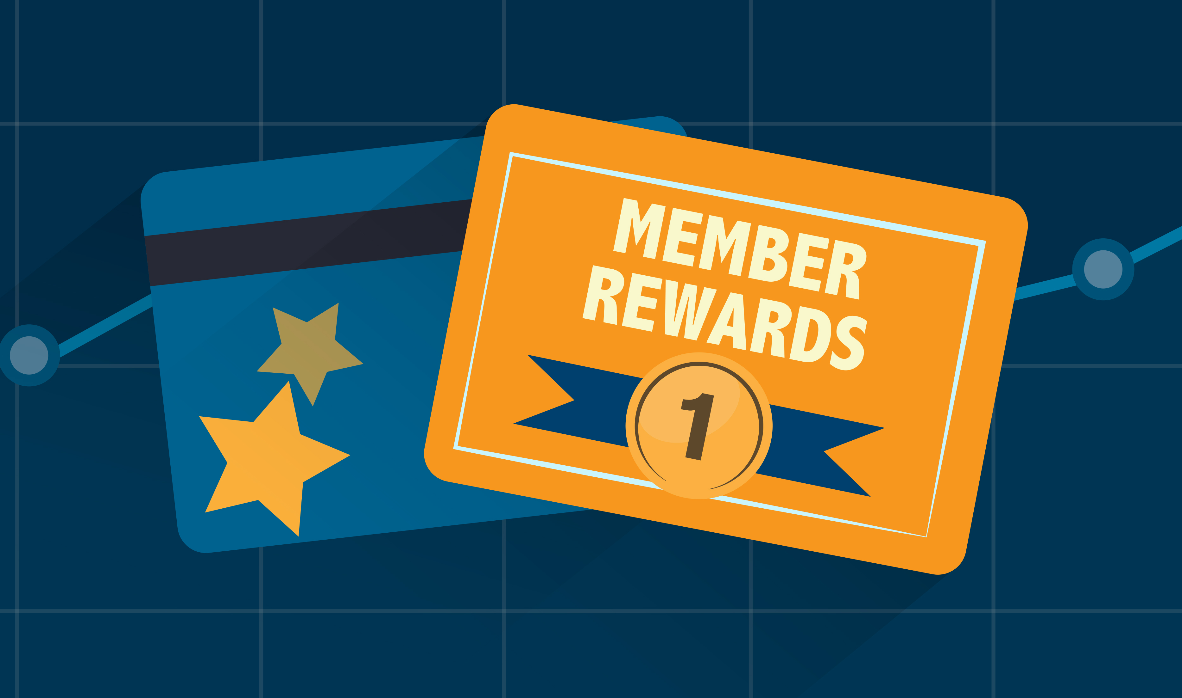
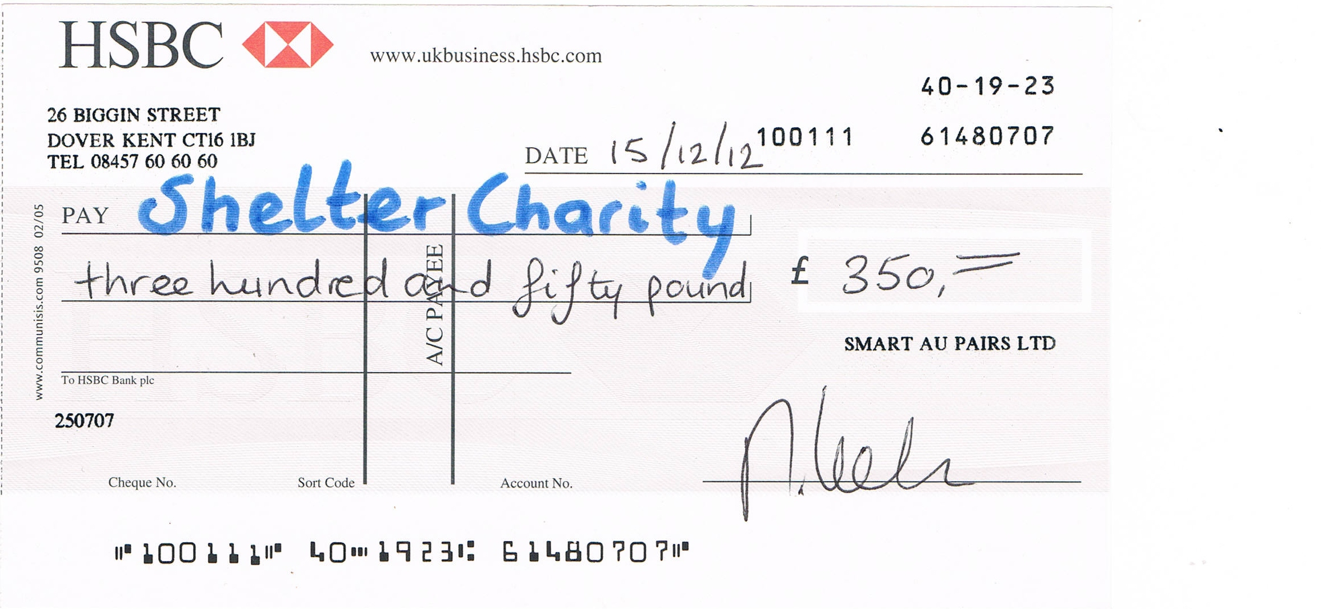
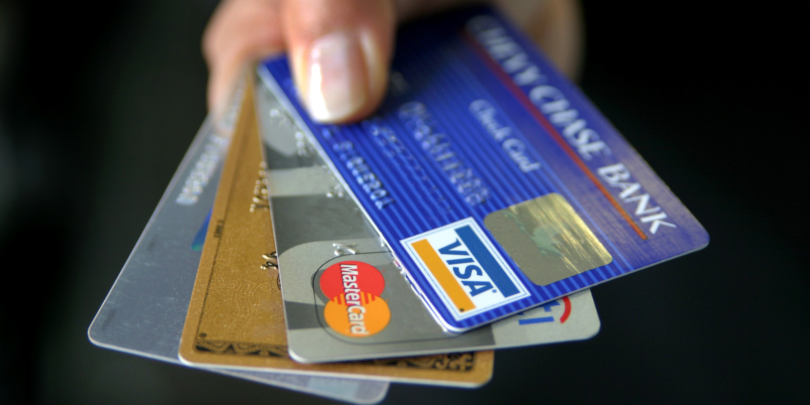
How many ways can we pay for things?
Cash
Credit card
Debit card
Using loyalty points
Cheque
Loan
Vouchers
Tokens/tickets
Standing order
Direct debit

Slide 5
Cash

Slide 6
Cheques

Slide 7
Bank cards

Slide 8
Online banking

Slide 9
Which of these methods involve borrowing?

Slide 10
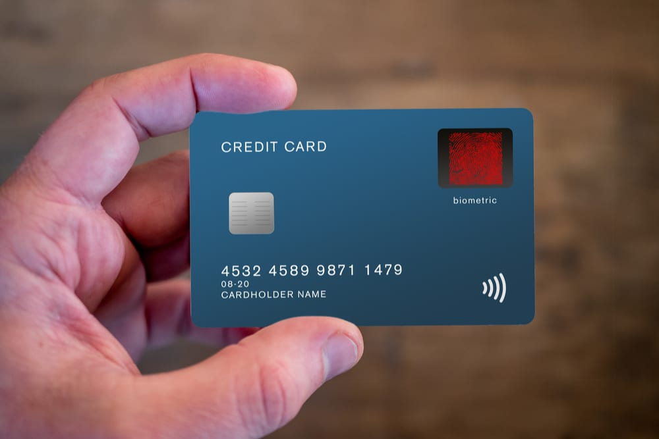
Which of these methods involve borrowing?
Credit cards!
Borrowing means you need to pay the money back. If you don’t pay it back within a certain time then you need to pay something called ‘interest’.

Slide 11
Activity- See if you can match the definitions and pictures to the key word

Slide 13
Your task
Spicy- Same as below and also describe what you think it means to be ‘good with money’.
Medium- Complete matching activity and then write down the best way to pay for:
A pizza
Phone bill
A laptop
A bag of crisps
Mild- Match the pictures to the payment method

Slide 15
Answers

Slide 16
Remote Learning Tracking
Click on the link to let us know that you have completed the lesson:
https://forms.office.com/Pages/ResponsePage.aspx?id=eCY4lN73r0G0KV1rDWITzRhTQ2IZqpBOsW8cFVoooF9UNVlMS1dCVkdaM0k0WlhFTE9WVFBTWEg1Ti4u

