Slide 1
R.E – 4.03.2021
L.O: Learn about the traditions based around Easter.

Slide 2
Recap: what was the religious festival that we learnt about last lesson?
Maundy Thursday
This was when Jesus had his last supper with his disciples on the day before he died on the cross.

Slide 3
Today, we are going to learning about Palm Sunday
Watch the video to listen and watch
the story.
God's Story: Palm Sunday - YouTube

Slide 4
Key Points
1. Jesus was going to Jerusalem with his disciples.
2. Jesus sent some of his disciples to get a donkey from a village nearby.
3. They put their coats on the donkey’s back and Jesus climbed on.
4. As Jesus set off, people in the village laid their coats and palm branches on the floor.
5. People recognised that Jesus was a king.
6. The crowd praised Jesus for coming to their village and believed he was the rescuer.

Slide 5
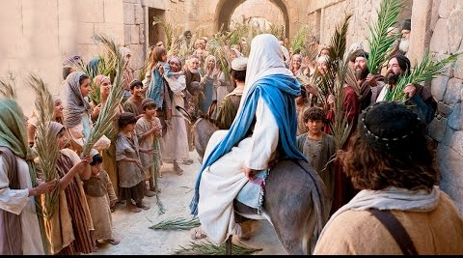
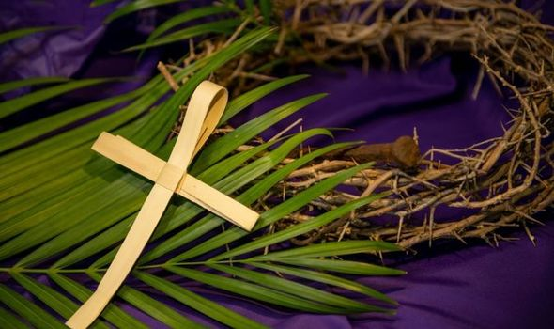
What happens in Church
On Palm Sunday, Christians go to Church.
They wave palm leaves as they walk around the Church.
Churches often gift people with a cross made of a single palm leaf.
Palm Sunday begins the lead up to Easter.

Slide 6
I don’t know anything about Palm Sunday. Please could you create me a leaflet that tells me all about it so I can tell all my alien friends!
Thank you!

Slide 7
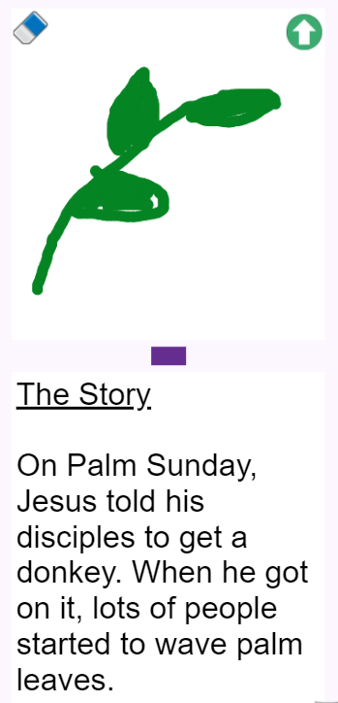
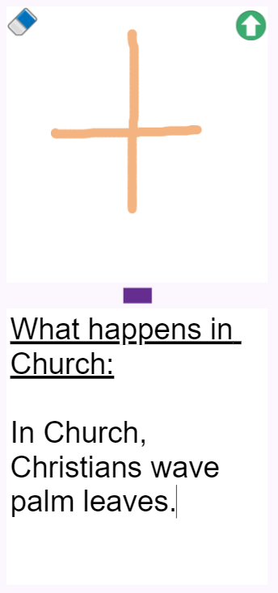
Complete the leaflet on Purple Mash
Here is an example of what sub headings you may use. I have given you a sentence to start you off.
Use sub headings to explain what is on the page
Retell the story of Palm Sunday
Can you complete the checklist so that the alien has all of the information he needs?
Say what happens in Church
Draw some images

Slide 8
Remote Learning Tracking
https://forms.office.com/Pages/ResponsePage.aspx?id=eCY4lN73r0G0KV1rDWITzRhTQ2IZqpBOsW8cFVoooF9UNVlMS1dCVkdaM0k0WlhFTE9WVFBTWEg1Ti4u

