Slide 1
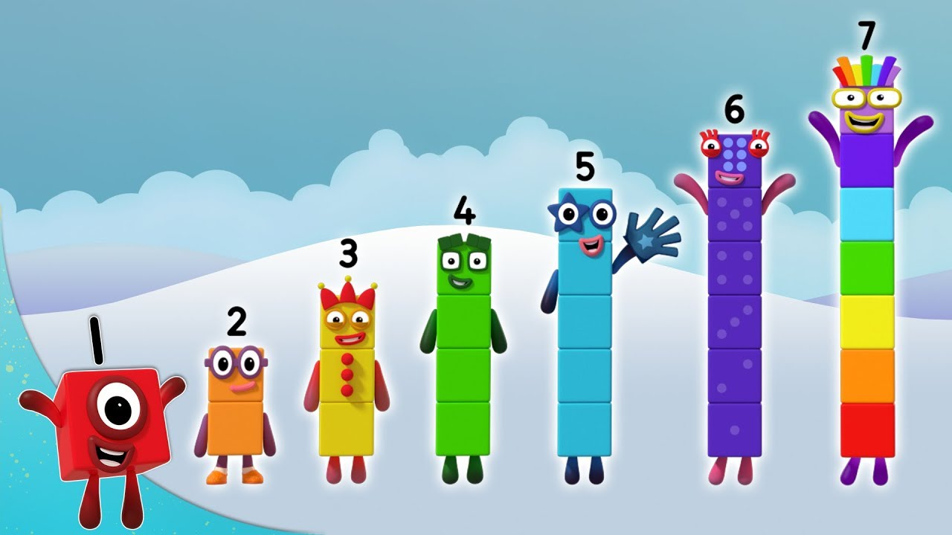
Friday 15th January
Maths

Slide 2
Today’s Number Song
Counting forwards and backwards to 10.
https://www.youtube.com/watch?v=IqelMGmpBoE

Slide 3
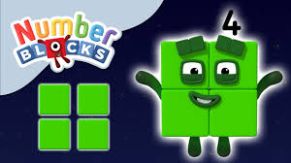
Today’s Learning
This week we have worked on the composition of numbers 4 and 5. Today we will consolidate our learning and make sure your child knows the different compositions of 4 and 5. For example, 5 can be composed / made up of 1 and 1 and 3, 2 and 3 or 1 and 4.
Watch Numberblocks 4. Click on the link below.
https://www.bbc.co.uk/iplayer/episode/b08d61cv/numberblocks-series-1-four
Ask your child if you hold up 1 finger how many more fingers do you need make 4? Repeat with 2, 3 and 4 fingers.

Slide 4
Today’s Maths Challenge
You will need: a bag or tea towel and 5 small items, e.g coins, small cars, pieces of pasta.
Your child will need a piece of paper and a pen or pencil.
How Many are Hidden?
Show the children 4 or 5 small objects.
Ask them to close their eyes while you cover some with a tea towel to resemble a pool. Can they work out how many of the objects you have put into the ‘pool’?
Practise in different contexts for example cars and a ‘garage’, coins in a purse, pasta in a bowl. Encourage children to draw a picture or use their fingers to help them explain how they know what is missing. How many are hidden? How do you know?
Can you draw a picture to show me?

Slide 5
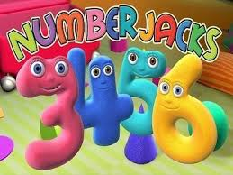
Friday Fun Day!
Why not watch Numberblocks number 5. Click on the link below.
https://www.bbc.co.uk/iplayer/episode/b08d630h/numberblocks-series-1-five
Or
NumberJacks Famous 5’s
https://www.youtube.com/watch?v=1oX4xitfmzQ

Slide 6
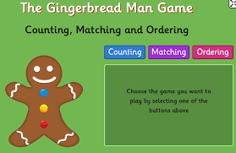
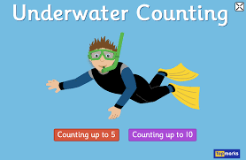
Have fun with maths!
If your child wants to do more number work, click on the link below and they can count with the Gingerbread man or an underwater diver. Select numbers 0-10 first and then, if they find this too easy, move to 0-20.
https://www.topmarks.co.uk/learning-to-count/gingerbread-man-game
https://www.topmarks.co.uk/learning-to-count/underwater-counting

