Slide 1
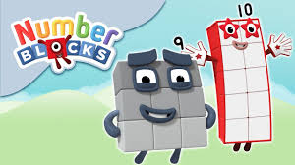
Thursday 4th March
Maths
This week’s focus: Addition and Subtraction within 10

Slide 2
Maths Word of the Week
add
Definition:
To bring two or more numbers (or things) together to make a new total.
Here 1 ball is added to 1 ball to make 2 balls.
1 + 1 = 2
Today’s Challenge: Using the word add can you describe what you see in the picture below.
+ = 3
+
=

Slide 3
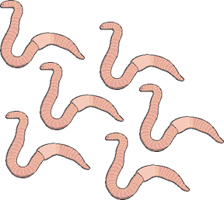
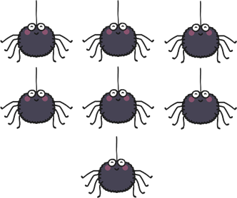
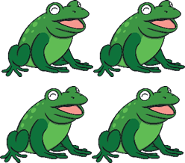
Maths Counting Warm-up
Today pretend to be a witch or wizard and cast a ‘one less than’ spell. How many things will there now be in each group?
You can use a number line to help you.

Slide 4
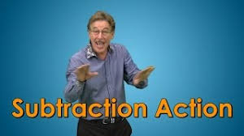
Today’s Maths Starter
Today’s focus skill is continuing to look at ‘understanding the concept of subtraction as take away’, so this clip gives a visual introduction on how to do this.
https://www.youtube.com/watch?v=pwQKugrFmJQ

Slide 5
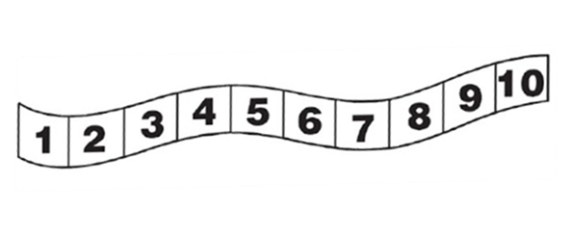
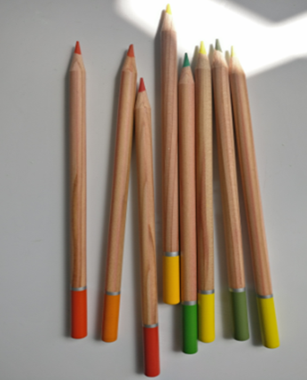
Today’s skill…..
Today you are going to be learning to understand the concept of subtraction as take away. To help with today’s learning the following resources will be helpful:
Counting objects. (use anything like lego or beads)
Number track (either draw one or print the one on the following slide.)
Everyday counting objects.
.

Slide 6
Number Track Resource
.

Slide 7
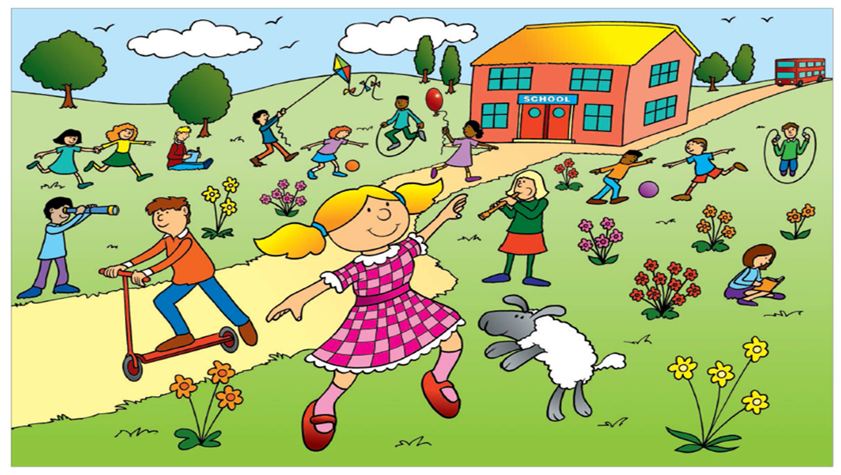
Today’s skill…..
Today you are going to be learning to understand the concept of subtraction as take away.
Look carefully at the picture I am going to count something I want you to try and guess what it is. I will give you a clue! There are fewer than 6 of them. Have a guess what I could be counting. If you said the pink flowers on the screen then you would be correct. I am going to represent the flowers with my cubes on the following slide.
.

Slide 8
Today’s skill…..
First I get my 5 cubes to represent the 5 pink flowers.
Now I am thinking about something else in the picture and there is only 1 of them. Can you guess what I can see? If you said the red scooter then you are correct, I can see 1 red scooter. I can represent that with my cubes too.
Then I could see 1 scooter
The last thing I can see is there are fewer than 7 of them. Have a guess what I could be counting. If you said the trees you were correct! I am going to represent the trees with 6 cubes.
.

Slide 9
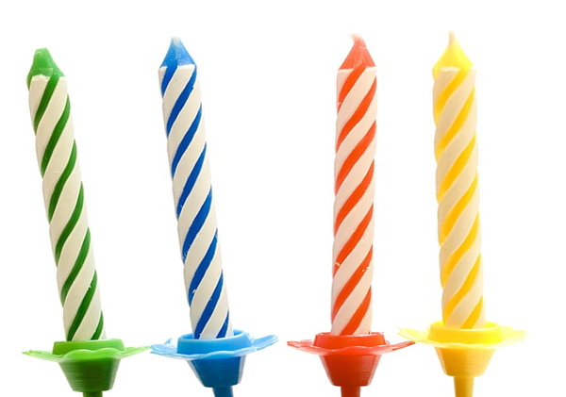
Today’s skill…..
We are now going to be practising take away using our number track to help us and some cubes to represent the numbers. So lets think about the number story: First I have 4 candles to blow out on my cake, then I manage to blow out 1 of them, now how many candles do I have to still blow out? (4 – 1 = 3)
.

Slide 10
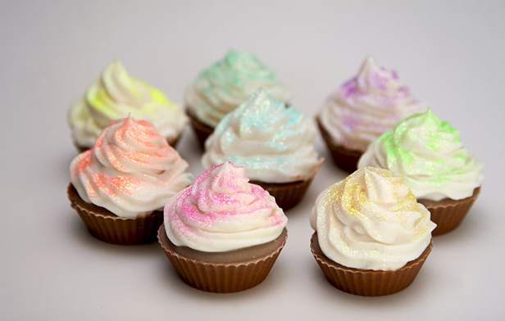
Today’s skill…..
This time you can have a go at solving the number story and practise taking away using the number track and some cubes to help. First I bake 8 cupcakes and then I give 5 away to my friends, now how many cupcakes will I have left? Try and the solve the problem with your cubes and number track. The answer will be on the following slide.
.

Slide 11
Today’s skill…..
Your answer should look like this:
First I baked 8 cupcakes and then I gave 5 away to my friends, so now I have 3 left.
8 – 5 = 3
.

Slide 12
Today’s skill…..
We will have one more practise at solving a number story and practise taking away using the number track and some cubes to help. First I get given 7 presents for my birthday and then I open 4 of them, now how many do I have left that I still need to open? Try and the solve the problem with your cubes and number track. The answer will be on the following slide.
.

Slide 13
Today’s skill…..
Your answer should look like this:
First I was given 7 presents and then I opened 4 of them, so now I have 3 left still to open.
7 – 4 = 3
.

Slide 14
Choose your maths Challenge!
Depending on how you managed with learning the skill and the practice question decide which challenge you would like to do today as your independent task.
The Red Bear Challenge
You found the practice question quite tricky and you need a little more practise.
The Yellow Bear Challenge
You managed to do the practice question just with a little bit of help.
The Green Bear Challenge
You feel really confident with today’s work and want to be challenged!

Slide 15
The Red Bear Challenge
For this task you are going to use some everyday objects to make up your own take away number stories grouping your objects like the pictures below. Remember how to make your story up by using the plan of ‘first…then… and now’. Make up a set of everyday objects like the pictures below and then visually show this with your counters on your number track. Next choose whether you either give 1 or 2 pencils to your friend and complete your take away number story! If you are unsure, see an example answer on the next slide. Repeat the activity using different sets.

Slide 16
The Red Bear Challenge
An example answer:
“First I have 6 pencils and then I give 2 pencils to my friend and now I have 4 pencils left.”
6 – 2 = 4

Slide 17
The Yellow Bear Challenge
For this task you are going to use some everyday objects to make up your own take away number stories grouping your objects like the pictures below. Remember how to make your story up by using the plan of ‘first…then… and now’. Choose an amount of your everyday object and then visually show this with your counters on your number grid. Next choose the number either 1 or 2 and this will represent how many objects you give away and complete your take away number story! If you are unsure, see an example answer on the next slide. Repeat the activity using different sets and try to write your calculation to each story.

Slide 18
The Yellow Bear Challenge
An example answer:
“First I have 10 pencils and then I give 2 pencils to my friend and now I have 8 pencils left.”
10 – 2 = 8

Slide 19
The green bear challenge
For this task you are going to use some everyday objects to make up your own take away number stories grouping your objects like the pictures below. Remember how to make your story up by using the plan of ‘first…then… and now’. Choose an amount of your everyday object and then visually show this with your counters on your number grid. Next choose a number between 1 and 10 and this will represent how many objects you give away and complete your take away number story! If you are unsure see an example answer on the next slide. Repeat the activity using different sets and try to write your calculation to each story.

Slide 20
The green bear challenge
An example answer:
“First I have 9 pencils and then I give 6 pencils to my friend and now I have 3 pencils left.”
9 – 6 = 3

Slide 21
Remote Learning Tracking
Once you have completed the PowerPoint please fill in the simple questionnaire below to let us know.
https://forms.office.com/Pages/ResponsePage.aspx?id=eCY4lN73r0G0KV1rDWITzRhTQ2IZqpBOsW8cFVoooF9UNVlMS1dCVkdaM0k0WlhFTE9WVFBTWEg1Ti4u
Thank you.

