Slide 1
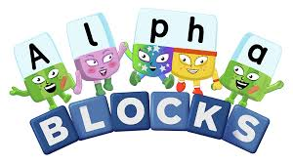
Thursday 14th January
Phonics

Slide 2
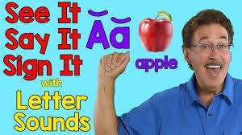
Phonic Sounds
The link below is for the ‘Alphabet Song.’ It is important children know the name and the sound each letter makes.
https://www.youtube.com/watch?v=WP1blVh1ZQM

Slide 3
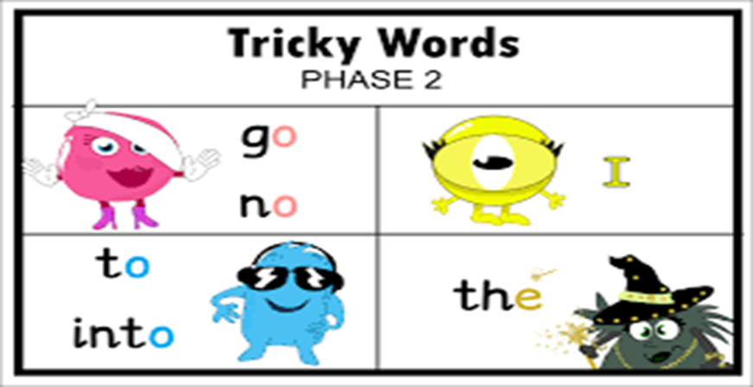
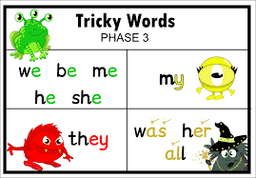
Tricky words
Tricky words are words you can not sound out. They are words your child needs to learn to recognise by sight. On the next few slides there are some tricky words. See whether your child can read them. If they struggle, make little flashcards so they can practise them.

Slide 4
go

Slide 5
no

Slide 6
I

Slide 7
to

Slide 8
into

Slide 9
the

Slide 10
we

Slide 11
be

Slide 12
me

Slide 13
New tricky word!
he

Slide 14
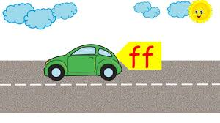
Recap phase 2 sounds.
Click on the link below to practise all the sounds you know !
https://www.youtube.com/watch?v=0mbqFcOGMw4

Slide 15
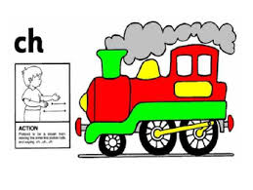
Recap new sound.
ch
https://www.youtube.com/watch?v=gLHpZyIu7ps

Slide 16
Recap new sound
sh
https://www.youtube.com/watch?v=3uyqR3u4jtg

Slide 17
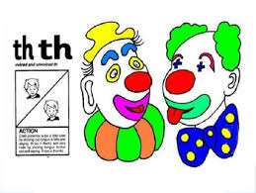
Recap yesterday’s new sound
th
https://www.youtube.com/watch?v=TQYDbZ8gqow

Slide 18
Today’s new sound
ng
https://www.youtube.com/watch?v=xqPMJR2cLwI

Slide 19
Making Words
On the next slide there are some pictures. All the words have the sound ‘ng’ at the end of them. This is the focus sound for today. For each picture say the word and then sound it out. I will model each word for you on the next slide.

Slide 20
Say the word and sound the word

Slide 21
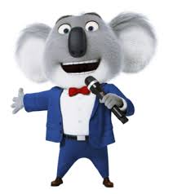
Say the word and sound the word

Slide 22
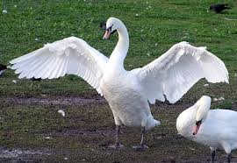
Say the word and sound the word

Slide 23
Lets make the words!
To do this you will need pieces of paper with the different sounds on
ng
i
s
w
r

Slide 24
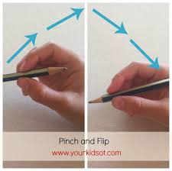
Writing the sound ‘ng’
Tips on the correct pencil grip: We encourage children to ‘pinch and flick’ the pencil to make sure they are holding it correctly.

Slide 25
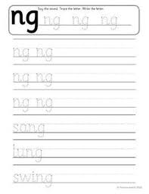
Writing the sound ‘ng’
First practise writing the digraph ‘ng’. Encourage your child to try and write it on lined paper. The picture shows an example instructing you on how to correctly form the letter.

Slide 26
Writing the words ending with ‘ng’
Your child has done lots of new learning this morning!
They have learnt a new digraph and the action to go with it and they have learnt the new tricky word ‘me’.
However if you have a really enthusiastic child they may want to write the words to match the pictures. Remember to encourage correct pencil grip and lower case letters.
Your child could also play Dragon’s Den which will develop your child’s segmenting and blending skills using the digraph ‘ng’
https://www.phonicsplay.co.uk/resources/phase/2/dragons-den

