Slide 2
www.planet-science.com/categories/under-11s/our-world/2011/10/what-makes-fossils.aspx
Use this link to find out how fossils are made.

Slide 3
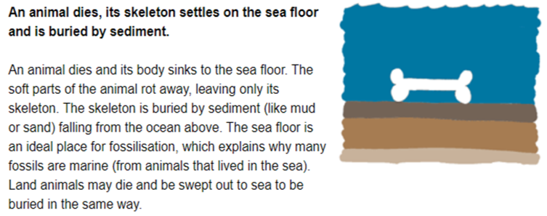

Slide 4
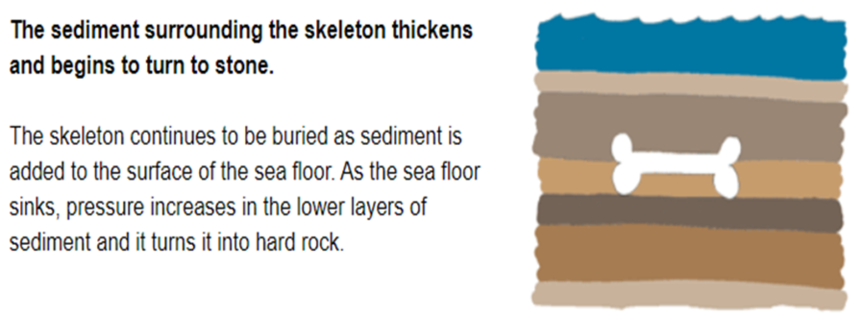

Slide 7
How are fossils formed?

Slide 8
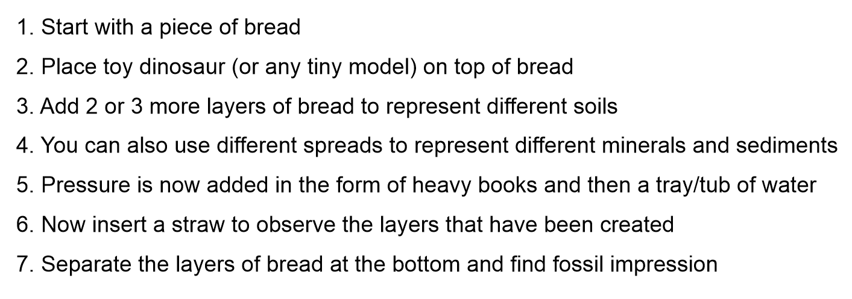
Want to make your own?

Slide 9
Why are fossils so important?

